Slide 1
Merchant of Venice
Josh, Michael, Ben, Hailey, Evan, Andrew, Santino

Slide 2
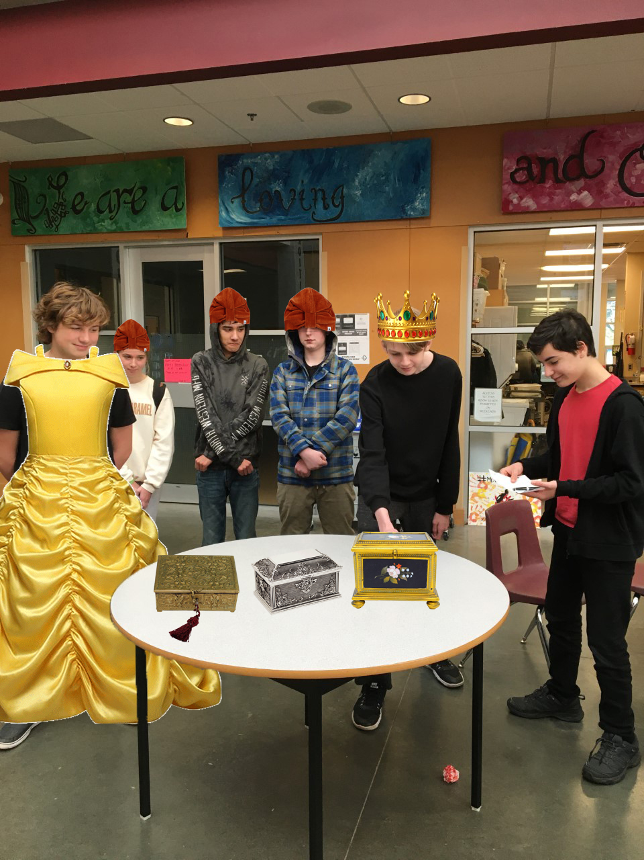

Slide 3
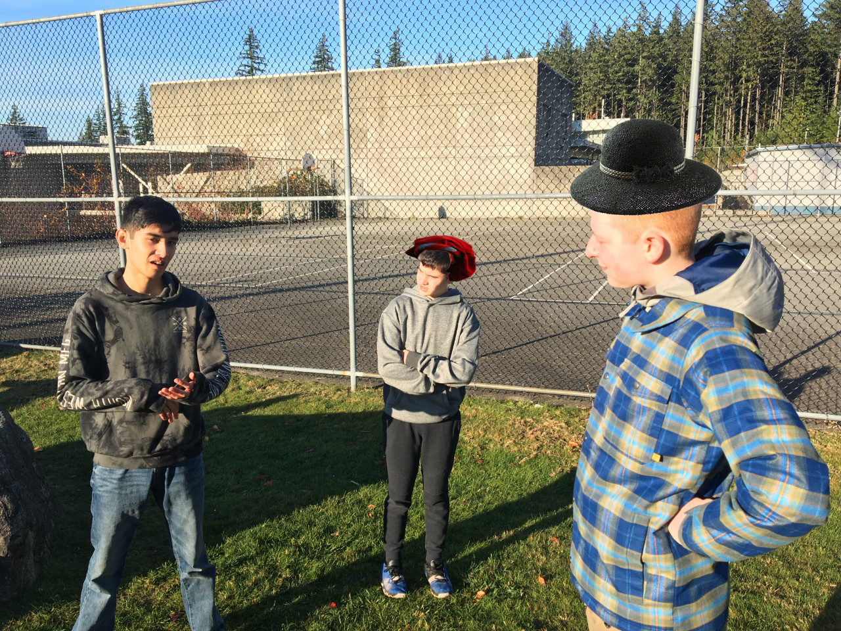

Slide 4
