Slide 1
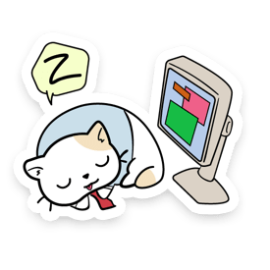
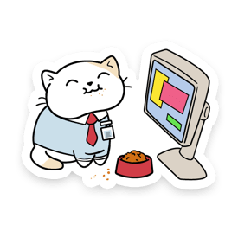
Digital Literacy Scavenger Hunt
Bridget
By

Slide 2
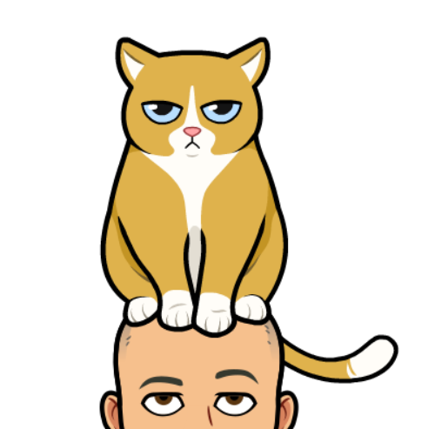
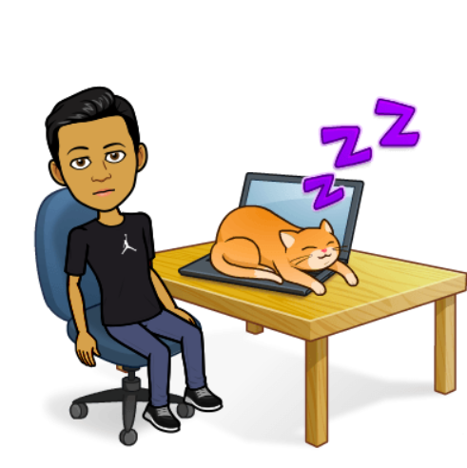
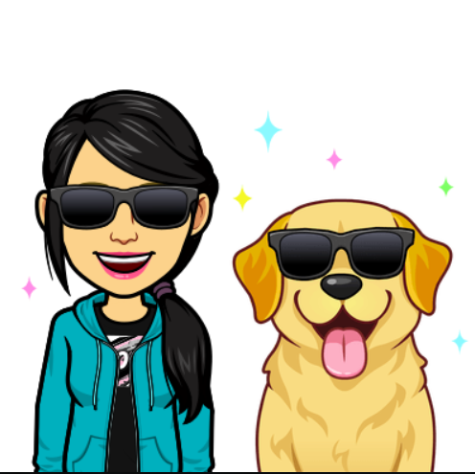
Section A: Guess Who?
To create these emojis, I used an app called Bitmoji
Mr. Blake
Ms. Kim
Mr. Raghoobarsingh

Slide 3
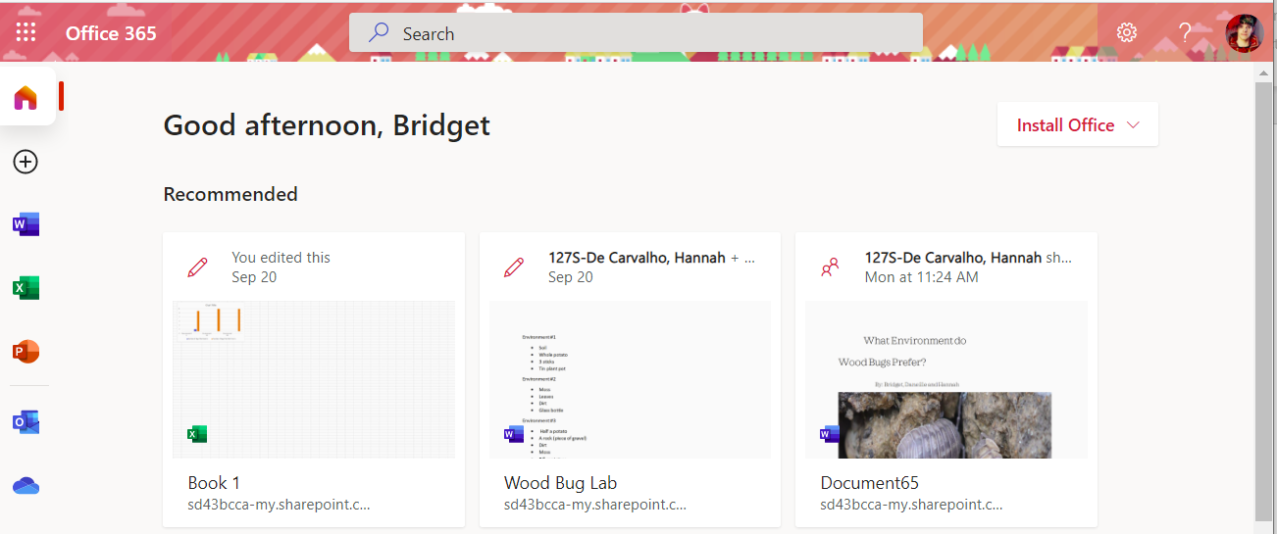
Section B: Solve the Riddle
The answer is Office 365

Slide 4
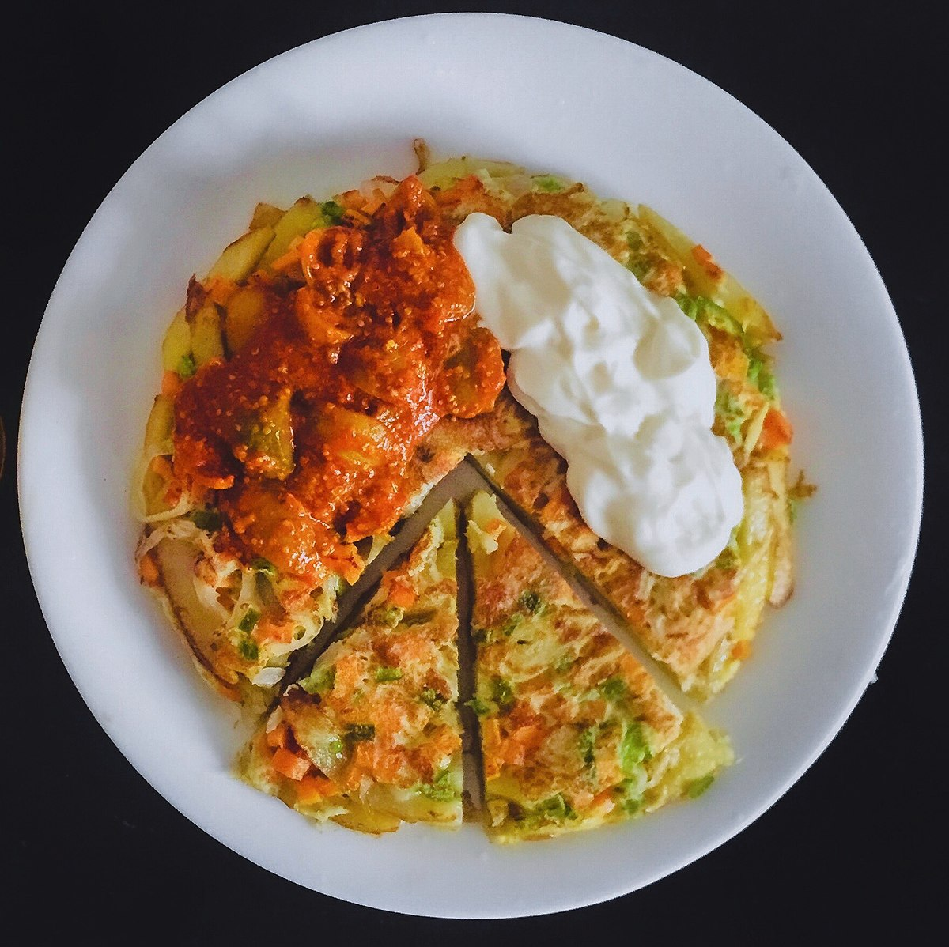
Section C: Food Recipe Theatre
Chipsi Mayai or Zege is a Tanzanian street food
It is a French fry omelette

Slide 5
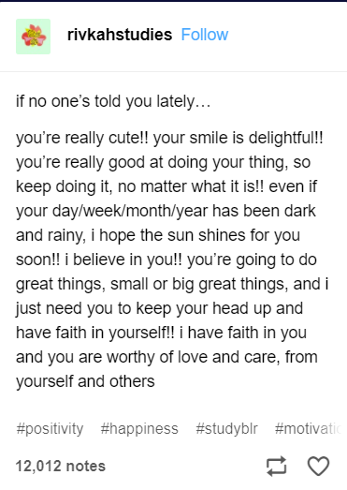
Section D: Hit the Post!
This post is from Rivkahtudies on tumblr
I chose this post, because it made me feel good about myself, and that I am a capable person. It also reminded me that I am loved by my family and friends.

Slide 6
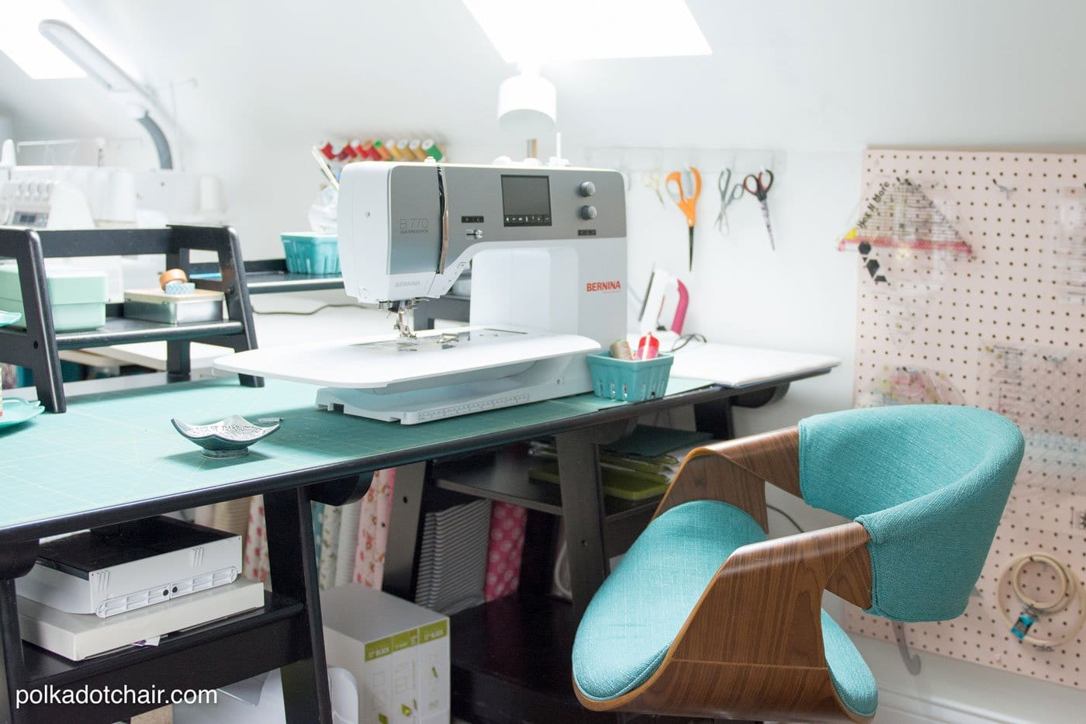
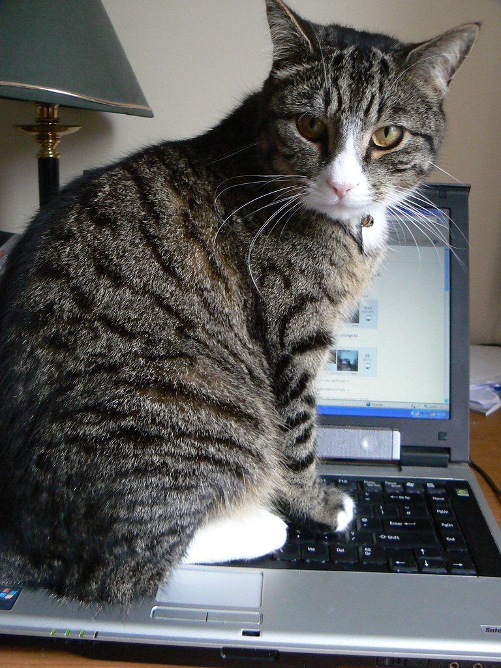
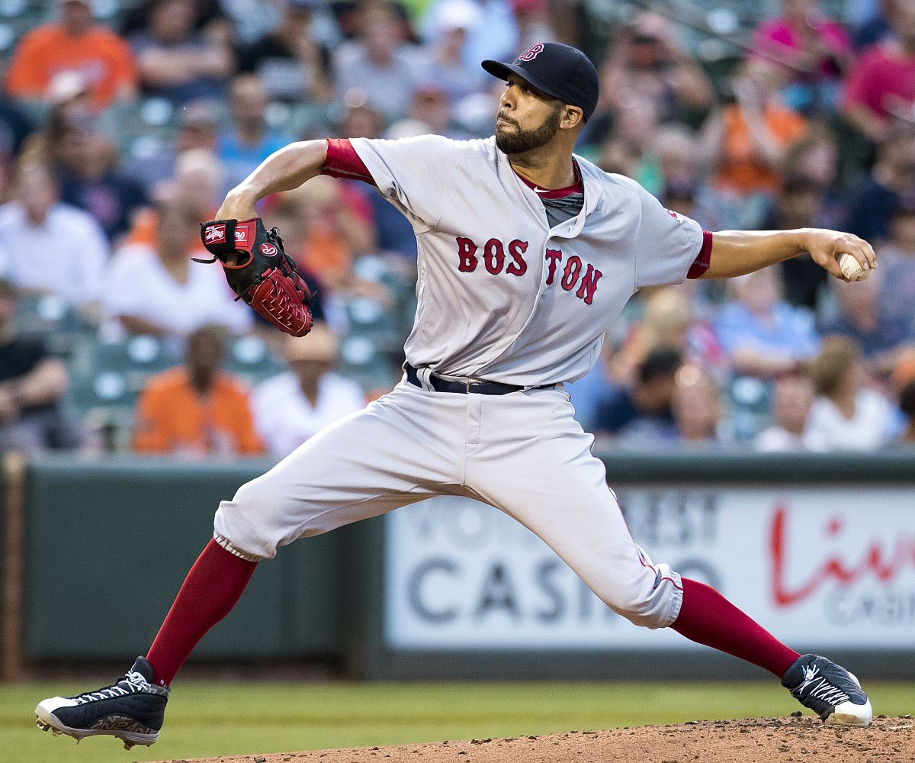
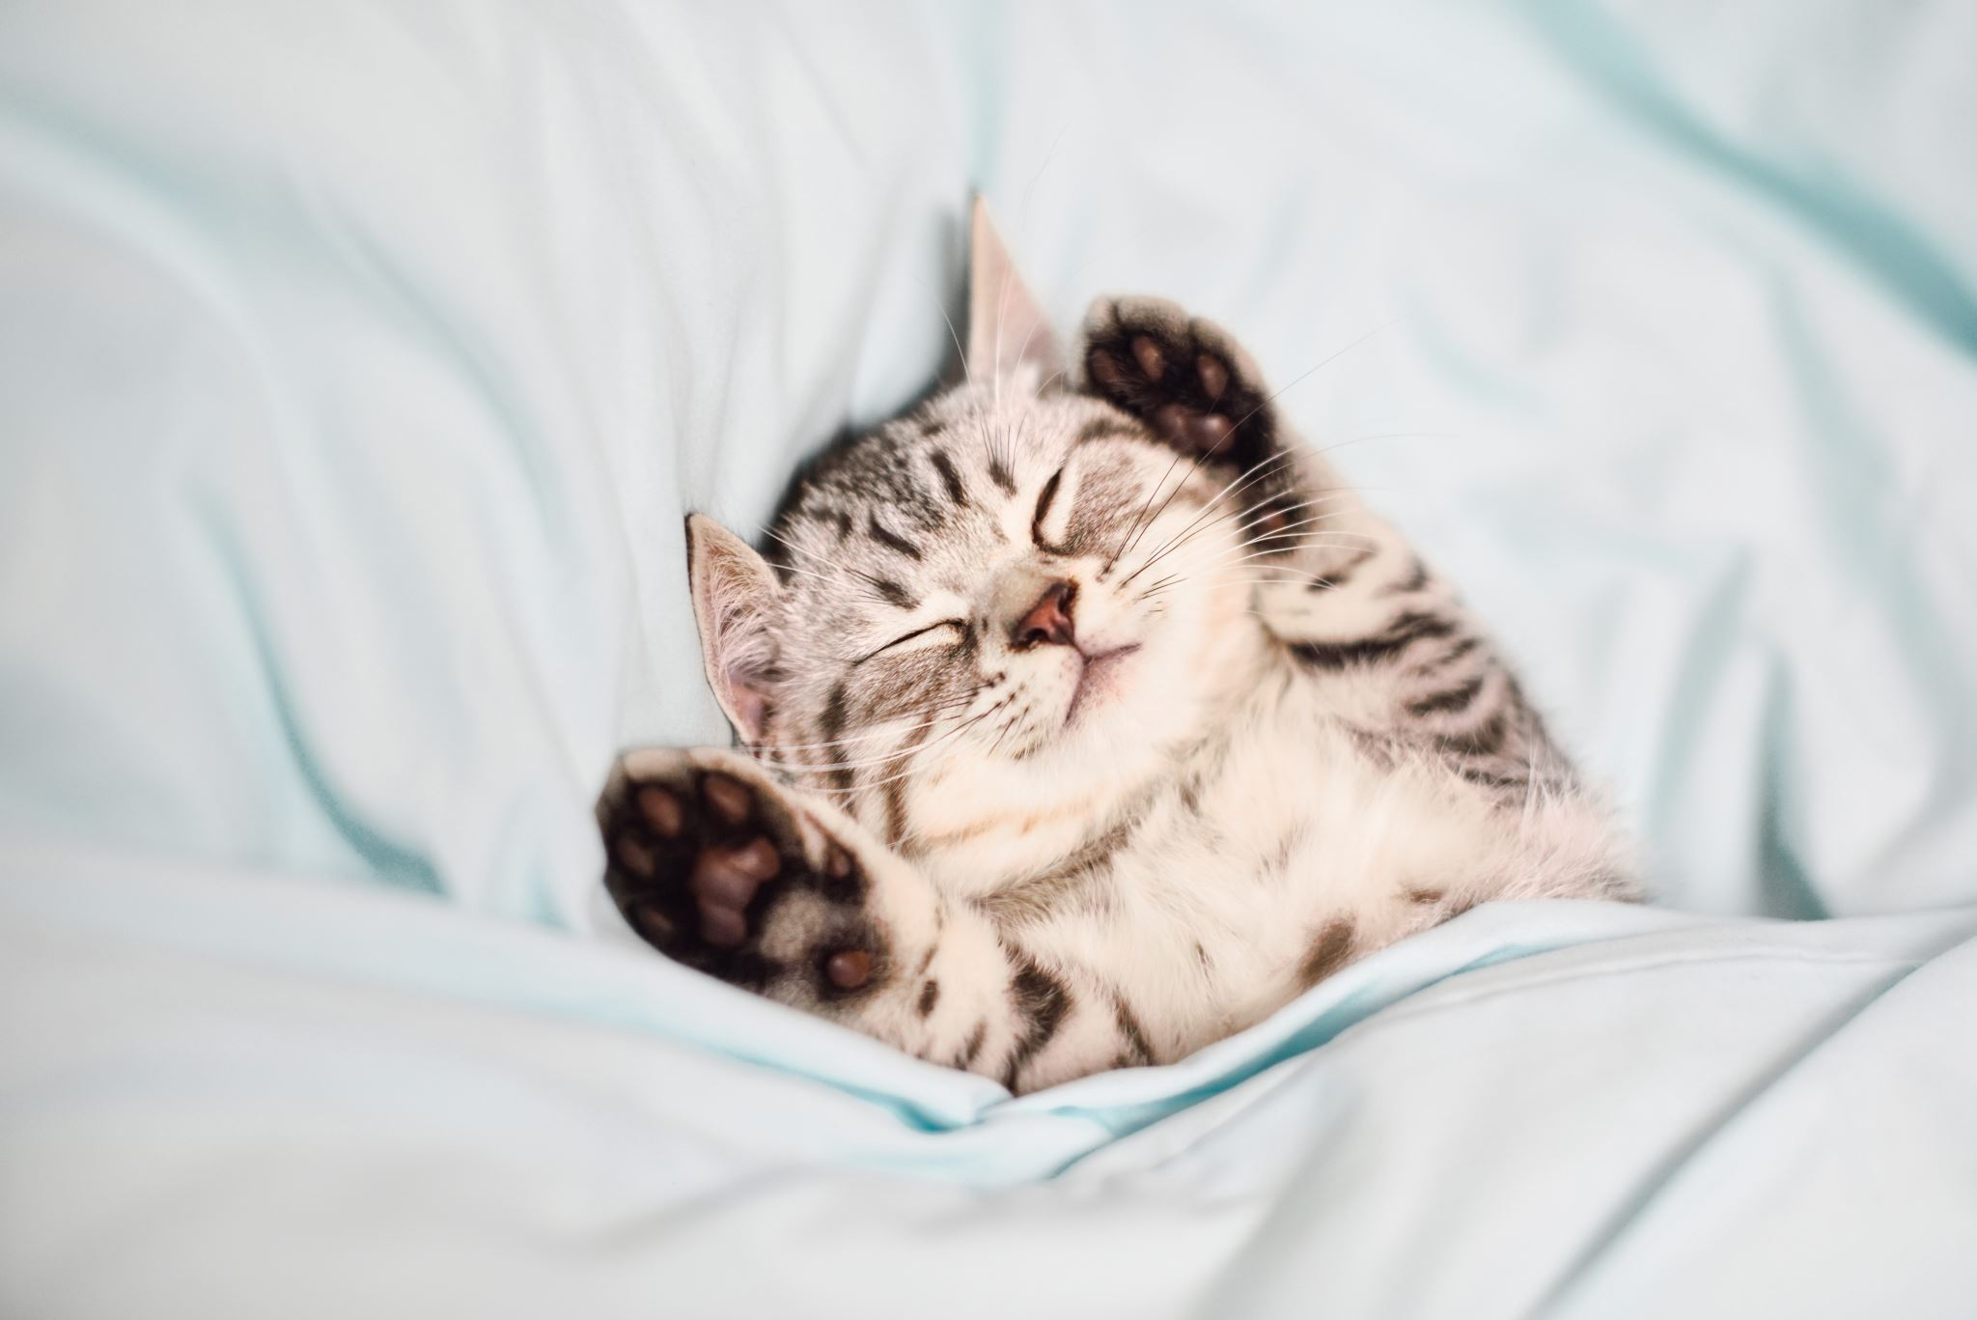
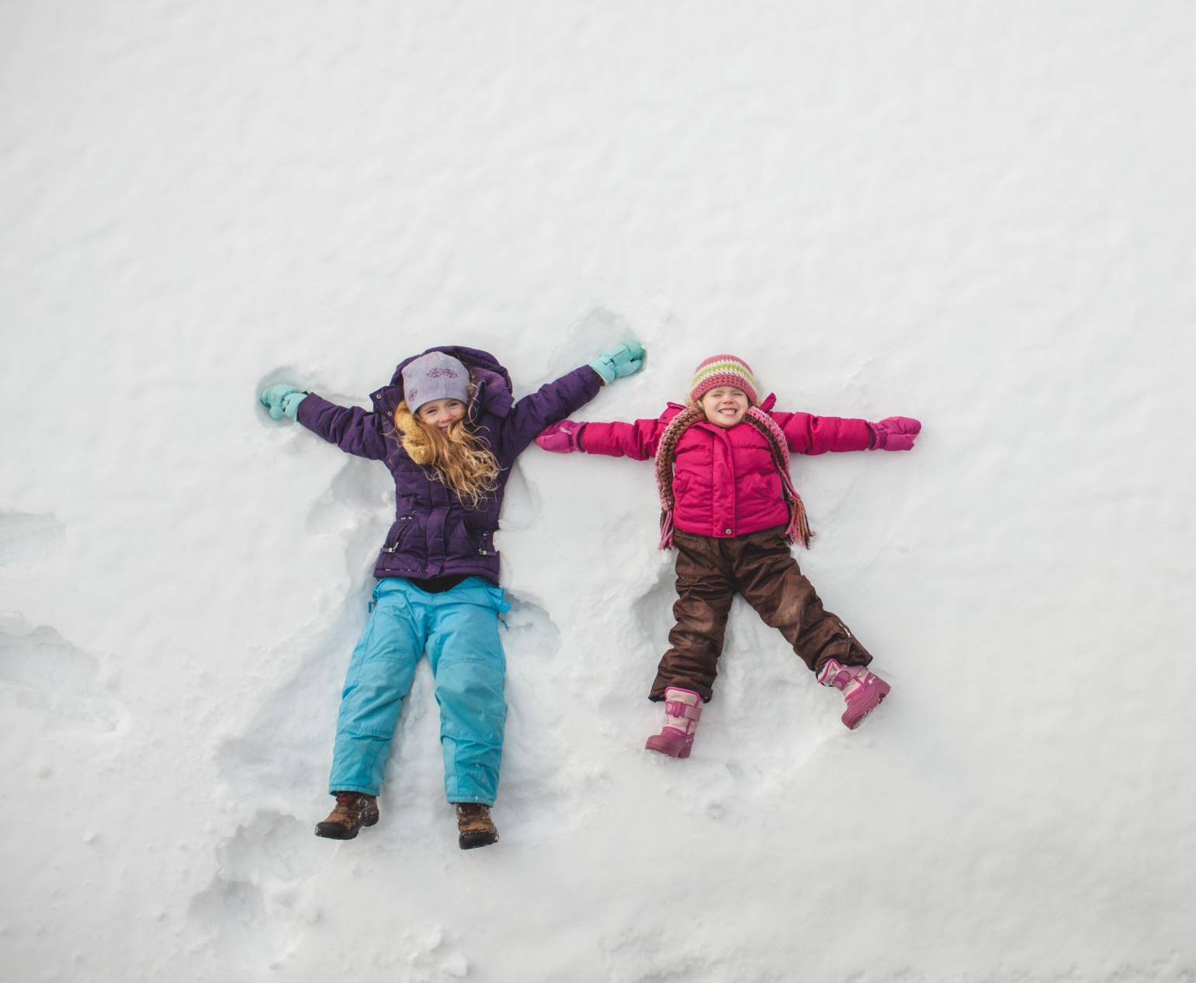
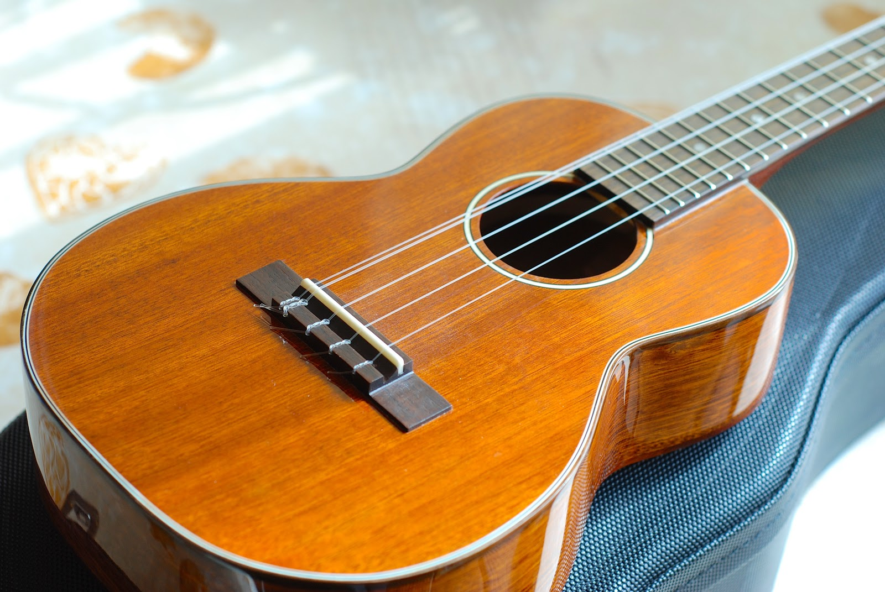
Section E: Hash -Tag -Your It
#RoomAesthetic
I don’t have social media, so with the help of one of the very nice student leaders, we found what hashtags that were trending on tiktok this week
I am not able to provide a link to these as I don’t have tiktok
#LaptopCat
#NBAChampion
#RememberWhy
#ScaryStories
#BaseballSzn
#TookaNap
#ToMyBestFriend
#BeConvincing
#OriginalMusic

