Slide 1
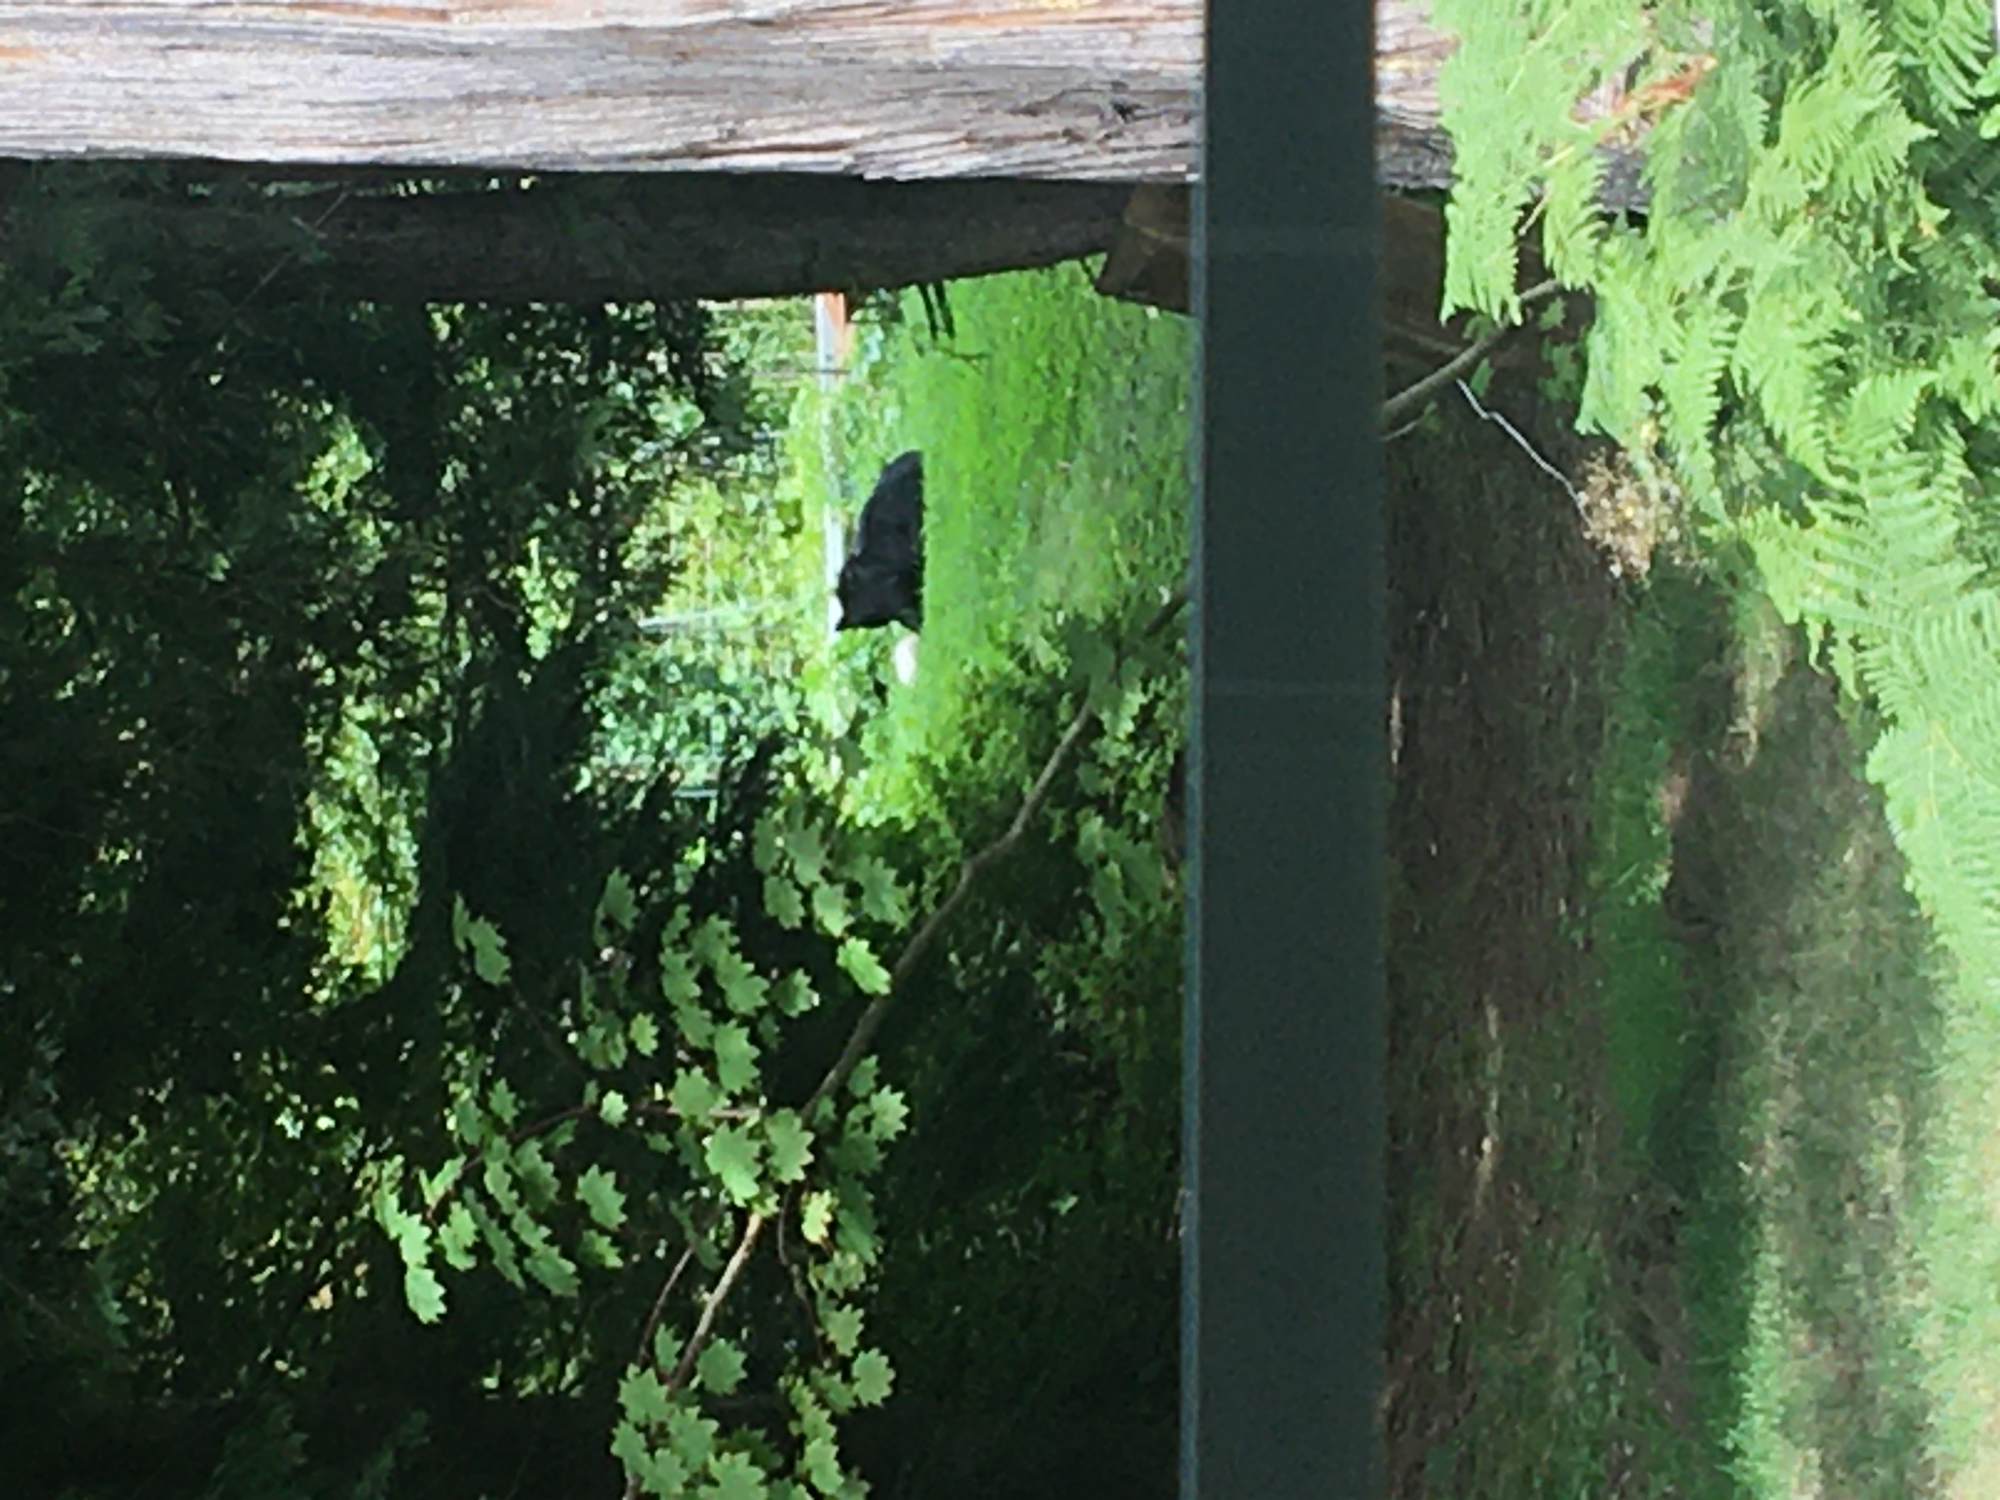
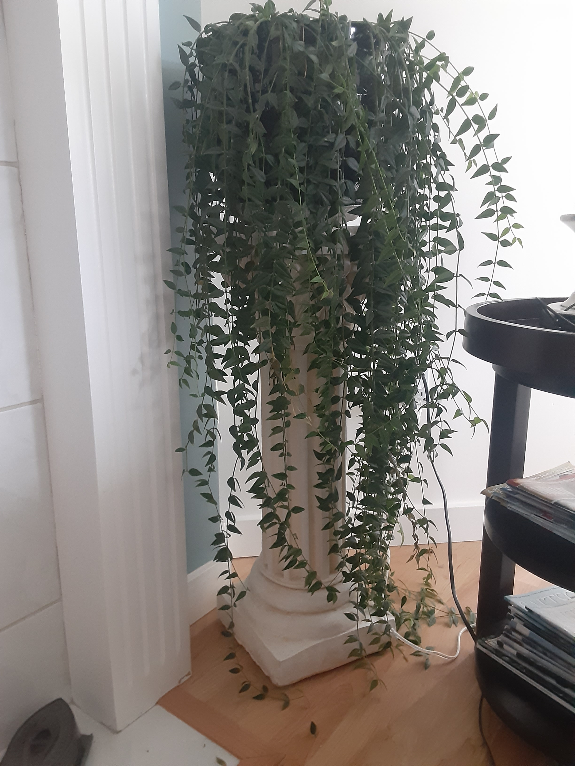
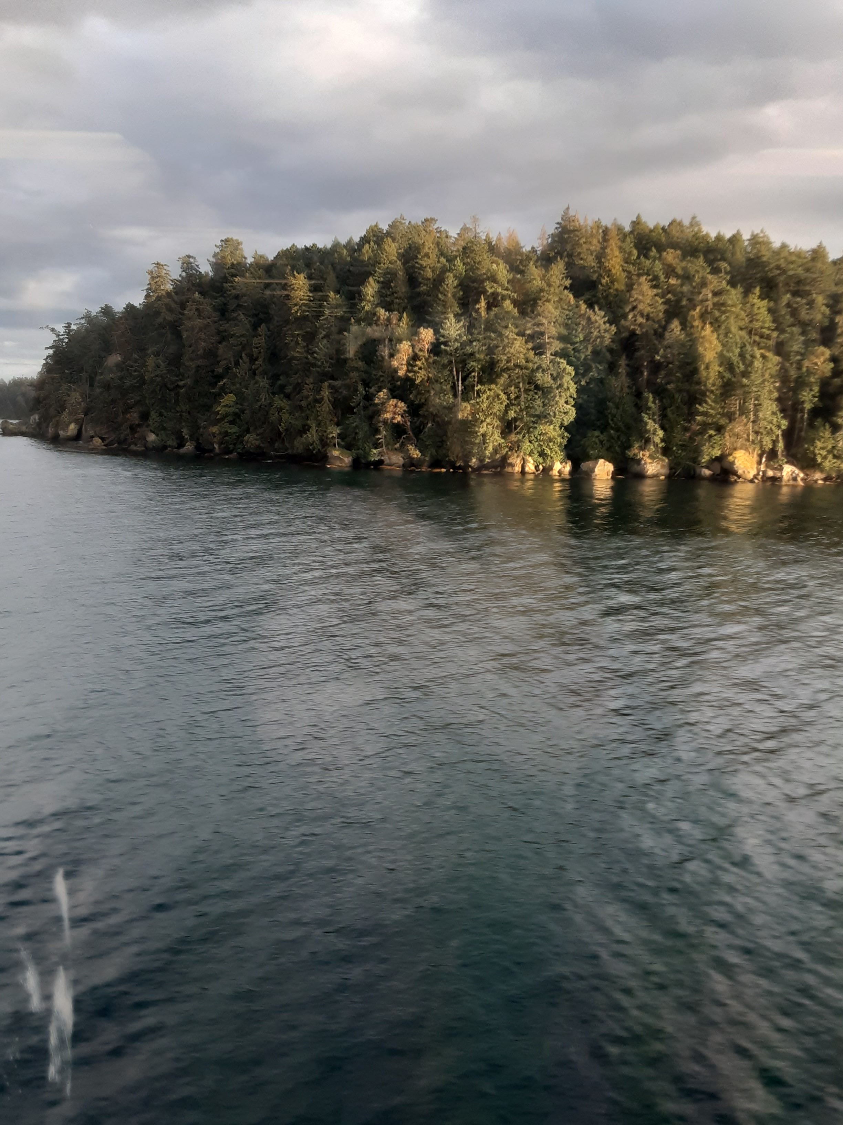
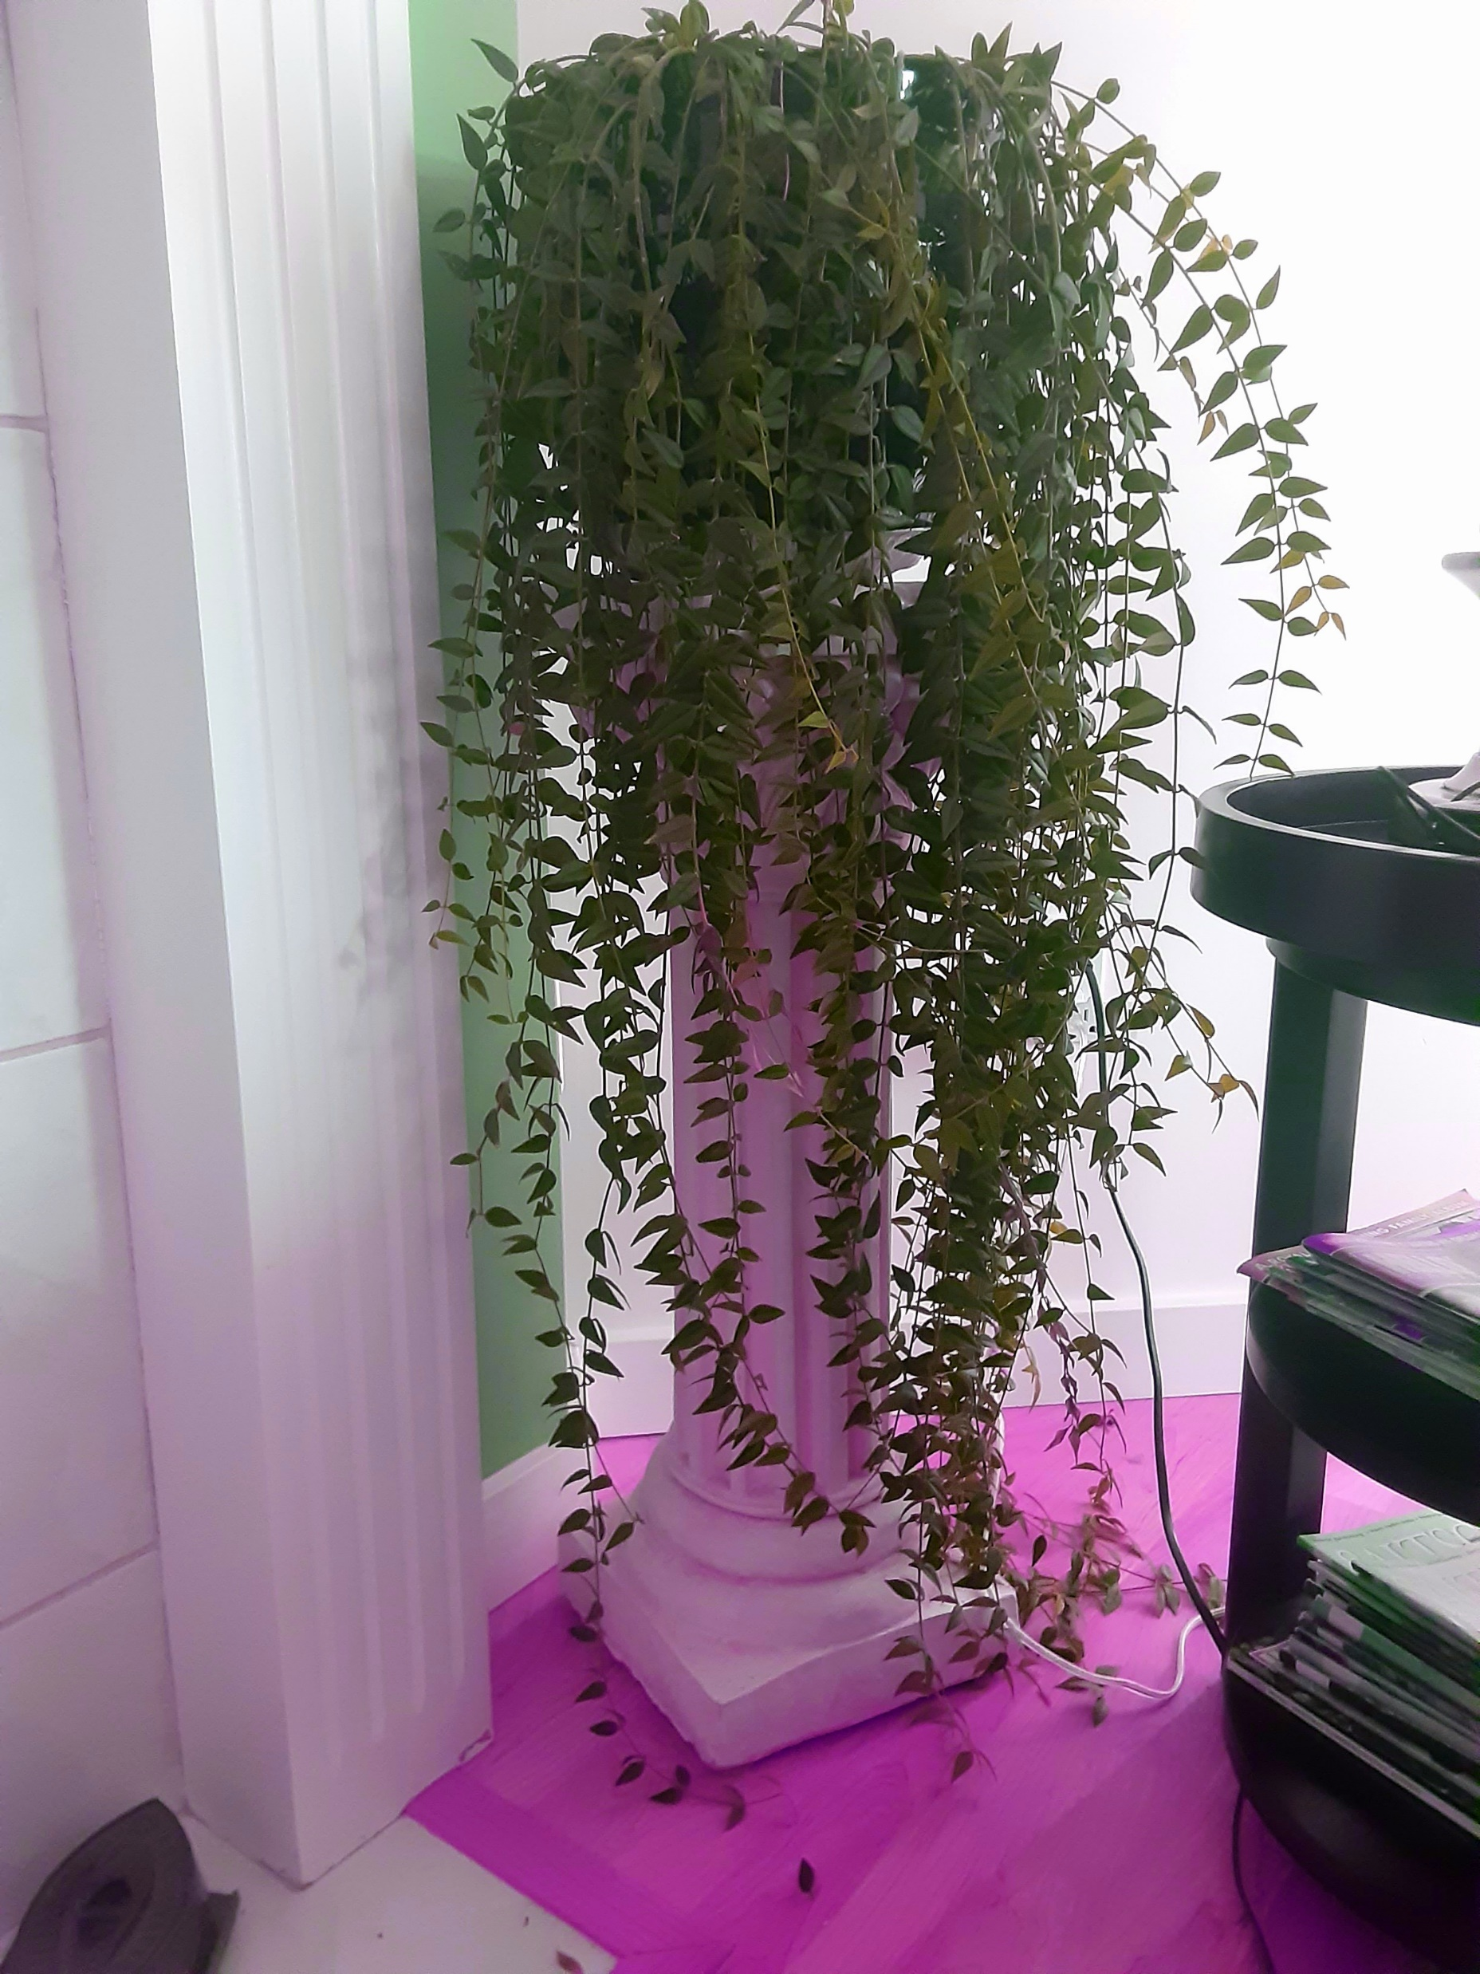
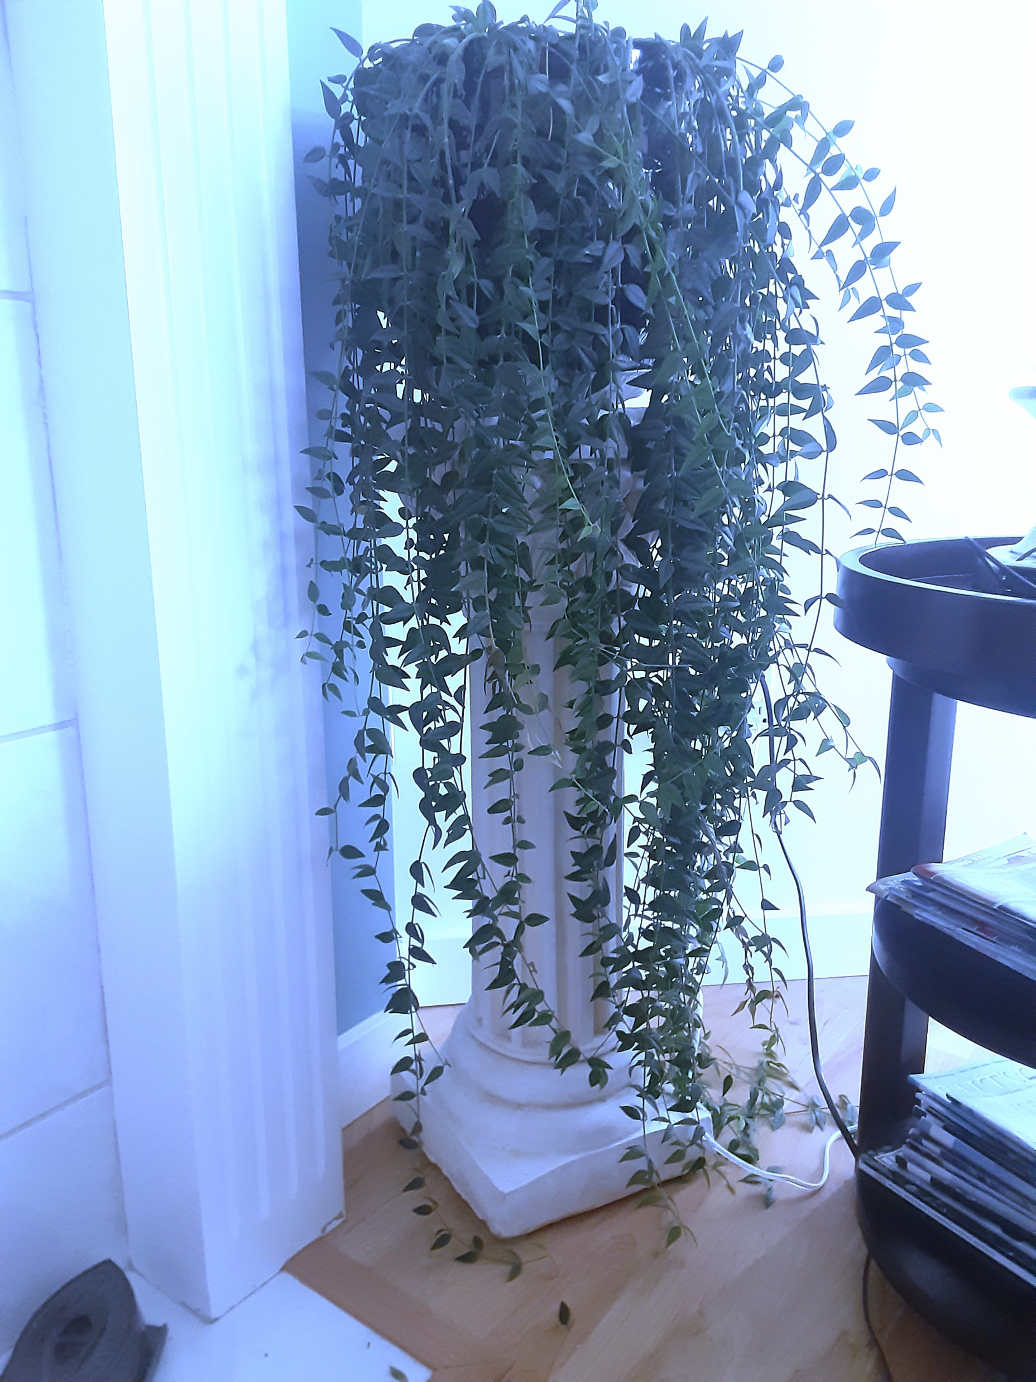
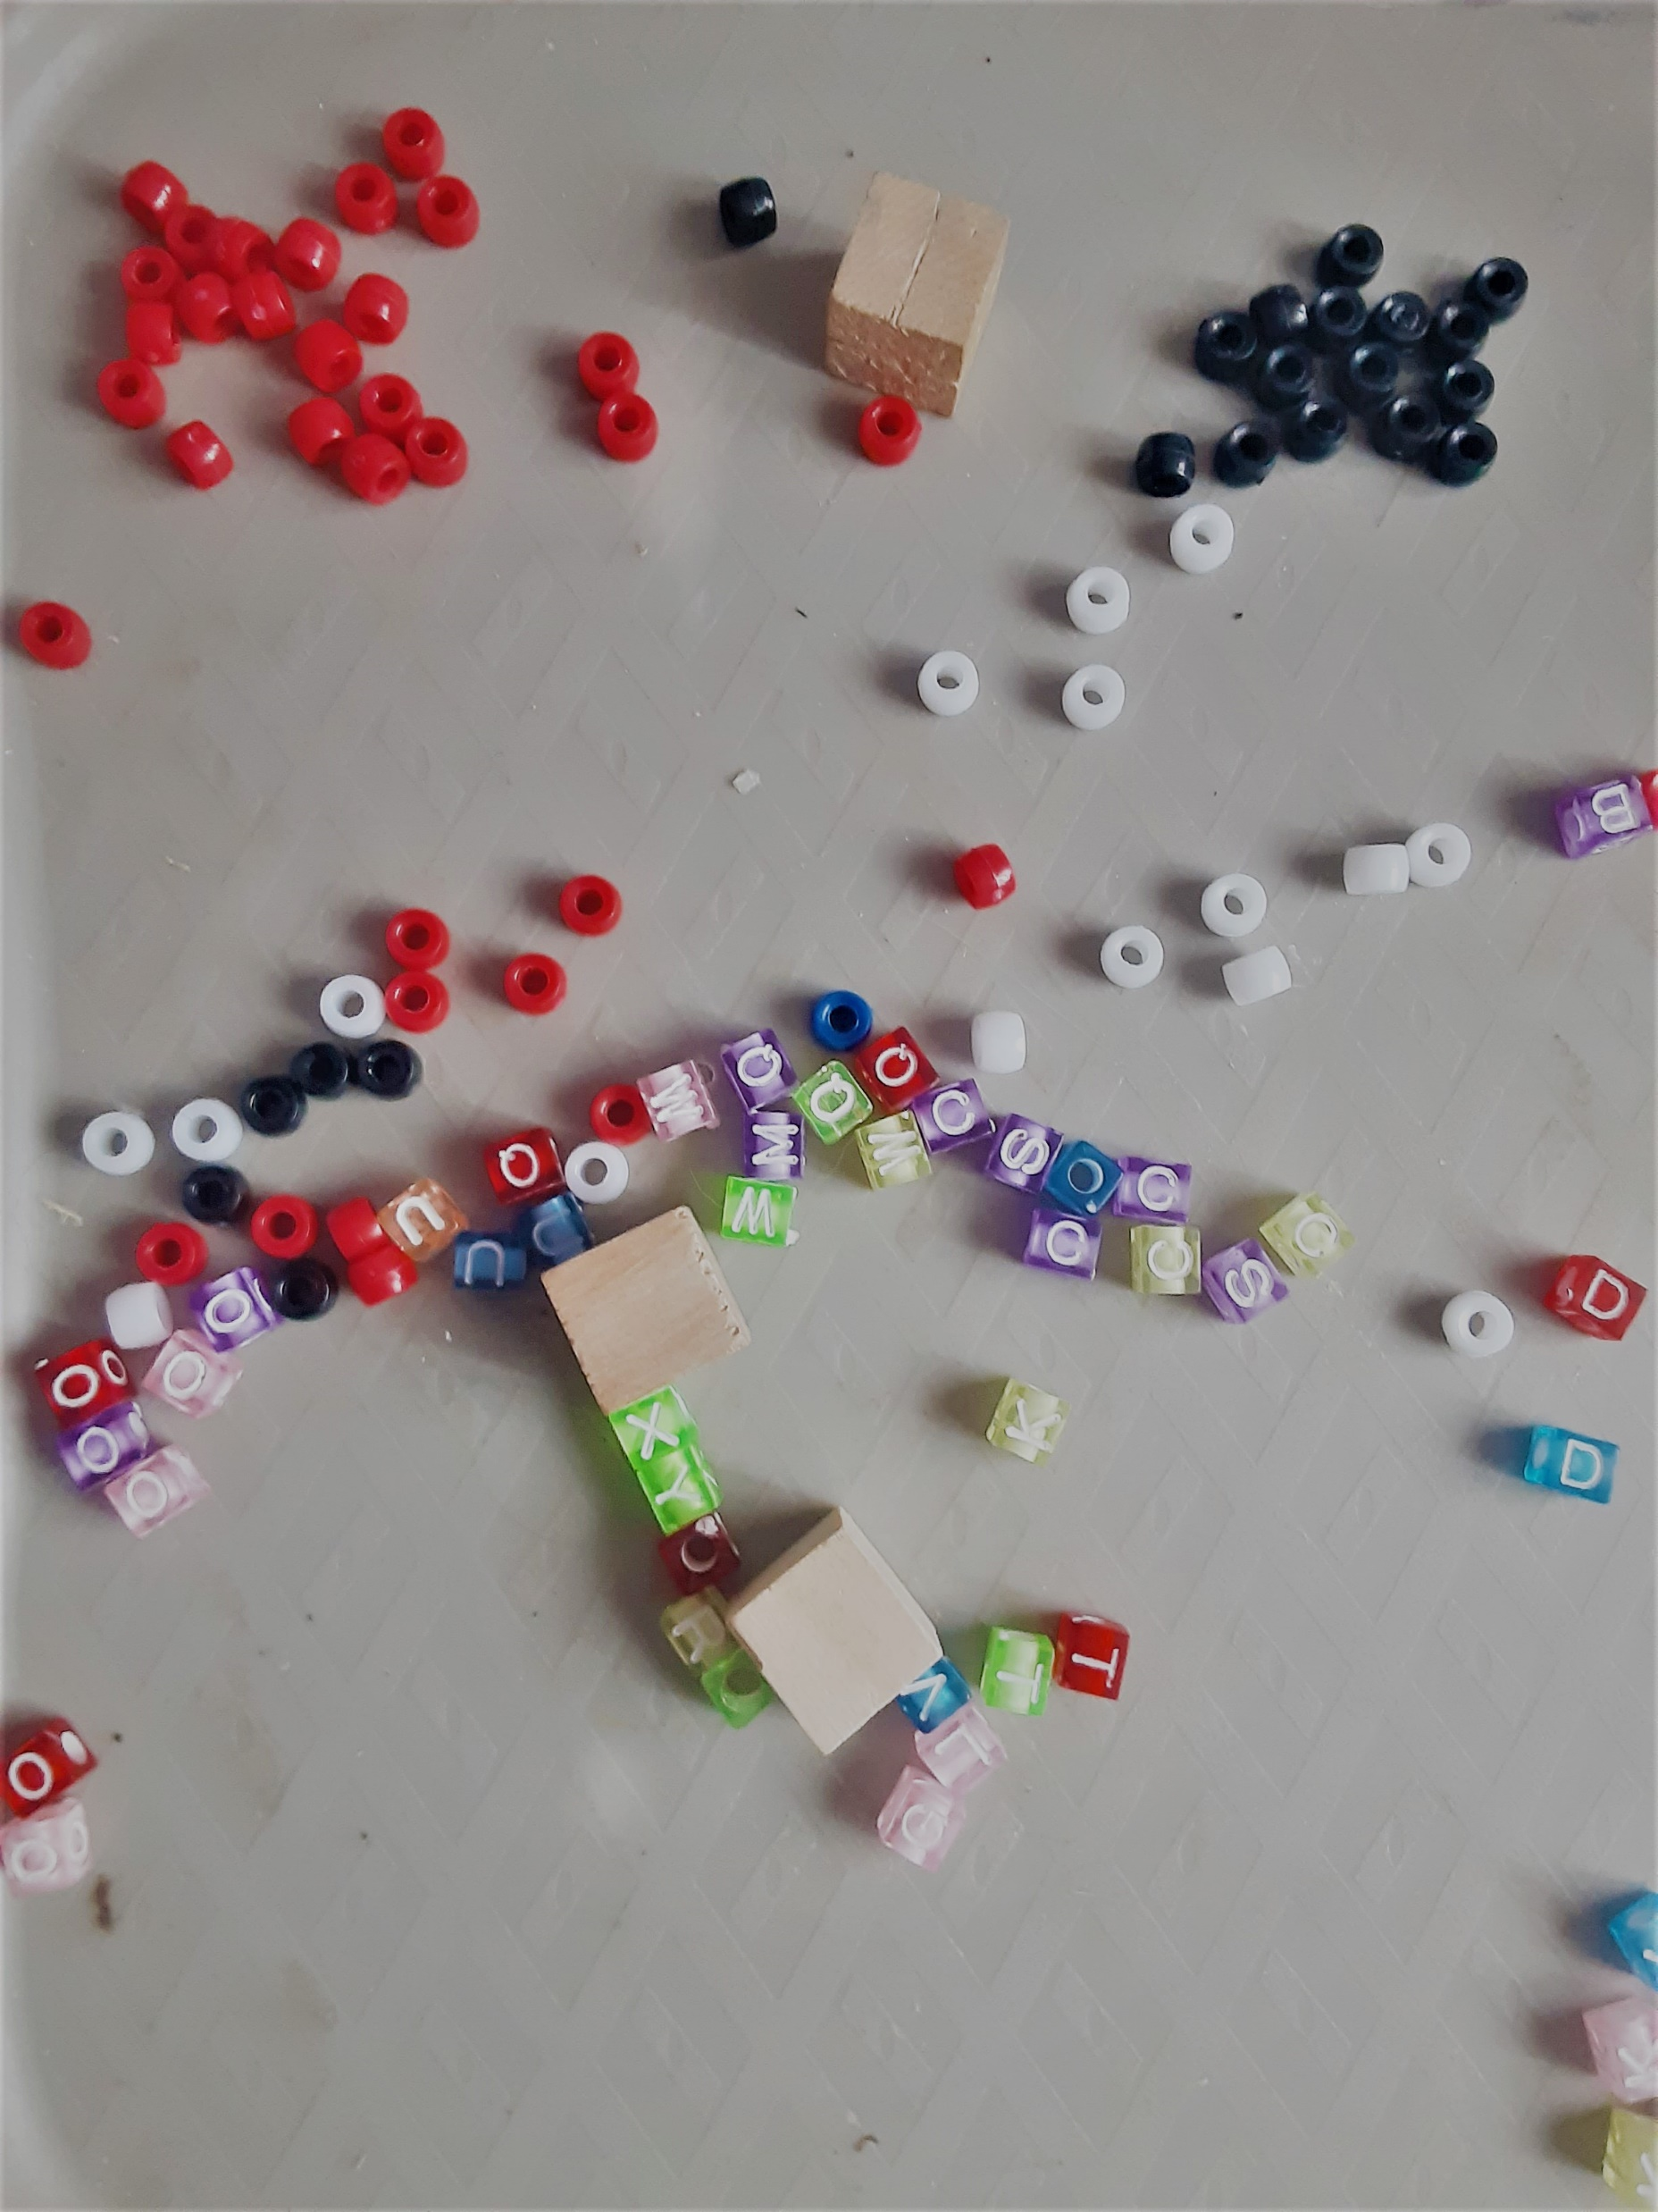
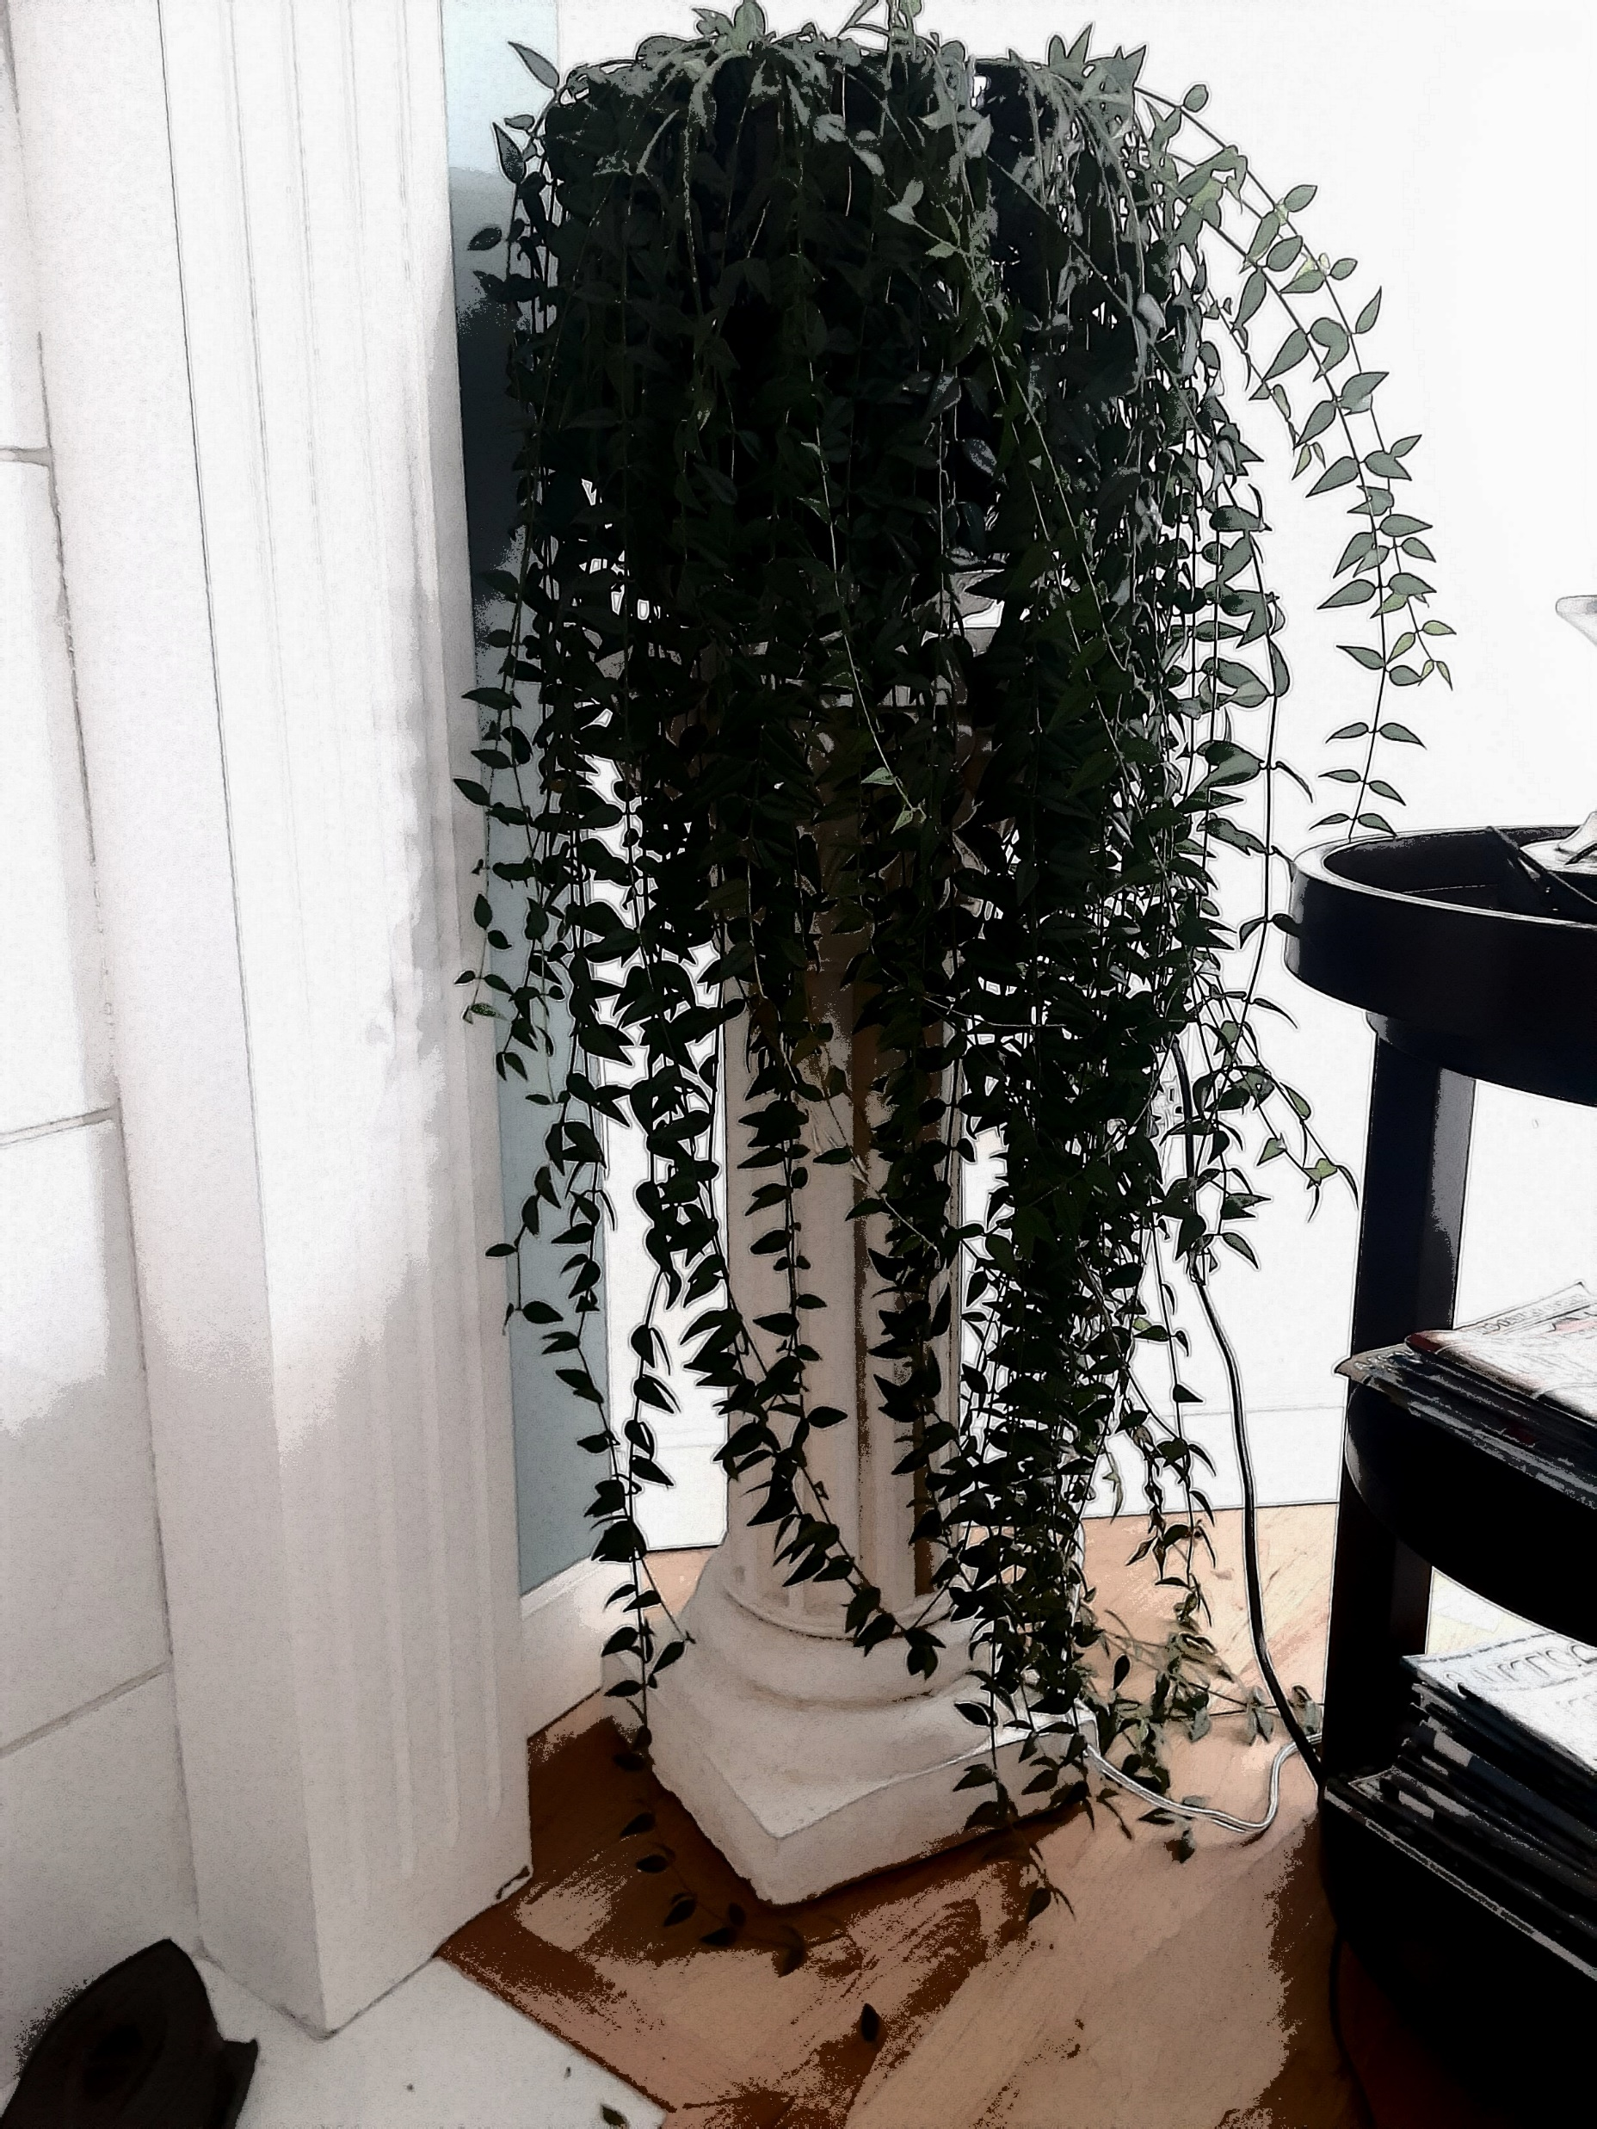
Section F: Its Photo Time!
A Bear in my back yard, cousin of the Kodiak
Original
The Beauty of Nature
Filtered
Abstract

Slide 2
Section H: It’s app time!
Facebook
Facebook Messenger
WhatsApp
Instagram
Snapchat
https://www.businessinsider.com/most-downloaded-apps-of-decade- facebook-instagram-whatsapp-tiktok-snapchat-2019-12
This Photo by Unknown Author is licensed under CC BY-SA
This Photo by Unknown Author is licensed under CC BY-SA

