Slide 1
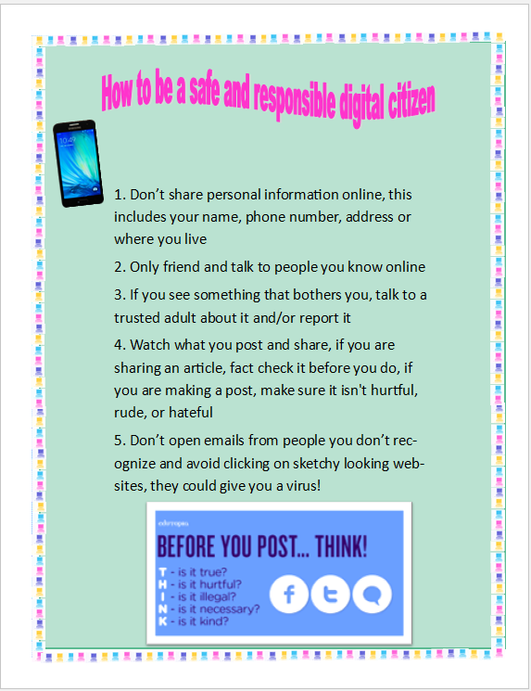
Section J: The Do’s and Don’ts of Digital Citizenship
https://www.youtube.com/watch?v=UXHtBNxnG6k
https://www.youtube.com/watch?v=X_duZ-1LApg
I used Publisher to create this.

Slide 2
Section G: What’s the Word
https://wordart.com/wmxq4e2on27t/internet-safety-emoji

Slide 3
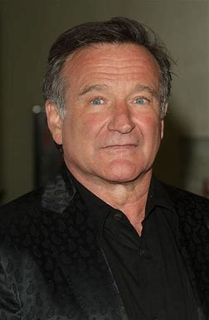
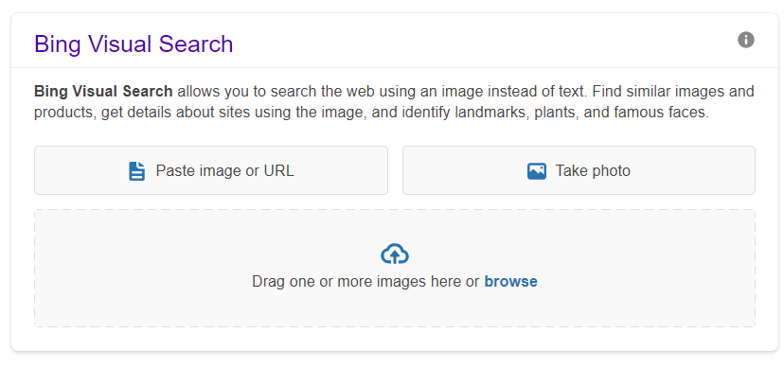
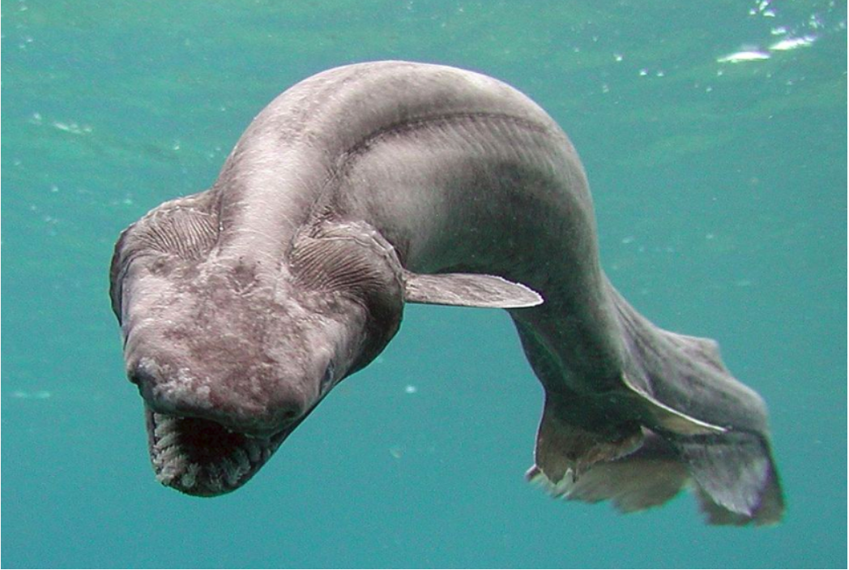
Section K: Digital Research
The song is called I ran (so far away), by A Flock of Seagulls. I asked my dad who it was by, and I already knew its title.
“Carpe diem! Seize the day, boys. Make your lives extraordinary.” this was said by Robin Williams, in a movie called “Dead Poets Society”. To find this information, I googled the quote.
I was originally going to use a reverse image search, but I found a different tool called Bing Visual Search and I used that instead
This creature is called a frill shark

