Slide 1
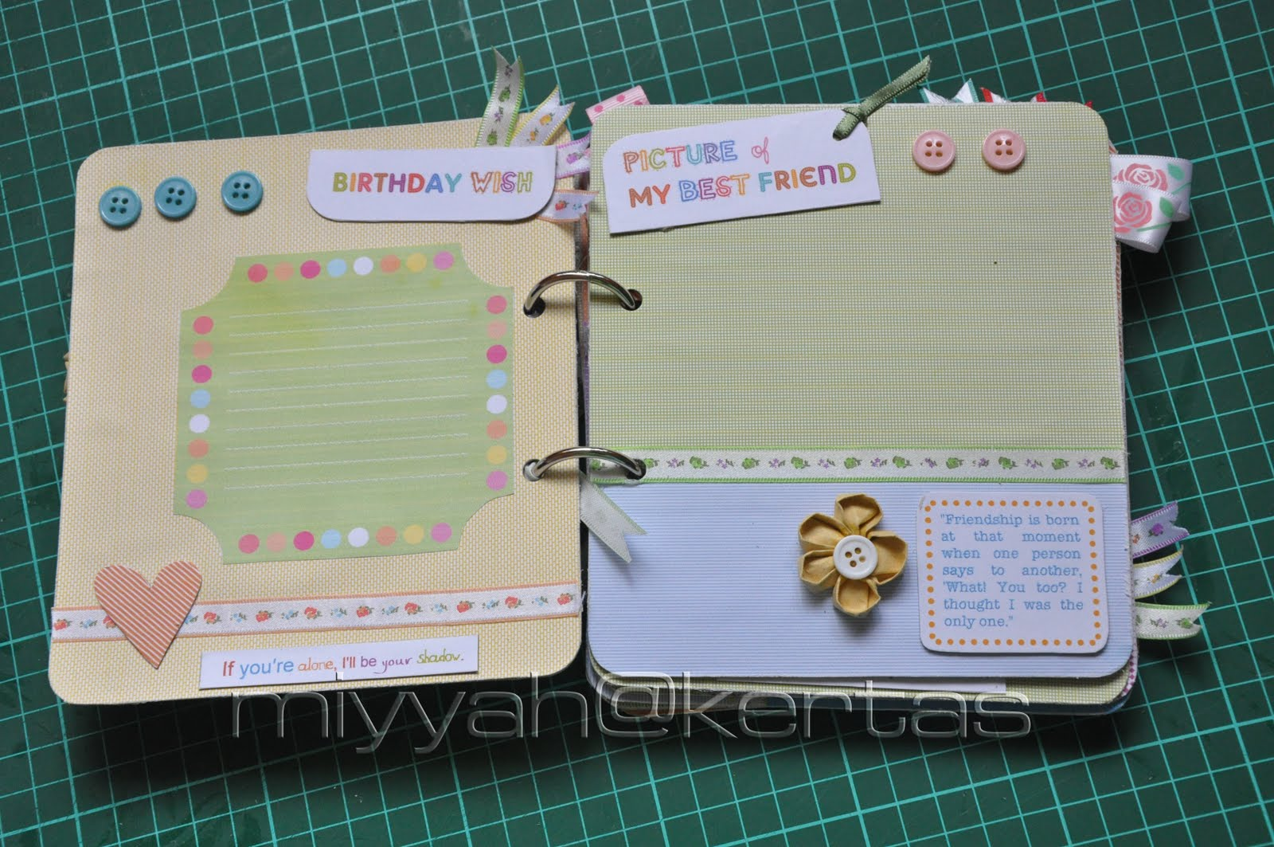
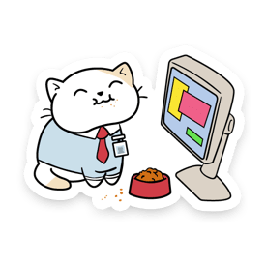
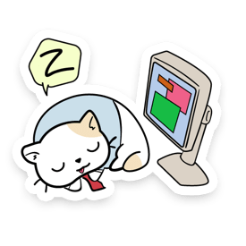
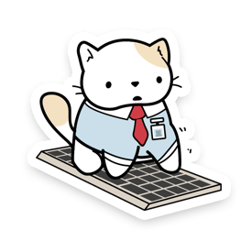
Digital Literacy Scrapbook Project
By Bridget

Slide 2
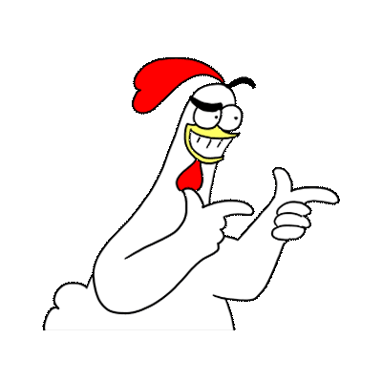
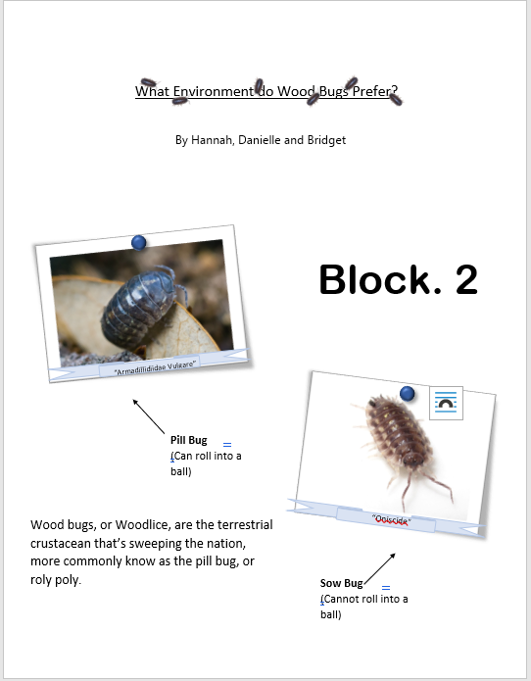
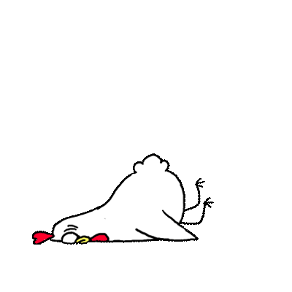
Artifact One: Wood Bug Lab
This is my science 9 wood bug lab I did with two other partners. We did an experiment on wood bugs to see what their preferred environment was.
Link to project
https://sd43bcca-my.sharepoint.com/:w:/g/personal/127-bthielecrocker_sd43_bc_ca/Eegl1C2aUTtOhVKNoKlVzF4BKKqkSGlP6ve-NA-qT0m-aQ?e=OKlb1T&CID=81969a47-50da-4872-7b11-e9c06d149feb
*Note
This project needs to be viewed in the app, otherwise it looks wonky

Slide 3
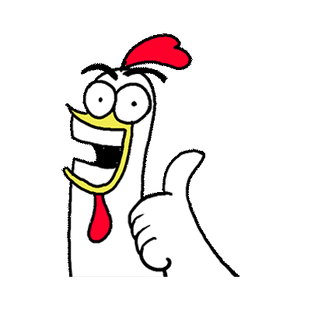
Artifact One: Reflection
Reflection
I feel that this project fits well into the communication competency. I think this because this was a group project where I had to work with two other people. We all had to pitch in and communicate clearly what we wanted done and what we didn’t want to do. We discussed what we wanted to do, then we all brought our supplies for the experiment, then we did it together, and lastly, we all pitched in to present it in a document. We had some struggles, but we overcame them as a group. This project reminded me that clear communication is important, because otherwise you won’t know what you need to do.

Slide 4
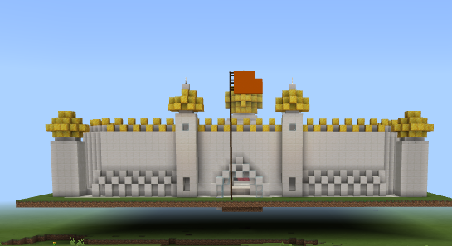
Artifact Two: Minecraft Education Gurdwara
This was a project I did last year when we learned about different religions and had to build their holy buildings in Minecraft education.
Gurdwara
Link to project
https://sd43bcca-my.sharepoint.com/:u:/g/personal/127-bthielecrocker_sd43_bc_ca/EeHKXnKgzKxEvJGJ0VW0Yd8BvudWzRwdBA76y1H7V7oDCw?e=0srdGG

Slide 5
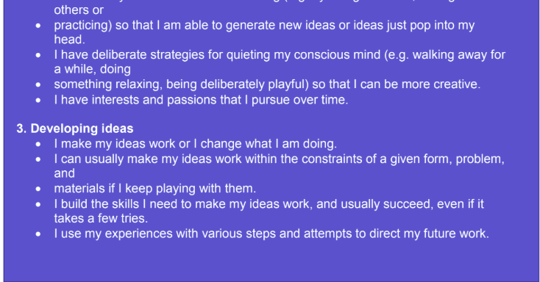
Artifact Two: Reflection
Reflection
I think this project fits well into the creative thinking competency. I think this because I had to research and design my build, then I played around in Minecraft and figured out what I could use and how I could use it. After that I built my Gurdwara with some trial and error. I looked at what other people in my class had done and I took inspiration from them, then I played with it a bit more. It was a fun project and I feel like I learned a lot and developed new skills in Minecraft and strengthened some too.

Slide 6
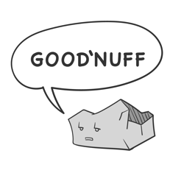
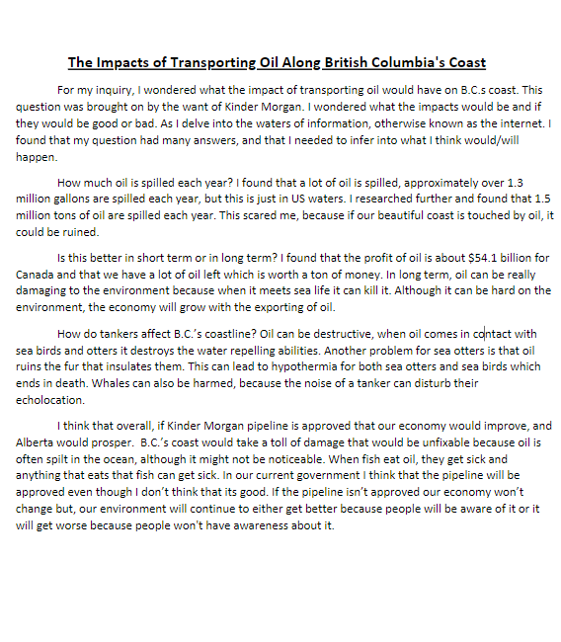
Artifact Three: Kinder Morgan Inquiry
Link to project
https://sd43bcca-my.sharepoint.com/:w:/g/personal/127-bthielecrocker_sd43_bc_ca/EY9O4scUOQdPmZpPsqakB4gBfAVjH6gyM9tf81HaCXHERg?e=qeDpHn
This was an inquiry project I did when I was in Gr.7. I believe it was the first inquiry I ever did. It was about the impacts of oil on BC’s coastline.

Slide 7
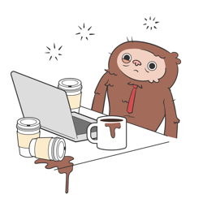
Artifact Three: Reflection
Reflection
I think that my inquiry project fits well into the critical thinking competency. I think this because I had an open-ended question that needed to be answered by me critically thinking and coming to my own conclusion. I researched about how oil impacts the environment and how it impacts the economy. I analyzed my evidence to come to a conclusion. I looked at more than one perspective about oil would impact BC (the economy and the environments). This project taught how I can answer a question without a one true answer, using facts and perspective.

