Slide 1
Scavenger Hunt
Notes:
NOTE: Want a different image on this slide? Select the picture and delete it. Now click the Pictures icon in the placeholder to insert your own image.

Slide 2
Section A: Guess Who?
The 3 digital literacy teachers are Ms. Kim, Mr. Blake, and Mr. Raghoobarsingh
Ms. Kim
Mr. Raghoobarsingh
Mr. Blake
https://emoji-maker.com/designer

Slide 3
Section B: Solve the Riddle
Oh what Am I?
And where can I be found?
Here’s a little Office hint and 365 countdown,
I am part of your district student accounts
And have many apps and tools abound!!!!
???

Slide 4
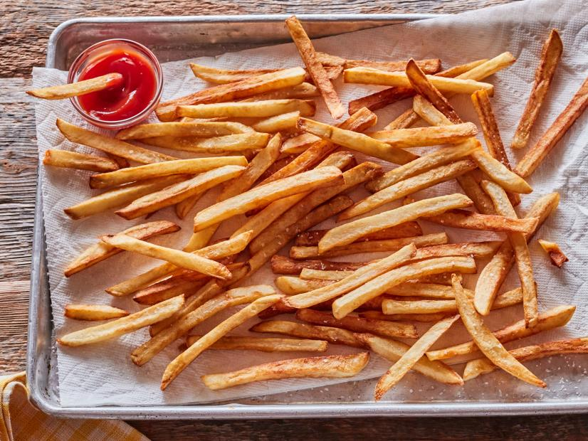
Section C: Food Recipe Theatre
Recipe
cooking spray
6 medium (2-1/4" to 3" dia, raw)s Yukon Gold potatoes, cut into thick fries
1 tablespoon white sugar
¼ cup extra-virgin olive oil
1 teaspoon garlic powder, or more to taste
1 teaspoon salt, or more to taste
1 teaspoon ground black pepper, or more to taste
Prep: 10 mins
Cook: 40 mins
Additional: 20 mins
Total: 1 hr 10 mins
Servings: 4
Yield: 4 servings
https://www.allrecipes.com/recipe/229310/best-baked-french-fries/

Slide 5
Section D: Hit the Post!
https://www.youtube.com/watch?v=VT5nX1p-TvI
I chose Dhar Mann because I was inspired by this person to try to be a better person. I always love his inspiration videos and the fact that he shares everyone's story to remind everyone to no take anything for granted

Slide 6
Section E: Hash -Tag -Your It
https://twitter.com/search?q=%23photooftheday.&src=typed_query
https://twitter.com/search?q=%23instagood.&src=typed_query https://twitter.com/search?q=%23nofilter.&src=typed_query
https://twitter.com/search?q=%23tbt.&src=typed_query
https://twitter.com/search?q=%23igers.&src=typed_query
https://twitter.com/search?q=%23picoftheday.&src=typed_query
https://twitter.com/search?q=%23love.&src=typed_query
https://twitter.com/search?q=%23nature.&src=typed_query
https://twitter.com/search?q=%23swag&src=typed_queryhttps://twitter.com/search?q=%23lifeisgood%E2%80%8B&src=typed_query
#photooftheday.
#instagood.
#nofilter.
#tbt.
#igers.
#picoftheday.
#love.
#nature.
#swag
#lifeisgood

Slide 7
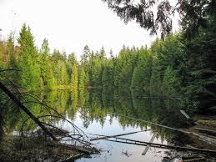
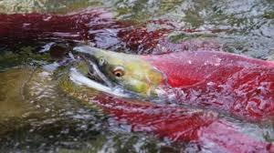
Section F: Its Photo Time!
Nature
I chose this because The trees are the essence of life
Kodiak
I chose this because Kodiaks eat Salmon
Abstract
Graffiti is very abstract

Slide 8
Section G: What’s the Word
https://www.powerthesaurus.org/digital_literacy

Slide 9
Section H: It’s app time!
Instagram
Google
Youtube
Netflix
Discord

Slide 10
Section I: Coding is Cool!
https://www.youtube.com/watch?v=pKBw98uHOyk
Codecombat
C
C+
C++
Python
Java

