Slide 1
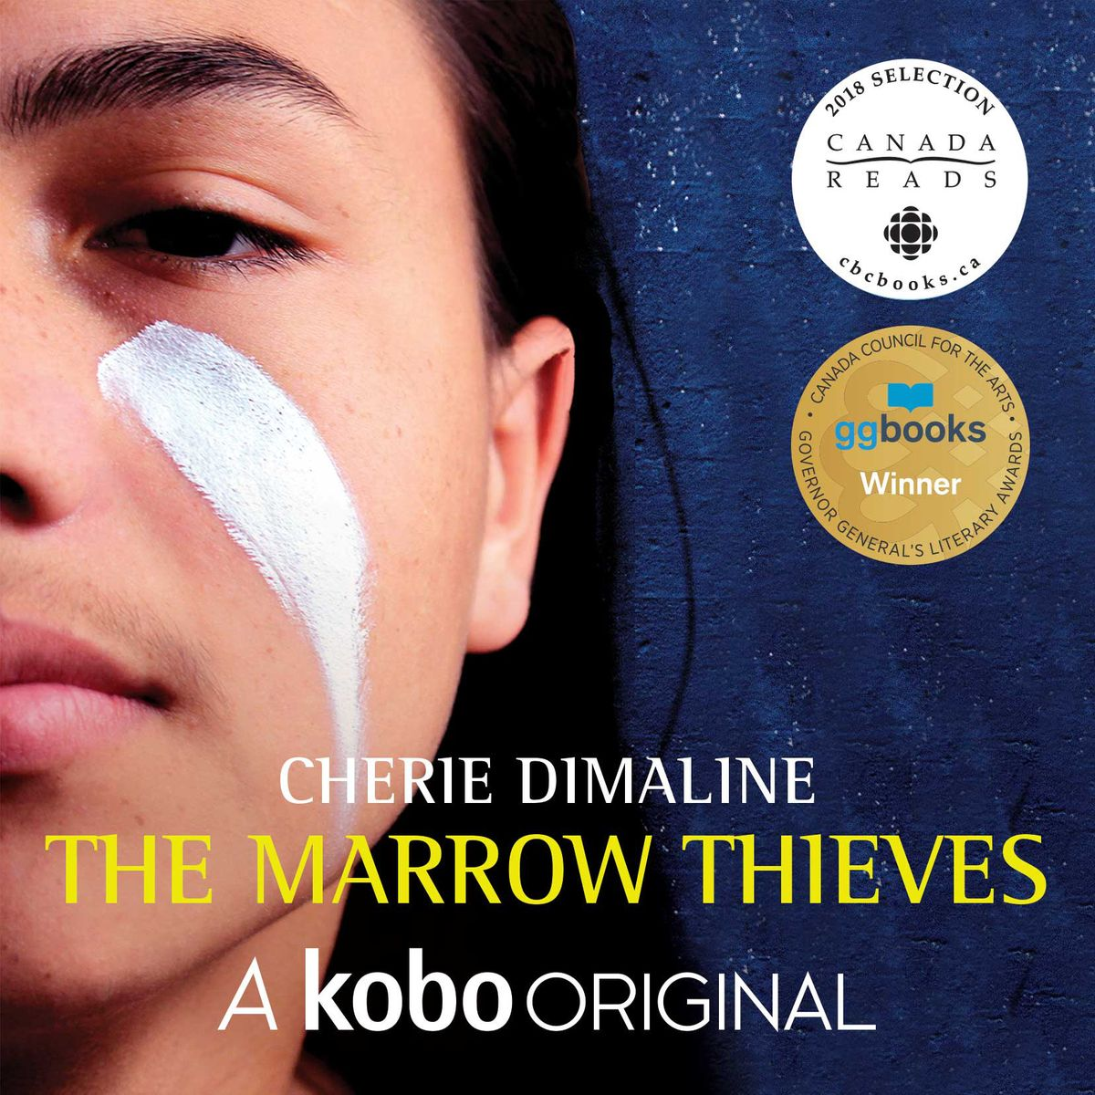
The marrow thieves
Erick Fu

Slide 2
Introduction

Slide 3
Escape to the north

Slide 4
Question
If you are Frenchie, will you choose to end your life like this. Explain your answer.

Slide 5
Family

Slide 6
Question
What bonds them together as a group

Slide 7
Betrayal

Slide 8
Question
What is the significance of RiRi’s death.

Slide 9
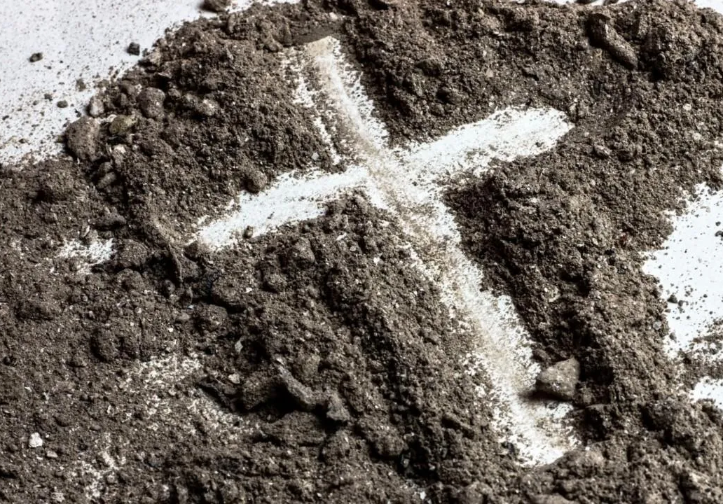
Reunion and sacrifice

Slide 10
Question
What endowed Minerva’s song with tremendous power that could destroy the marrow harvesting machine.

Slide 11
Love and strangers

Slide 12
Question
What changes and strength have you seen in the development of Frenchie’s character

