Slide 1
Coquitlam Open Learning Digital Learning 10
Paul Aitken A – Co
Roger Raghoobarsingh Co – Li
Lance Castonguay LL- We
Cindy Hewitt Wo - Z

Slide 2
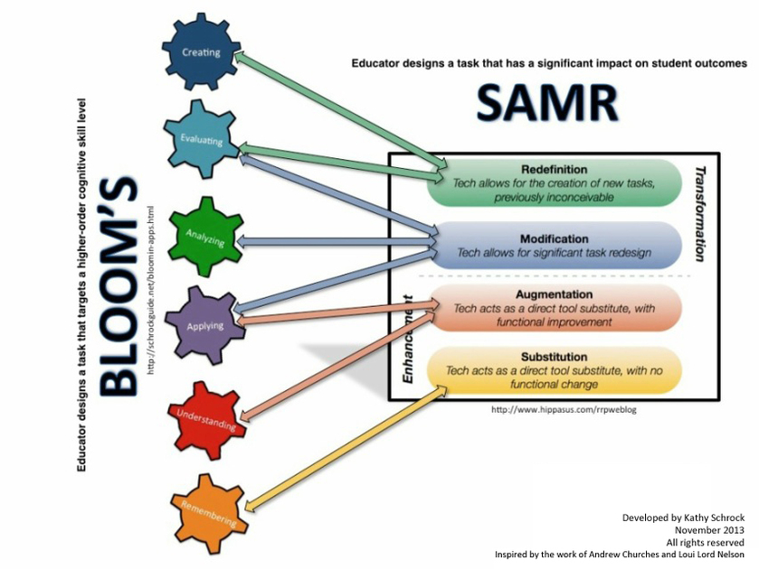

Slide 3
Bouqets
A growing number of classroom teachers have adopted using Edublogs for communicating with their classes
A huge Thank you to all the Block 2 teachers who let us come to your classes. Thank you for your patience.
The Number of student’s completing First Assignment was about 80% this year vs. 25% last year.
Bouqets and Bummers thus far

Slide 4
Bummers
If / or more likely when the New Funding Formula goes through, Digital Learning will no longer be offered since it is a 9th course. Dig Lit teachers will be looking for new positions.
When the question was asked at the meeting about how kids will develop the important skills they are currently learning in Digital Learning 10 the answer was it will now have to be taught by the classroom teachers.
Do not know if that means certain departments will be expected to teach certain skills or we will use the everyone is expected to teach everything and no one teaches anything type of model.
For the Digital Awareness Infographic which was the second assignment, where we did not have access to students it was about the same as last year 20- 25%

Slide 5
Lance Castonguay
OCTOBER 2, 2019 AT 9:45 PM EDIT
Josh, You haven’t achieved a passing mark on this assignment. Please have a look at the assignment page and follow the directions. http://kodiaks.sd43.bc.ca/digital-literacy-assignments/ You need a video, a quote, an image, and a link to your favorite website, as well as a paragraph for each explaining why these are meaningful to you. The Assignment should be located on this page. If it is somewhere else, please copy it to this page. Please feel free to email me a link to your assignment using your district email account if you make significant improvements and want the page marked again. If you need help you can come see me in room 213 at flex.
Lance Castonguay
OCTOBER 3, 2019 AT 4:06 PM EDIT
Josh, 3/5 – You have done a satisfactory job constructing your About Me page and have integrated media and text. You need to embed your picture. It would be advisable for you to provide more description in your assignments – be mindful not to provide too much personal information but provide more of an explanation about your quote, video, or favorite website. Please feel free to email me a link to your assignment using your district email account if you make significant improvements and want the page marked again. If you need help you can come see me in room 213 at flex.
Lance Castonguay
OCTOBER 6, 2019 AT 9:16 PM EDIT
Josh, You have done a good job constructing your About Me page and have integrated your media and text quite well. You could earn a better mark by providing more detailed explanations in the paragraphs about yourself, your video, image, quote, and favorite website, don’t forget to include a Wordle and cite your sources. Please feel free to email me a link to your assignment using your district email account if you make significant improvements and want the page marked again. If you need help you can see me in room 213 at flex. Mark: 4/5

Slide 6
Using EduBlogs for Capstone and Extracurricular
COL Digital Learning 10 Interview Assignment
Where are you now?
Where would you like to be in 4 years as you graduate from HWSS?
How can you use some of the skills you learned this year to help you get to where you want to be 4 years from now?
Attend an interview with your Digital Learning teacher at your assigned time. During your interview you will present your Sway presentation to your Digital Learning teacher and a small group of peers. Your focus needs to be on where you would like to be in 4 years as you graduate and how you are going to get there

Slide 7
Students are now able to:
Log in to SD43S Wifi, log in to District email and use it to communicate with teachers, login to Edublogs, create a Page, create a Post, insert tags and categorize posts, embed videos, pictures, infographics, sways, and other media and personalize their blogs and assignments.
I have successfully used Edublog to showcase my learning in Digital Learning 10 by completing the following assignments:
1. About Me 2. Digital Awareness Infographic
3. Take Your Kid to Work Day 4. Extracurricular Post
5. Science (If in Semester 1) 6. English Assignment 1 (If in Semester 1)
7. English Assignment 2 (If in Semester 1) 8. Socials Assignment 1 (If in Semester 1)
9. Socials Assignment 1 (If in Semester 1) 10. Capstone Digital Learning Sway
11. Capstone Digital Learning 10 Interview

