Slide 1
Digital literacy 10 scavenger hunt!
This Photo by Unknown Author is licensed under CC BY-NC-ND

Slide 2
A guess who?
Ms. Kim
Mr. Blake
Mr. Raghoobarsingh

Slide 3
B solve the riddle
Answer: office 365

Slide 4
C food recipe
BBQ Chicken Ranch Loaded Fries
https://youtu.be/jv_u1JsM2QQ
I found this video on youtube

Slide 5
D hit the post!
The blog is called The Positivity Blog
I think post like these are very important because they help remind us that sometimes in life we need to slow down and take everything in before it's gone for good, I know I have to be reminded of this sometimes. https://www.positivityblog.com/

Slide 6
E hash-tag-it
Food
Fashion
Fitness
Retail
Travel
Music
Sports
Entertainment
Beauty
Lifestyle
https://blog.kicksta.co/trending-instagram-hashtags/#Food

Slide 7
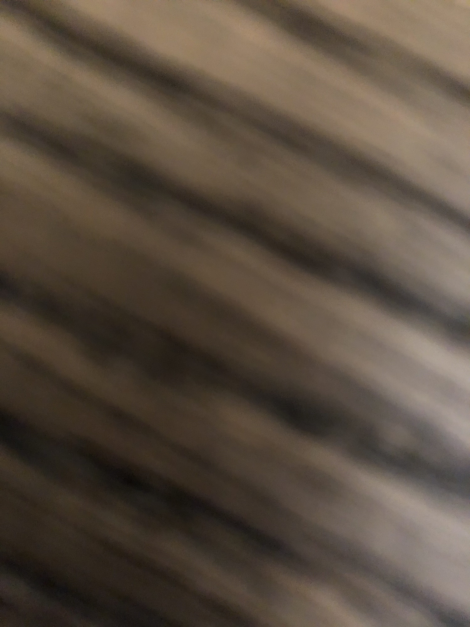
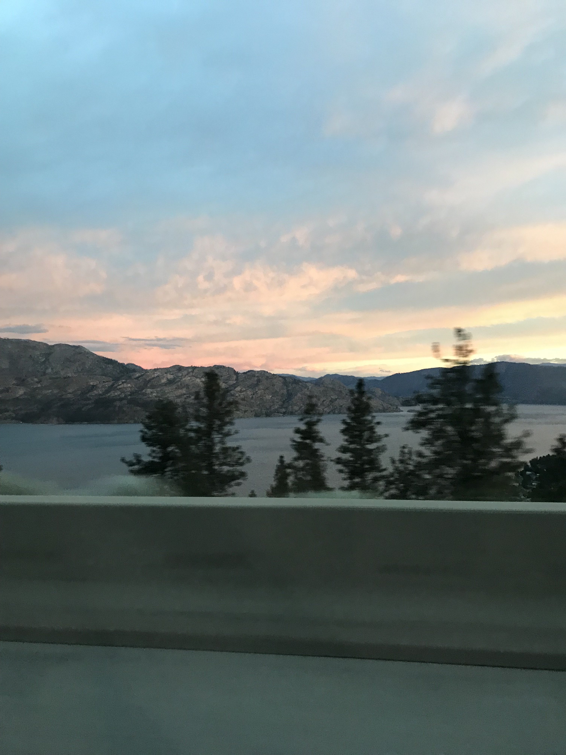
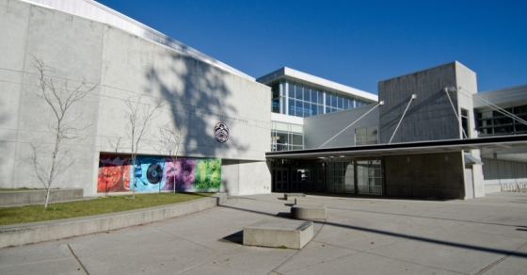
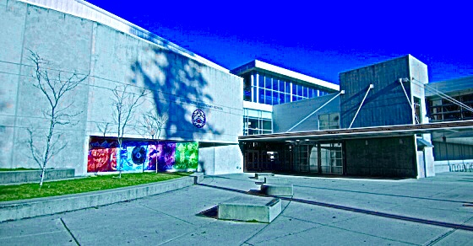
F it’s photo time
Abstract
Nature
Kodiaks

Slide 8
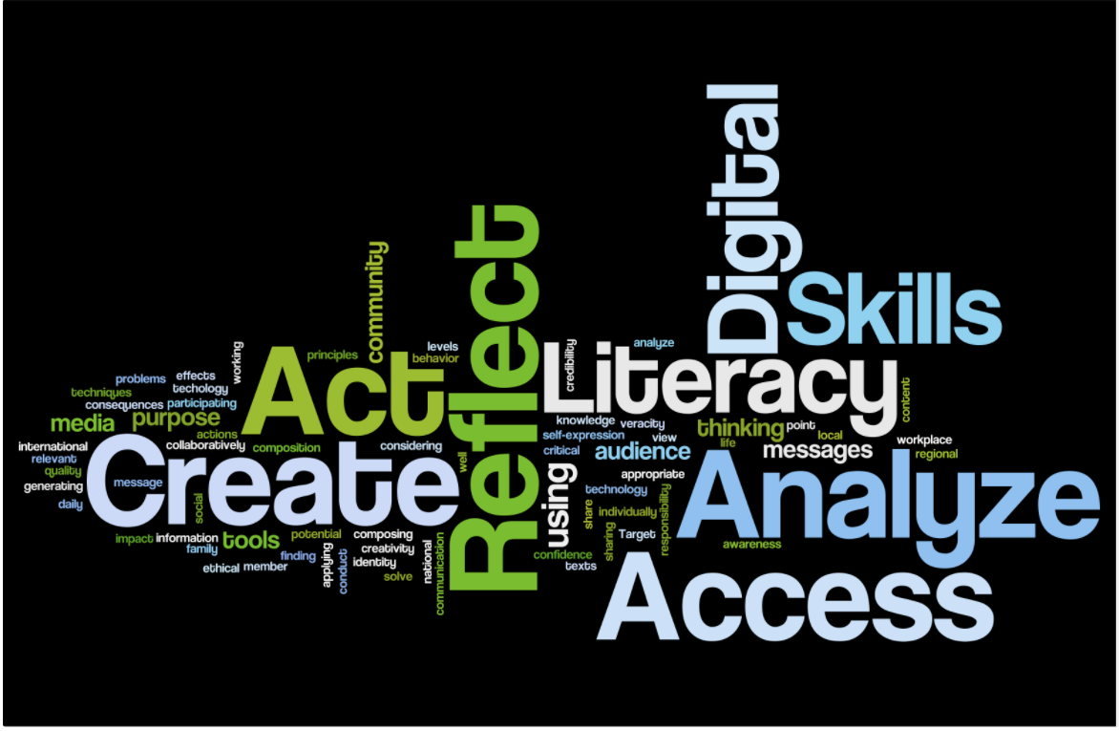
G what's the word?
https://sites.google.com/site/digitalliteracyskillssss/wordle

Slide 9
H it’s app time
Zoom
WhatsApp
Facebook
Messenger
Instagram
https://content.techgig.com/top
-8-most-downloaded-apps-in-the
-world/article show/76248673.cms

Slide 10
I coding is cool
What is coding video
Online free coding game
https://www.codemonkey.com/

Slide 11
J The Do’s and Don’ts of Digital Citizenship
https://www.teq.com/news/5-tips-good-digital-citizenship/

Slide 12
K My Very Own Edublog

