Slide 1
Scrapbook
Digital Literacy 10
By Jessica Goller

Slide 2
Assignment #1
English News Article

Slide 3
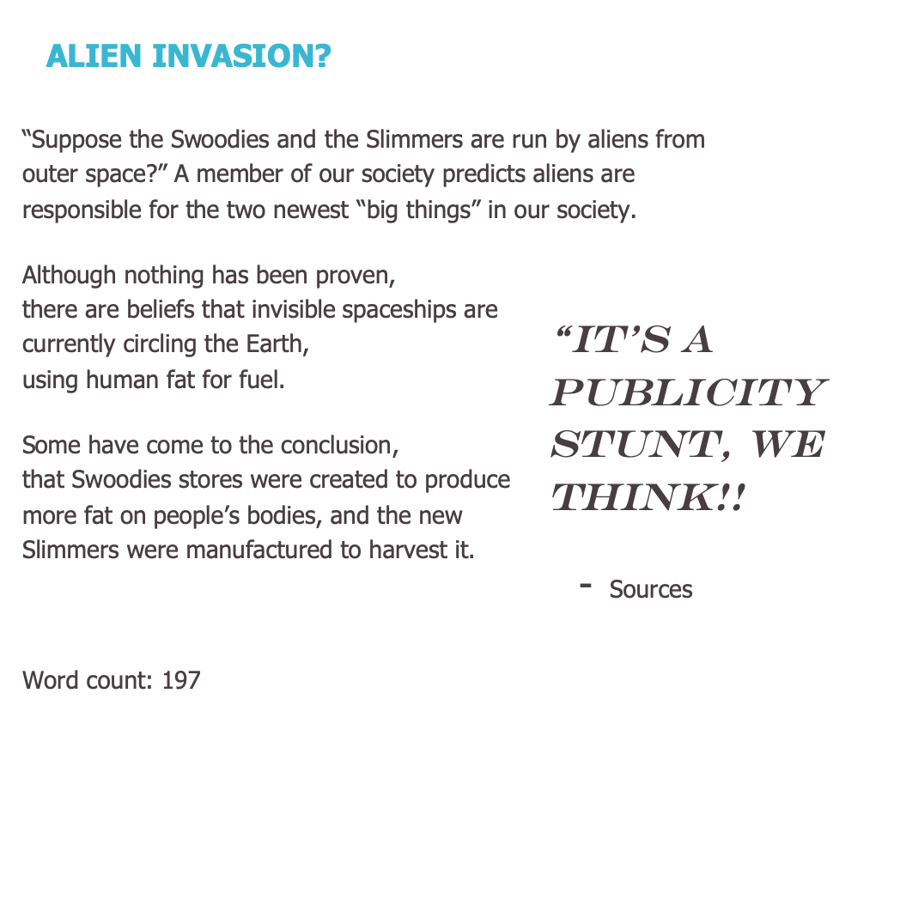
ASSIGNMENT
Response
20 years into the future an unknown company created a product where you can loose fat instantaneously. My assignment was to pretend I was a journalist, talking about these new developments. When I was writing this news article I used the “Personal Awareness,” core competency. I used lots of self determination because I was very set on improving my grade. I worked to advance my punctuation and use of descriptive words. By using self regulation, I understood when I need to take a break from the assignment. If ever felt stressed out or had trouble focusing, I would step back and do something else for a while. I monitored my plan, and was in a flexible mindset throughout the assignment. Perseverance played a big role when I was writing; it was very challenging to get the text to line up so it looked like a news article. By using the core competency, ”Personal Awareness,” I completed my assignment with a sense of pride and satisfaction.
Link: http://kodiaks.sd43.bc.ca/jessicag2020/2020/12/21/english-news-article/

Slide 4
Assignment #2
English Shakespeare Script

Slide 5
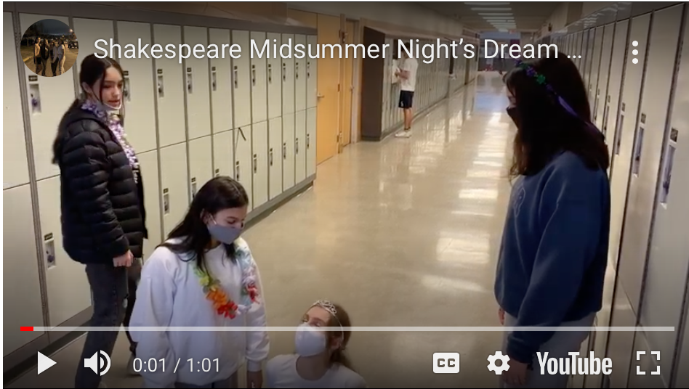
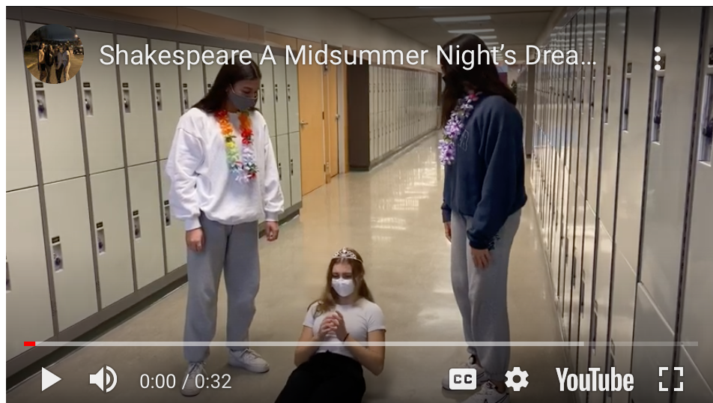
Link:
https://kodiaks.sd43.bc.ca/jessicag2020/type/link/
Response
My midterm project was to act out one of the scenes in a Shakespeare Play. This was a group project which required lots of my core competency, ”Communication.” We had to plan, write, and present our scene in one minute, thirty seconds and ten seconds. We had to be very productive and communicate as much as we could. We listened to each other, shared our ideas for the script because we could only use the most important parts. Smooth transitions were a key role in the outcome of the project as we would be docked marks if we went above the time limit. We had to collaborate to do costume changes and everyone had to work together to neatly perform our play. Whenever there was a disagreement we always took a step back and discussed what we could do to move forward. Furthermore this project would not have been such a success without communication in our group.

Slide 6
Assignment #3
English Short Story

Slide 7
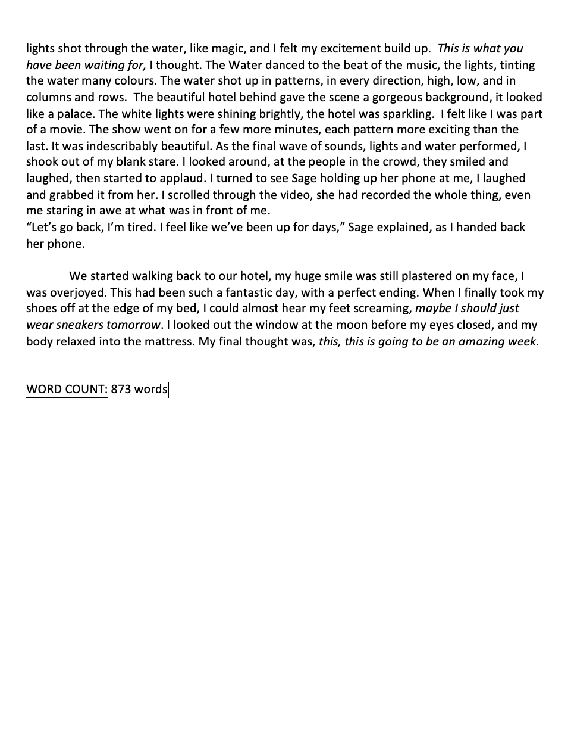
Response
To wrap up our short story unit, we created a descriptive story based on a photo we chose. I used lots of the “Creative Thinking,” core competency when writing, in order to fully describe every detail. I based my story on a women's trip to Las Vegas with her friend. I went on a trip there a few years ago so I dug through old photos and videos. It helped me develop ideas about what my characters are going to do when visiting this beautiful city. It also helped me decide on emotions that the characters would likely feel during each event. Creative thinking also allowed me to express the five senses in a more mature manner. I was always changing words in order to get a better description and flow for the story. This was one of my favourite and most successful writes of the semester because of my use of Creative Thinking.
ASSIGNMENT
Link: http://kodiaks.sd43.bc.ca/jessicag2020/2020/12/21/english-short-story/

