Slide 1
Section A. guess who?
-Kim, Elizabeth
-Choi, Deborah
-Blake, Don
This Photo by Unknown author is licensed under CC BY-SA.
This Photo by Unknown author is licensed under CC BY-SA.
This Photo by Unknown author is licensed under CC BY-SA.

Slide 2
Section B. solve the riddle
Oh, what am I?
And where can I be found?
Here’s a little Office hint and 365 count down.
I am part of your district student account
And have many apps and tools abound!!!!
Answer: teams

Slide 3
Section c. food recipe
https://www.bing.com/videos/search?q=french+frie+recipes&&view=detail&mid=FDBD2A18B18046D9BA20FDBD2A18B18046D9BA20&&FORM=VRDGAR&ru=%2Fvideos%2Fsearch%3Fq%3Dfrench%2Bfrie%2Brecipes%26FORM%3DHDRSC4

Slide 4
Section D. hit the post
https://cookieandkate.com/
I chose this blog because I am in food studies right now and was interested in new things to cook. This blog shows you how to cook and eat healthy.

Slide 5
Section E. hash tag
#Fitness #fashion #sports #film #winter #snow #getfit #tictok #goviral #movie
Source -https://www.instafollowers.co/blog/100-top-instagram-hashtags

Slide 6
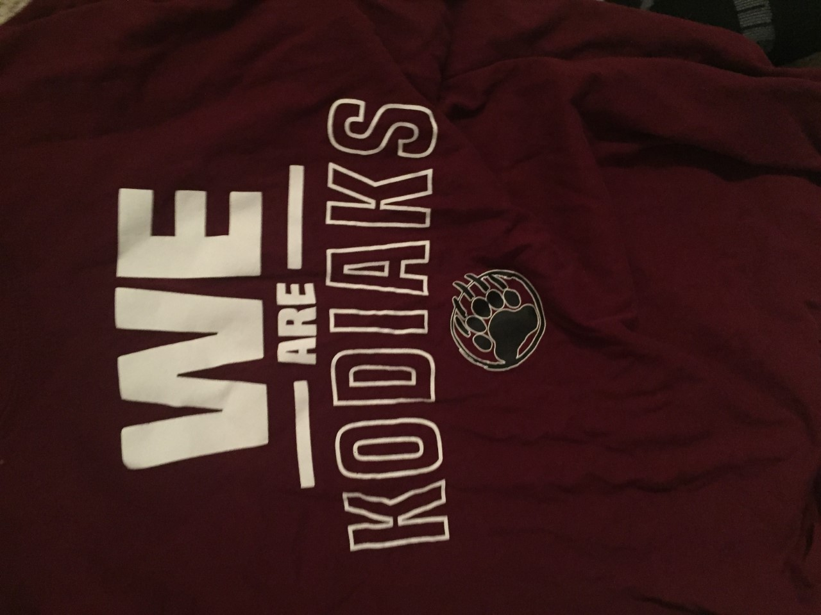
Section F. it's photo time
beautiful/nature
kodiaks
abstract

Slide 7
Section G. what's the word
https://www.bing.com/images/search?view=detailV2&ccid=uNi5F1Xo&id=8E5AC3FF7C17999A25F130AD266B813D8269B1B7&thid=OIP.uNi5F1XoQnPQPoSAzzARMAHaEf&mediaurl=https%3a%2f%2fswinemoorprimary.org.uk%2fwp-content%2fuploads%2f2014%2f03%2fdigital-literacy-wordle1.jpg&exph=509&expw=839&q=wordles+digital+literacy+photos&simid=608012961541062942&ck=15892561523FCD075D392F483E84CA32&selectedIndex=0&FORM=IRPRST&ajaxhist=0

Slide 8
Section H. it's app time
-instagram
-clock
-camera
-settings
-mail

Slide 9
Section I. coding
https://www.bing.com/videos/search?q=how+to+code+kid+vid&&view=detail&mid=B03795F8C619A66DB332B03795F8C619A66DB332&&FORM=VRDGAR
https://www.bing.com/videos/search?q=free+coding+games&&view=detail&mid=3BF0092989FF11DEA02B3BF0092989FF11DEA02B&&FORM=VRDGAR&ru=%2Fvideos%2Fsearch%3Fq%3Dfree%2Bcoding%2Bgames%26FORM%3DHDRSC4

Slide 10
Section J. inportance of digital safty what to do
https://www.bing.com/videos/search?q=how+to+be+a+digital+citizen&&view=detail&mid=74130CBBDEF5ED20AEFB74130CBBDEF5ED20AEFB&&FORM=VRDGAR

Slide 11
Section K. my edublog

