Slide 1
Act 1
By: Kaitlin, Chloe, Mackenzie, Makenna and Cameilla

Slide 2
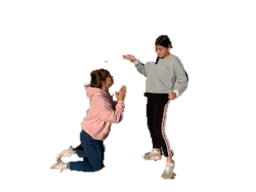
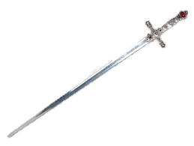
"O my Antonio, had I but the means to hold a rival place with one of them, I have mind presages me such thrift that I should questionless be fortunate"

Slide 3
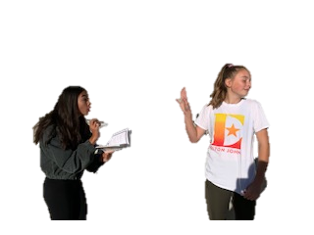
\
"I had rather be married to a death's-head with a bone in his mouth than to either of these"

Slide 4
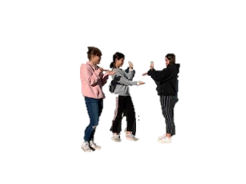
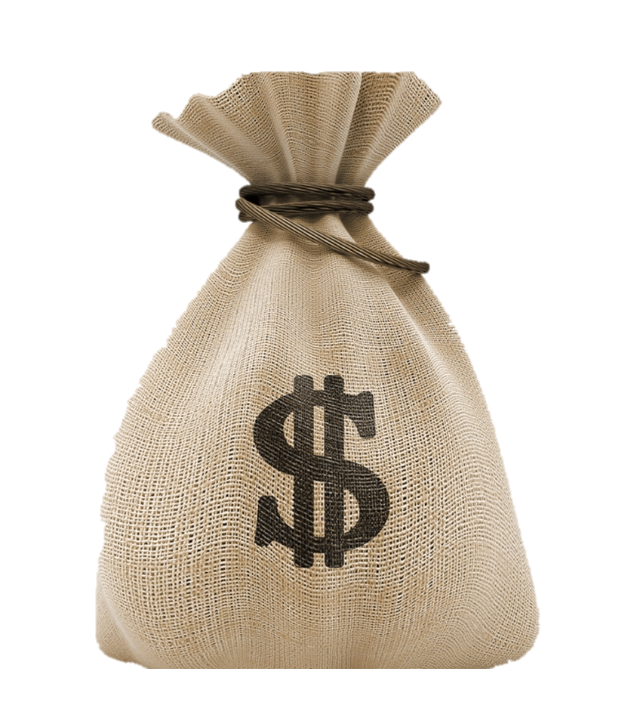
"Go with me to a notary, seal me there your single bond, and -in a merry sport- if you repay me not on such a day, In such a place, such sums or sums as are expressed in the condition, Let the forfeit be nominated for an equal pound of your fair flesh, to be cut off and taken in what part of your body pleaseth me.

