Slide 1
DIGITAL LIT SCAVENGER hunt
Assignment #2
By Mataya spaidal

Slide 2
A: guess who
I am so sorry for this
Ms. Kim
Mr. Blake
Ms. Raghoobarsingh

Slide 3
B: solve the riddle

Slide 4
C: food recipe theatre
Gordon Ramsay|| Perfect Chips with Chris Moyles

Slide 5
D: Hit the post
“The world is changing, and it’s important to acknowledge that certain long held beliefs should be re-examined. So many of us are stuck doing things in an outdated way and it’s only leading us to unhappiness. With that in mind, let’s rethink the paths people can take from ages 18 to 28. I don’t have all the answers, so after reading this piece, leave a comment so I can get your perspective on the 18 to 28 debate.”
Gary Vaynerchuk
https://www.garyvaynerchuk.com/

Slide 6
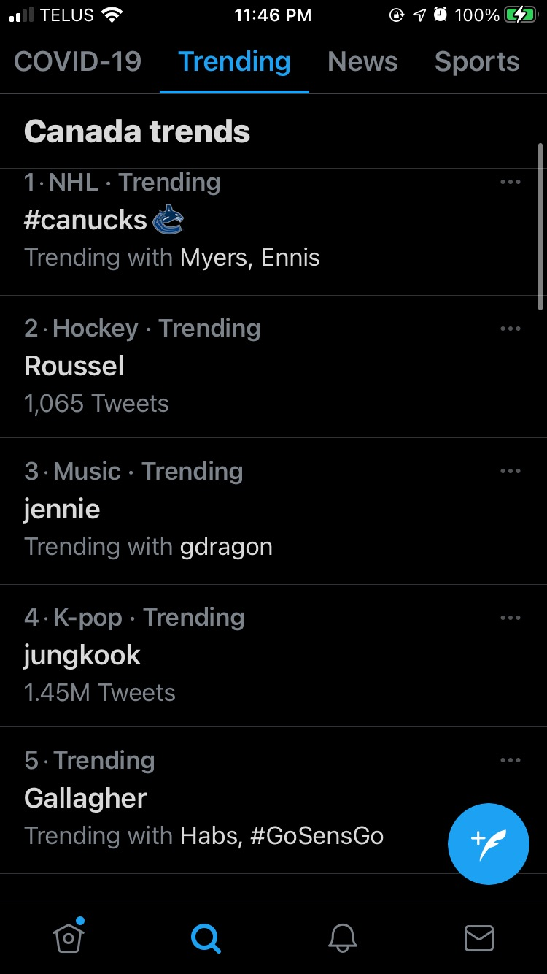
E: hash-tag it
https://twitter.com/Canucks
https://twitter.com/Rous_ant
https://twitter.com/i/topics/913136751920611329
https://twitter.com/search?q=Jungkook&src=typeahead_click
https://twitter.com/search?q=Gallagher&src=recent_search_click
https://twitter.com/hashtag/FireBenning?src=hashtag_click
https://twitter.com/search?q=murray%20&src=typed_query
https://twitter.com/search?q=%23mike%20smith&src=typed_query
https://twitter.com/search?q=luka&src=typed_query
https://twitter.com/ItsTravisGreen

Slide 7
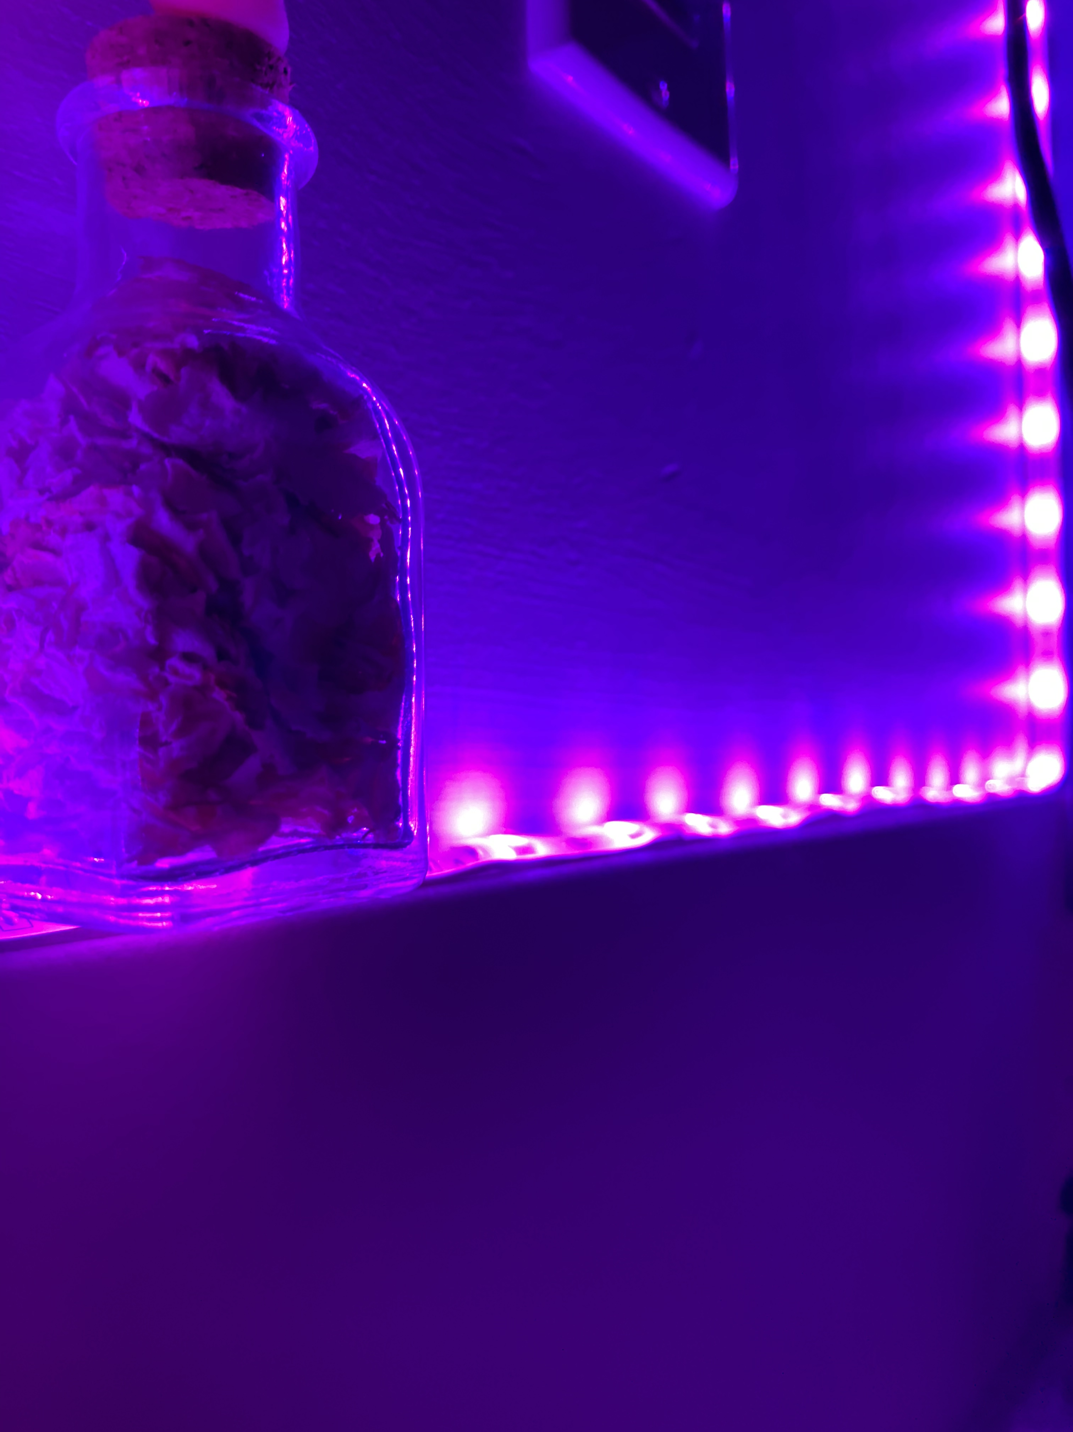
F: It’s photo time

Slide 8
G: what’s the word
https://www.emergingedtech.com/2016/07/assessing-digital-literacy-standards-tools-techniques/

Slide 9
H: its app time
1 2 3 4 5
https://content.techgig.com/top-8-most-downloaded-apps-in-the-world/articleshow/76248673.cms

Slide 10
I: Coding is cool
Coding Game
https://code.org/learn

Slide 11
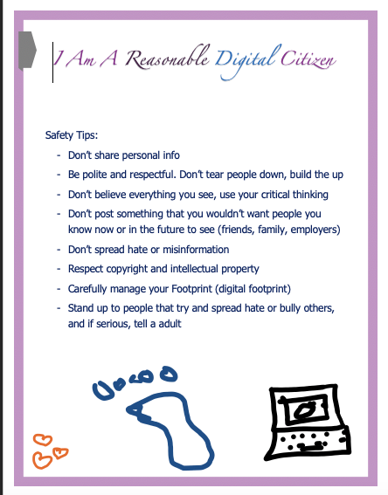
J: The Do’s and Don’ts of Digital Citizenship

Slide 12
K: My Very Own Edublog!

