Slide 1
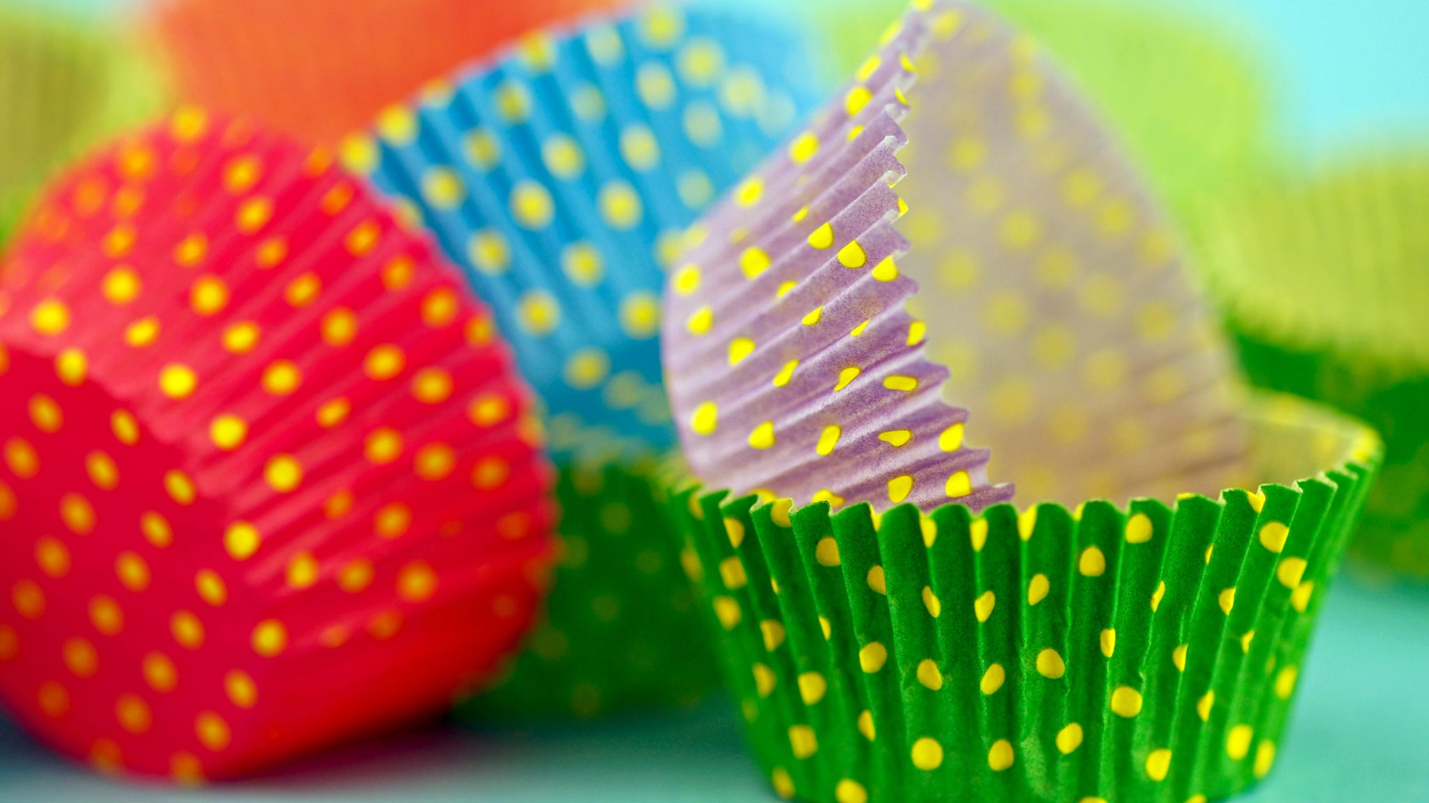
Muffin Method

Slide 2
What is the muffin method?
Steps:
1) Sift together the dry ingredients into one bowl
2) Combine liquid ingredients in a separate bowl
In muffin recipes, the fat would be liquid
3) Add liquids to the dry ingredients all at once
4) Stir ingredients just until combined

Slide 3
What should the “perfect” muffin look like?
-Golden brown
-Slightly rounded, and with a pebbly surface
-Tender and light
-Even textured with medium, round holes
-Moist inside
-Easy to remove from pan

Slide 4
The “Not So Perfect” Muffin
Problem: | Possible Cause:
-Pale -Peaked and smooth on top -Tough and heavy -Uneven texture with tunnels -Dry -Stuck to the pan or paper liner -Dark crust but center not cooked | -Oven too cool -Overmixing -Overmixing/Too much flour -Overmixing -Too much flour/Oven too hot -Not enough fat -Oven too hot/Dull or dark pan

Slide 5
Why don’t my muffins look and taste like the ones at the store?
-Commercial muffins are specially formulated with special leaveners and different amounts of fat and sugar
-They also use commercial ovens that give baked goods a “jump start”

Slide 6
Difference Between Oil or Melted Butter
-Butter produces a lighter muffin, adds flavor, and encourages browning
-Oil keeps longer, has a natural flavor, and a light crumb

Slide 7
How do I know my muffins are done?
-Golden brown top
-Do the “Toothpick Test”
Poke a toothpick into the center of the largest muffin
Toothpick should come out completely clean
If the toothpick has dough on it, muffins need to be cooked longer

Slide 8
Biscuit Method

Slide 9
What is the biscuit method?
-Used for mixing in most biscuit and scone recipes
-Butter or fat is “cut in” to the flour mixture, then liquids are added
-Butter or fat should be cold with this method
-In the heat of the oven, the butter melts, the water in the butter creates steam, and the product rises into flaky layers

Slide 10
Biscuit Method Cont..
-Steps:
1) Sift dry ingredients into a bowl
2) “Cut in” the fat with a pastry blender until the mixture is granular, with particles approximately the size of peas
3) Combine liquid ingredients together in a separate bowl
4) Add liquids to dry ingredients, then stir until combined
5) Remove dough to a counter lightly dusted with flour, then knead the dough 10-12 times – DO NOT OVERMIX
6) Cut dough into shape, and then bake

Slide 11
What should my biscuits look like?
-Golden brown
-Flaky layers
-Evenly risen

Slide 12
The “Not So Perfect” Biscuit
Problem | Possible Cause
-Dense Biscuit/No Layers -Small biscuits -Biscuits didn’t rise -Flat biscuits | -Too much liquid, over-kneading -Biscuits too far apart on the pan -Oven temperature too low -Twisting the biscuit cutter

Slide 13
Remember…
-Biscuits work best with chilled butter! Do not let the butter get too soft or over-knead your biscuits – they won’t rise properly
-Alternatively, you can freeze a cube of butter and then grate the butter into your recipe

