Slide 1
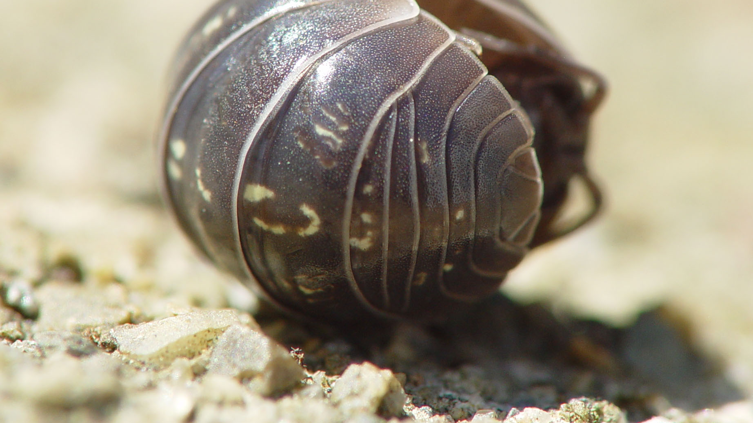
Wood Bugs
Ella and Neha
Block 3

Slide 2
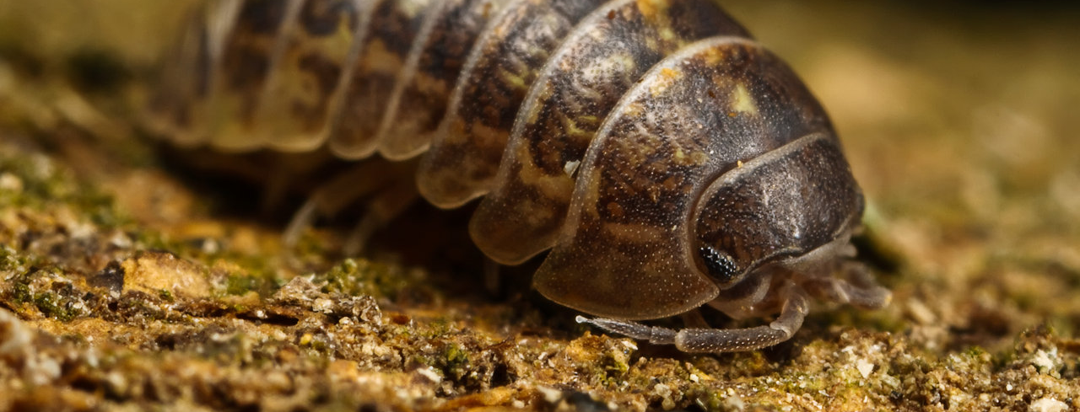
Observation Page
We noticed that the wood bugs tend to stay in the corners or the border of the box. The reason we think they like those spots is because it is darker than the middle

Slide 3
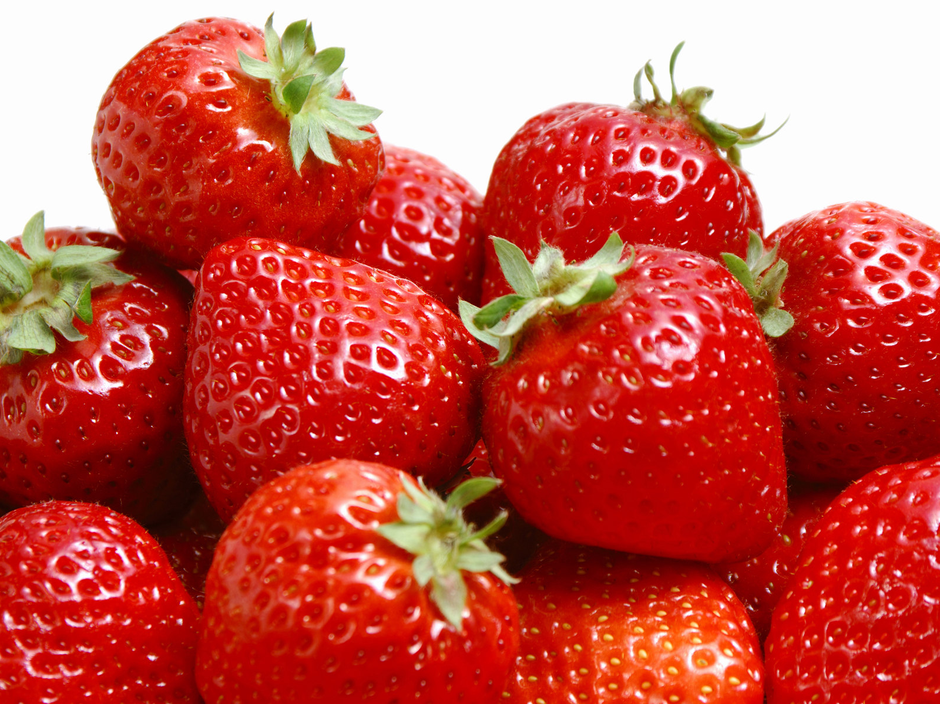
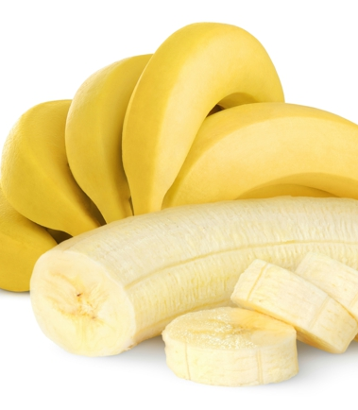
Hypothesis
Strawberries & Bananas
If we separate the bananas and strawberries, then we believe that the wood bugs will go to the bananas because they are moister and softer.

Slide 4
Materials
- Shoebox (1)
- Bananas (1)
- Strawberries (2)
- Spray bottle (1)
- Wood Bugs (9)
- Soil

Slide 5
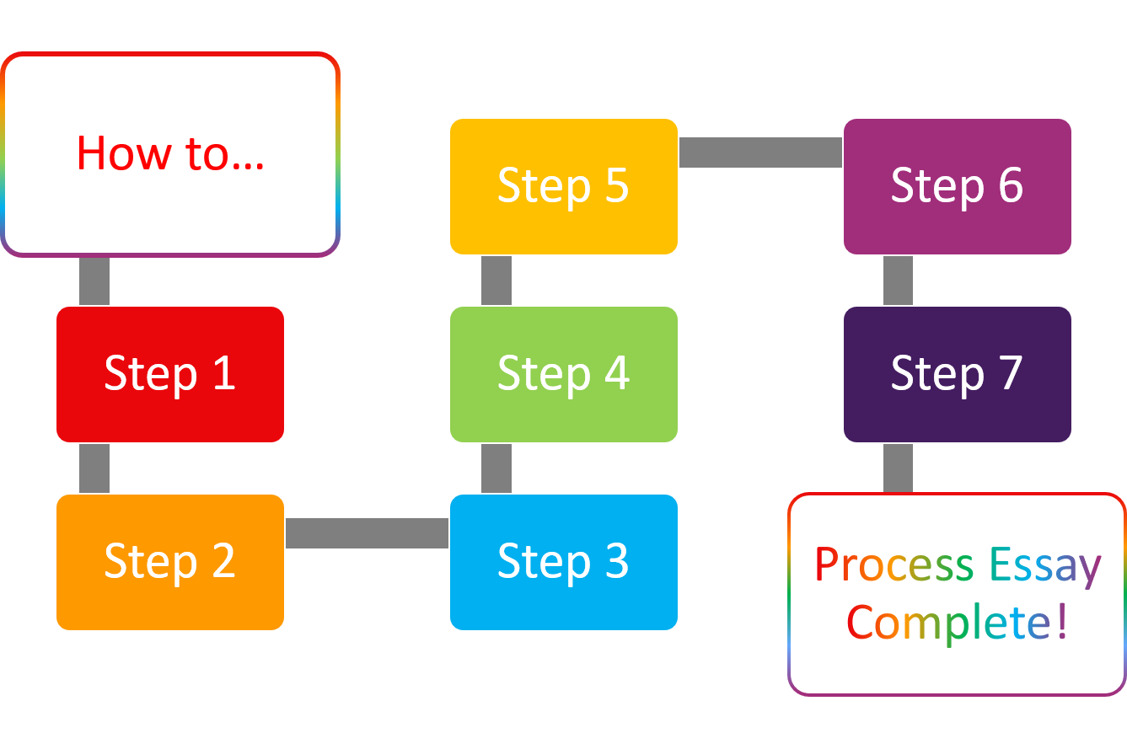
Procedure
1. We got a 4x7 shoebox
2. We covered the bottom with 4 pieces of damp paper towel
3. We covered the paper towels with damp soil
4. Next we added 3 pinecones and 1 flower
5. Then we brought rotten strawberries and 1 old banana, and we cut them up then placed the fruit on opposite ends of the shoebox
6. Then we collected 9 wood bugs
7. After all the above was completed we put 1 wood bug in the center of the box and recorded where the bug went

Slide 6
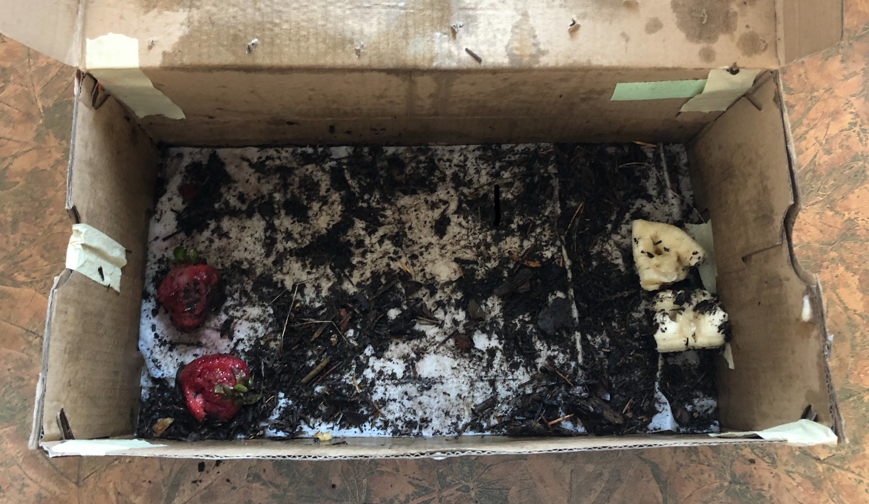
Procedure Photo
This is a photo of our procedure. Strawberries to the left and bananas to the right.

Slide 7
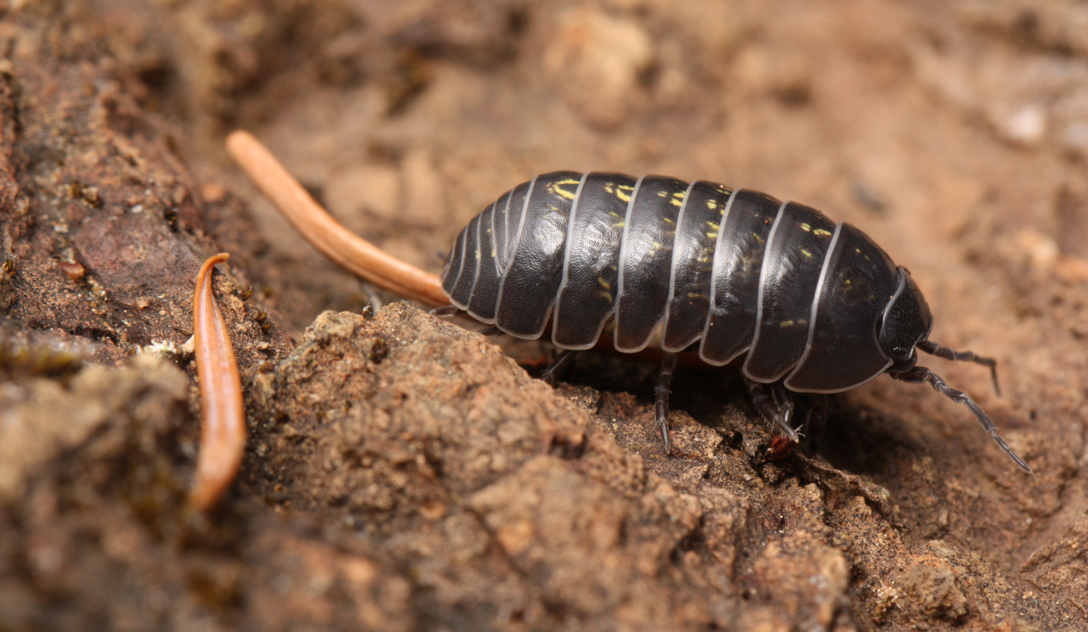
Quantitative Observation
-4 Wood bugs went to the strawberries
-3 Wood bugs went to the bananas
-2 Wood bugs attempted to get out of the box

Slide 8
Qualitive Observation
-The larger wood bugs were stronger than the little ones
-They rolled up into little balls to protect themselves when we had to pick them up
-There shells are very crunchy, and they protect the inside of the wood bugs very well

Slide 9
Data Analysis Graph
Wood Bug Graph
Number of Bugs (y)
Where the woods bugs went(x)

Slide 10
Our conclusion is Wood bugs prefer strawberries instead of bananas. During our experiment we ran into problems involving Wood bugs finding escape routes in the box causing us to lose visual causing us to find them and replace them in the middle.

