Slide 1
Act 3 Scene 1
By: Scarlett, Alexa, Neha, Sophia, Andia

Slide 2
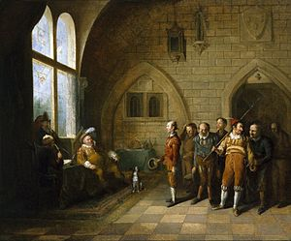
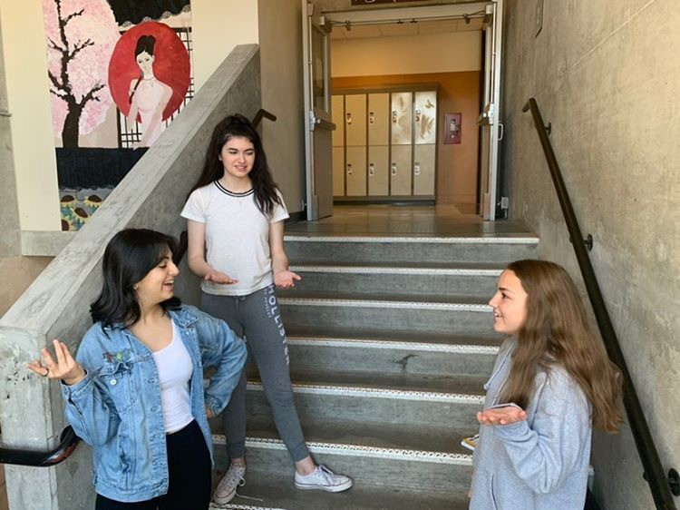
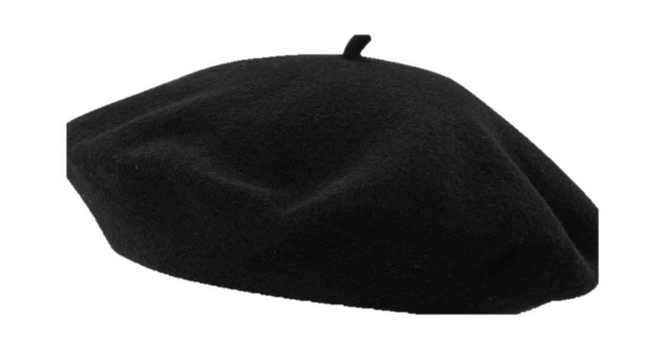
In this scene, Solanio and Salarino are gossiping about Antonio’s shipwreck

Slide 3
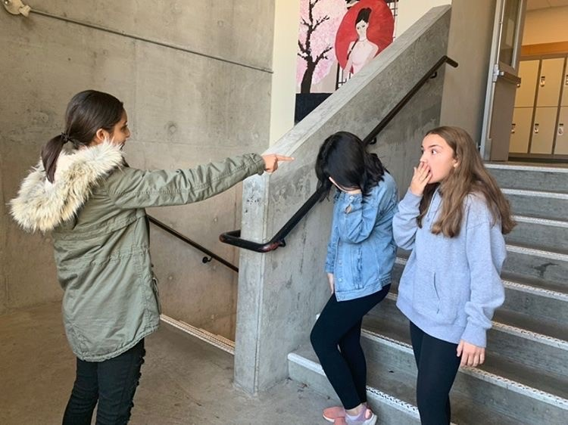
Shylock finds out that Salonio and Salarino knew about his daughter Jessica’s plan to run away, and discuss Antonio’s loss at sea

Slide 4
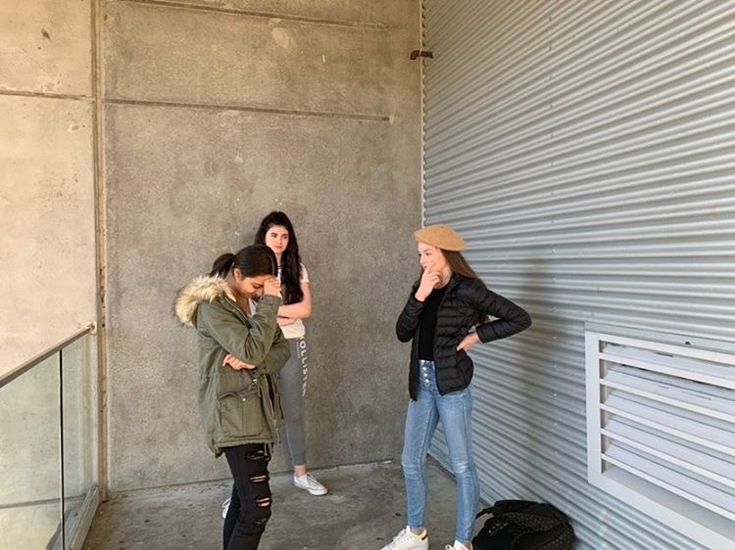
Tubal and Shylock meet and they discuss news about Jessica

Slide 5
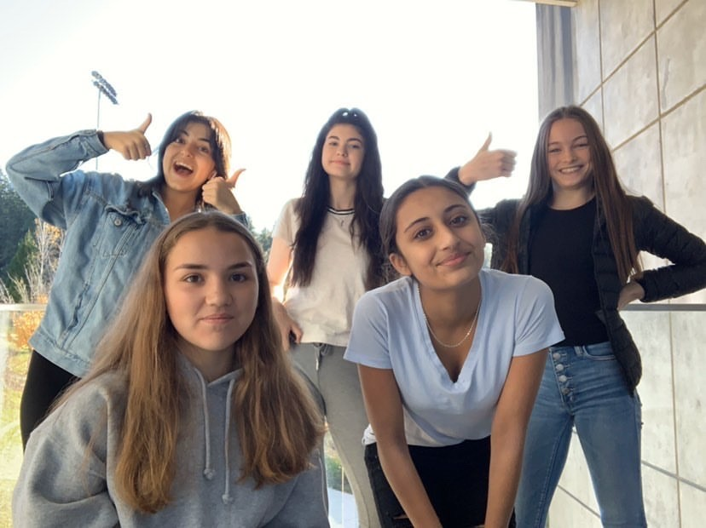
Cast
Scarlett: Tubal
Andia: Salarino
Alexa: Salonio
Neha: Shylock
Sophia: Man

