Slide 1
The Hate You Give

Slide 2
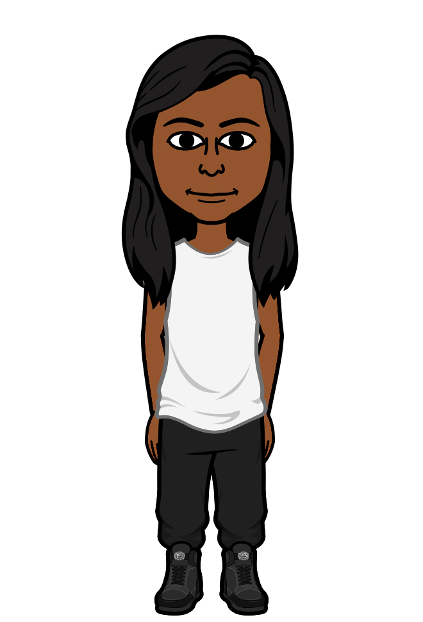
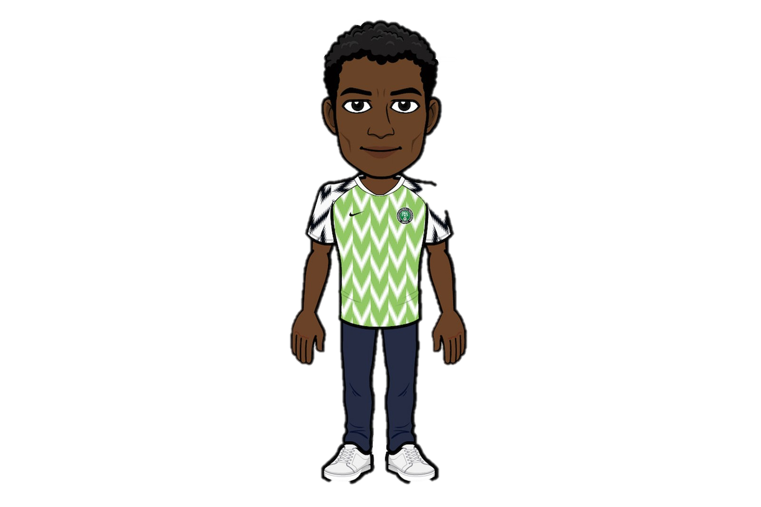
Starr and Khalil find each other at a party and they here gunshots.
Hi Khalil,
How ya doin?
I’m good, long time no see!
How have your parents been doing?
Fine, grandma aint been doing to well tho, she got cancer.
Man, stop the cap, we all know you cant dress up.
Oh, thanks Starr, these the new Jordans.
Yea, they fresh man but I got way better ones at home.
Damn bro, that sucks, at least you got new shoes.
Man shush, you cannot dress up.
Anyways how long has it been since we talked?
True, we should hangout more later!
Idk, bro too long.

Slide 3
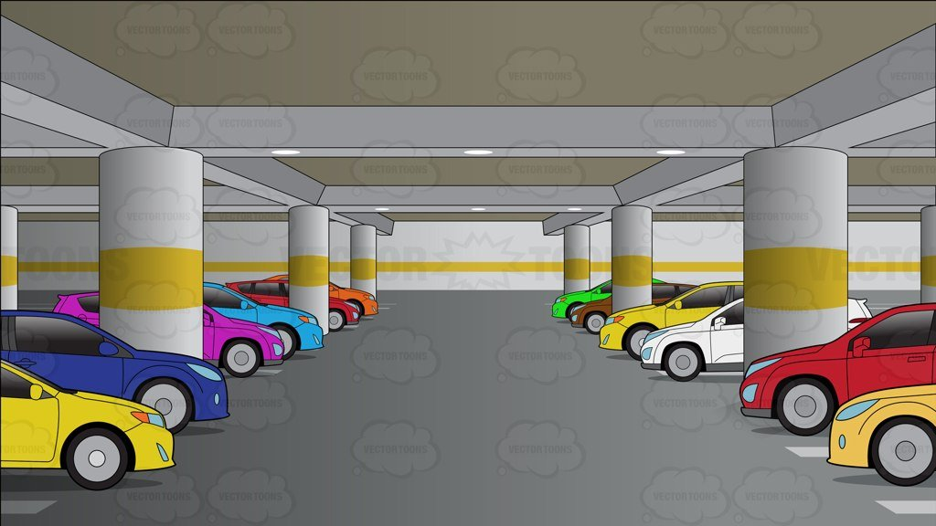
Ight Starr, it’s go time!
Bro did you hear that lets gout outa here!
Man, where your car at?
It’s the red one, now run faster Starr!

Slide 4
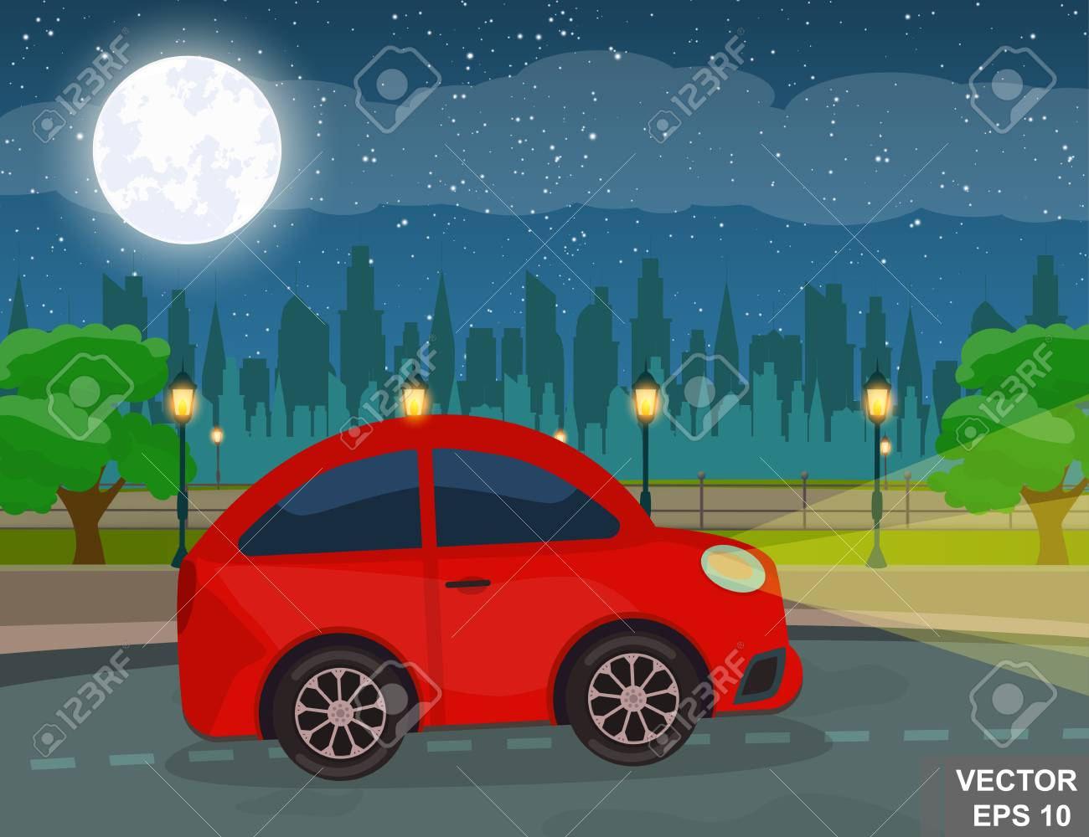
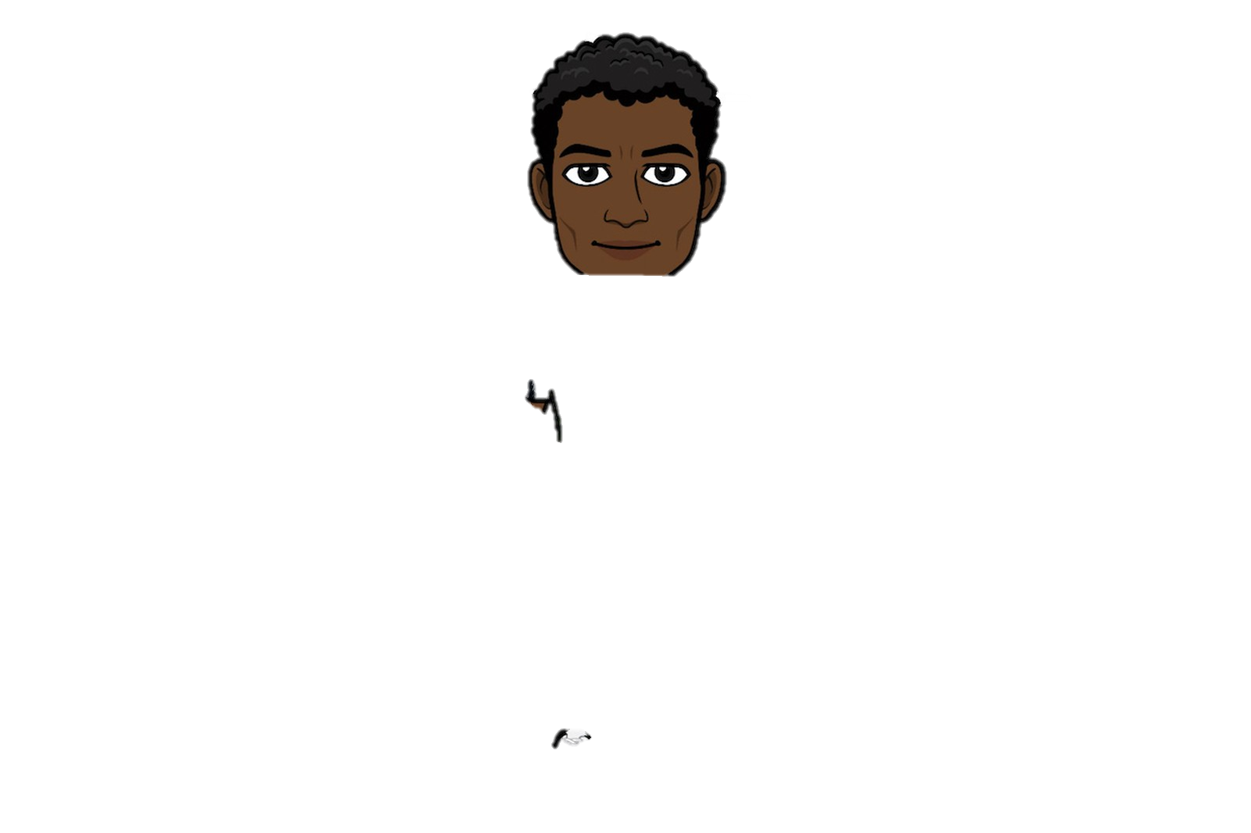
I heard you’ve been getting into drug dealing, is that true?
Bro I have to do something for my family to survive and you know their aint no jobs around here.
My daddy can just give you a job at the store!
Yea I could, but it don’t pay enough, I got bills man.

Slide 5
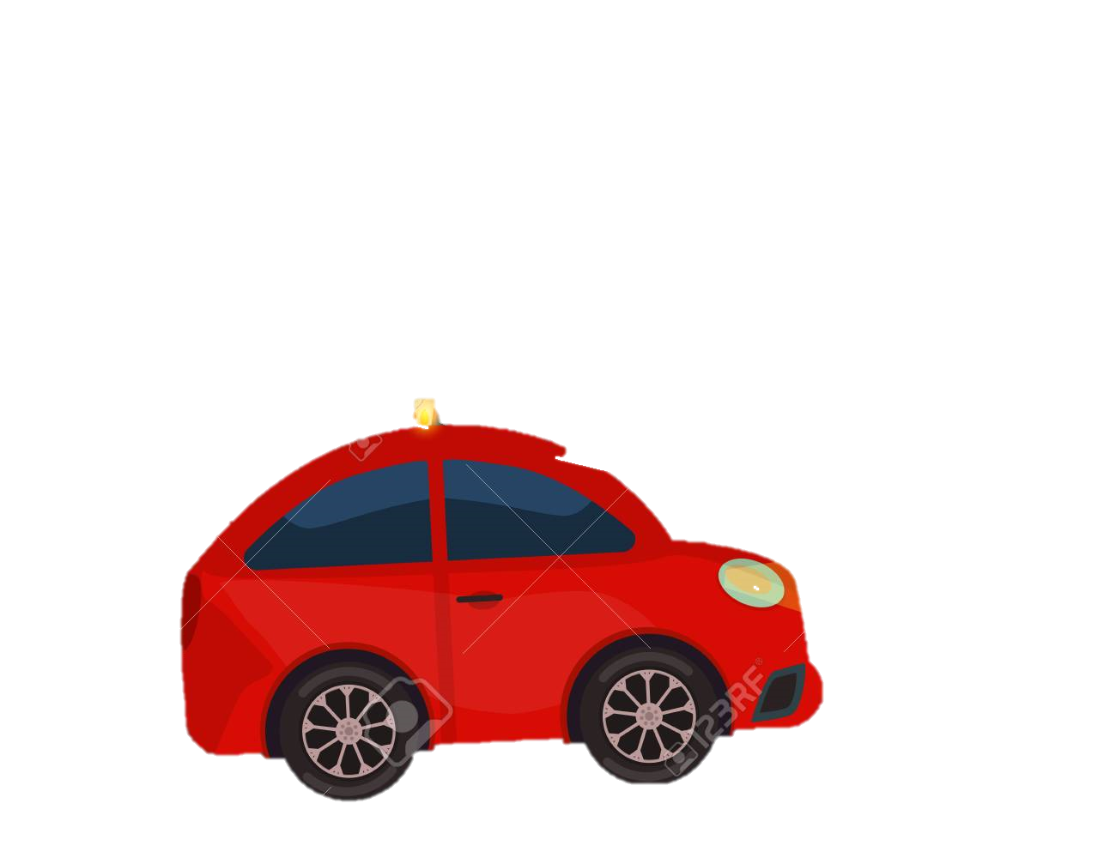
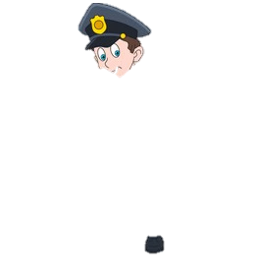
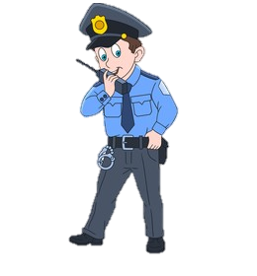
Officer 115 pulls over Khalil and Starr who kills Khalil.
Man, what they pulling us over for?
Don’t do anything stupid I beg of you.
This car looks suspicious!

Slide 6
Man, what did I even do
Get out tha car man, right now!
Stay here don’t do anything dumb.
Lemme check his stuff real quick.
Ima ask what I did wrong, be right back.
NO!

Slide 7
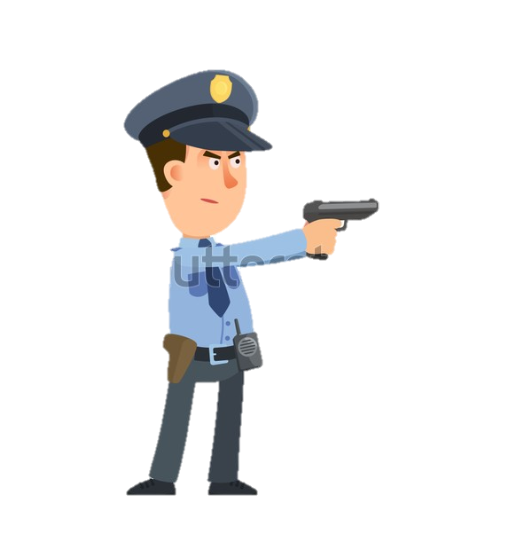
HEY GET BACK!
Man what did I do wrong?
Khalil, what are you doing !?!
HANDS UP LADY!
NO! KHALIL

Slide 8
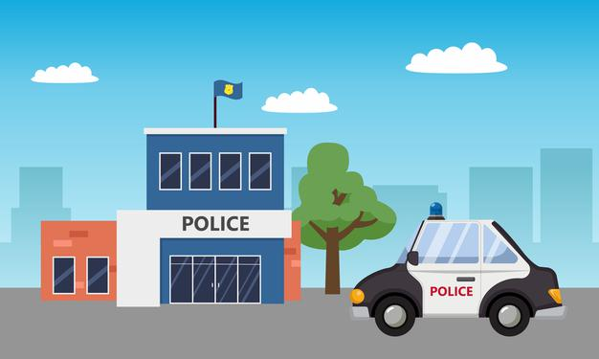
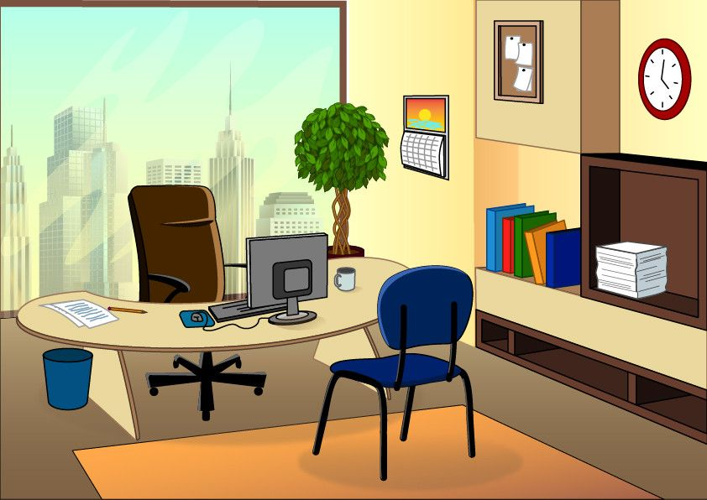
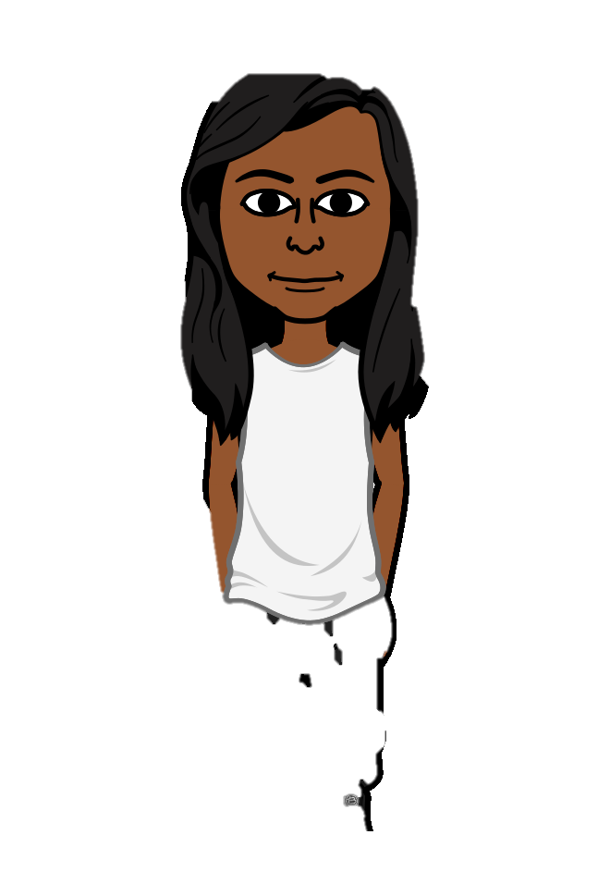
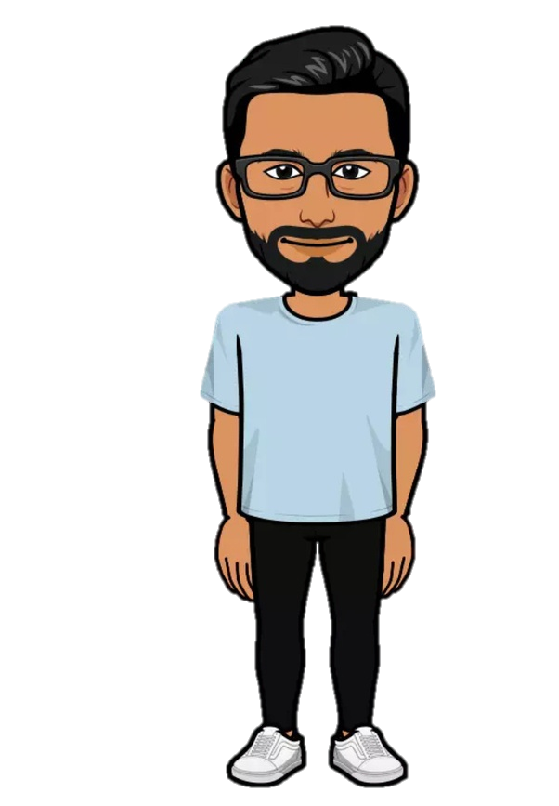
Starr gives her statement to the police.
I was in the car, when he died, when officer 115 murdered him.
Where were you the night of Khalil’s death?
Be calm in there and speak the truth.
Starr, follow me!
Just for details, if you cant handle this at the moment we can do it later if you would like?
I think that’s all I can say at the moment.
Okay and did Khalil have any drugs or guns on him at the time?
No, why would you ask that?

Slide 9
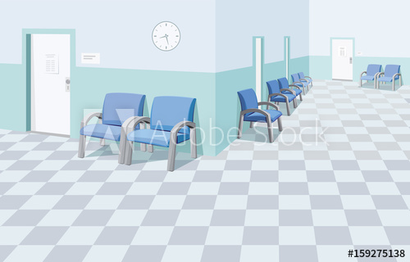
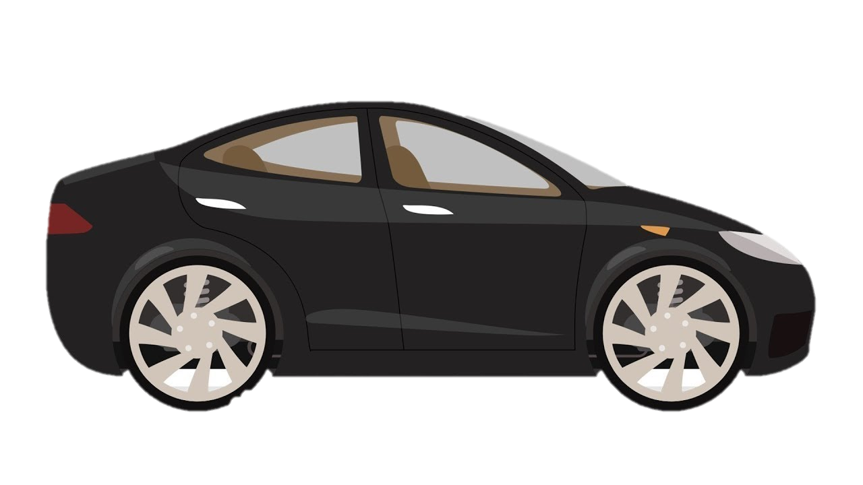
Ok no more questions.
How did it go?
Lets go please.

Slide 10
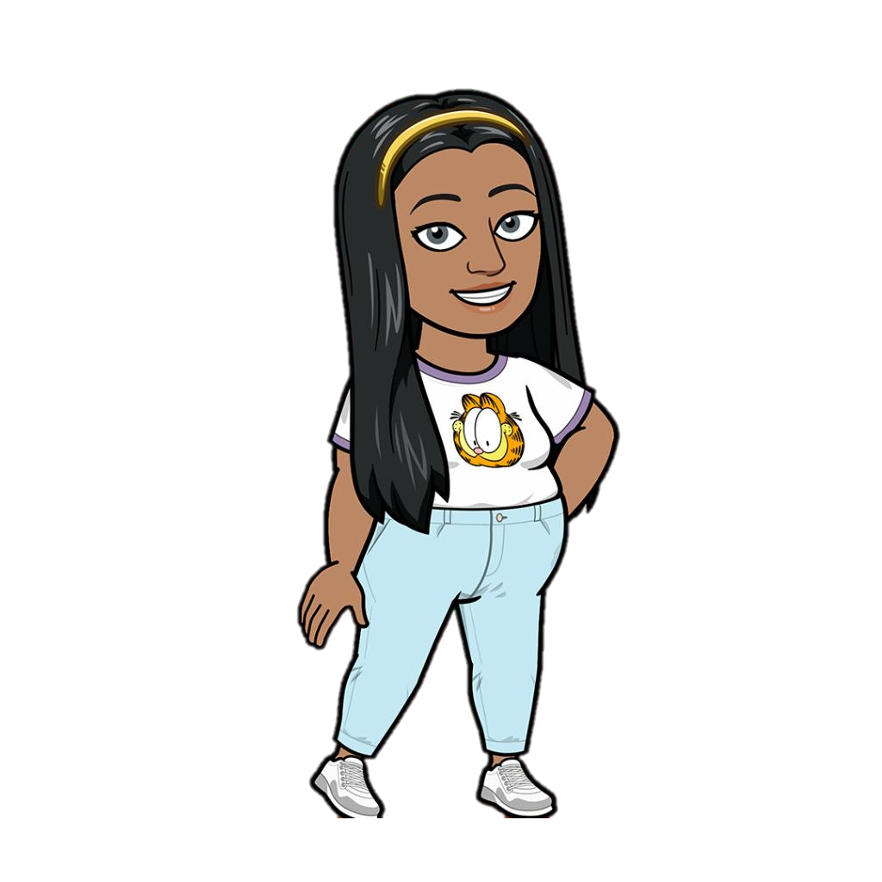
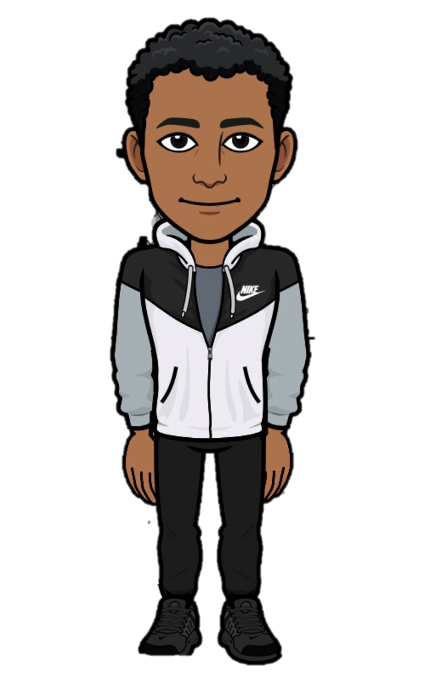
Riots about Khalil’s death.
Black Lives Matter!
Lets go riot for Khalil!
Black Lives Matter!
Black Lives Matter!
Should we go back because of the tear gas? It’s getting in my eyes
Yea, I agree, but where else do we go to?
Lets go back to the store!

Slide 11
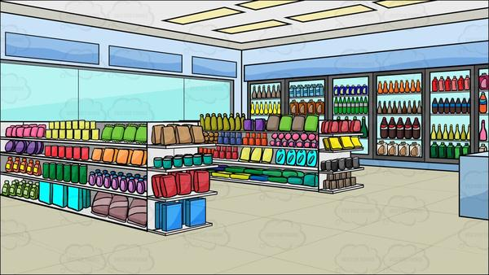
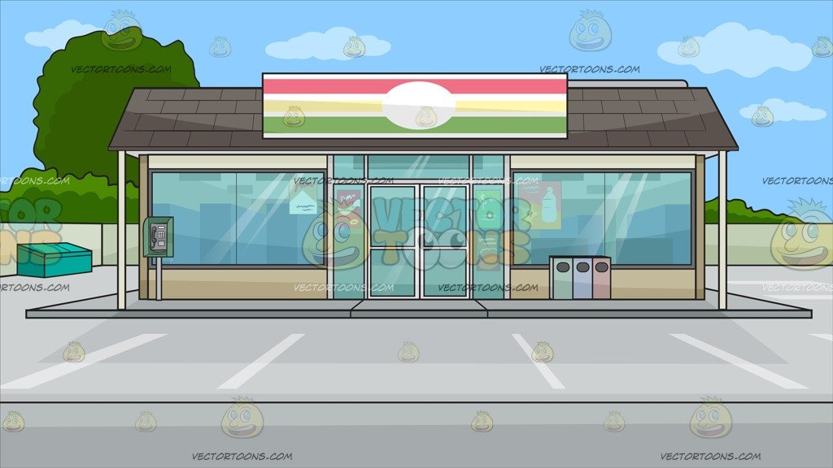
King burns Big Mavs house.
It smells like smoke.
Do you smell that?
Yea.
HURRY GET OUT!
RUN!
Who did this?
It must have been King.

