Slide 1
Trench Warfare
Socials 10 WWI Unit

Slide 2
Oh the Good ol’ Days…

Slide 3
WWI would be different…

Slide 4
The western front

Slide 5
schlieffen plan

Slide 6
Stalemate
German army dug trenches on Western Front (France)
Allies could not defeat strong defences so they dug trenches too.
Germans held high ground, best positions leaving British troops in poor conditions (nice and moist)
Neither force could advance, neither would retreat. It became a Battle of Attrition (whoever can last the longest)

Slide 7
Parapet (Front) and Parados (rear) heavily sandbagged to absorb bullets and shrapnel
6-8 feet deep, 6 feet wide

Slide 8
Zig-zag design
Trenches were not straight
Why?
Complex network, 200-500 yards
Communications trenches to transport troops, messages.

Slide 9
No mans land
Area between trenches
Ranged from 10-1000 yards depending on battlefield
Barb wire, corpses, craters, water, mud, bullets, bombs, gas

Slide 10
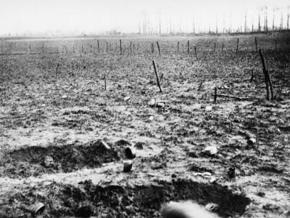
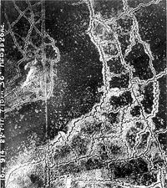

Slide 11
Conditions
Drainage problems
Water, feces/urine, blood, bodies lingered in trenches
Unsanitary conditions caused dysentery, typhus, cholera
Trench foot and mouth
Infections
Parasites
Exposure
Winter – Sub-zero temperatures, snow
Summer – Heat + dead bodies = ?!
Spring/Fall – Rain, mud, flooding

Slide 12
Trench foot
Wet socks/shoes for extended periods of time
Feet went gangrene after time, swollen, infected

Slide 13
Trench foot
Loss of toes, feet

Slide 14
I hate rats…
Fed off dead (or live…) bodies, food which littered trenches
Could have 800+ offspring per year
Would burrow inside corpses, eat eyes
Could steal food from soldiers

Slide 15
Lice infestations
Tightly packed, dirty conditions in trenches led to Lice infestations
Soldiers had bathes only once or twice per month, clothing worn for days or weeks.
Lice caused trench fever – headaches, rashes, shooting leg pains, high fever, could takes weeks to go away.

Slide 16
German soldiers
Searching their clothing for lice

Slide 17
Shell shock
Symptoms:
Fatigue, irritability, giddiness, lack of concentration.
Could lead to mental breakdowns making it impossible for them to remain on the front line.
Some doctors felt the cure for shell-shock was complete rest away from the fighting
Army unsympathetic to ordinary soldiers
Some senior officers believed these men were cowards, as did many back at home
Though many officers were given extended leaves

Slide 18
Shell Shock

Slide 19
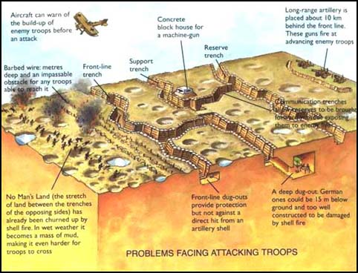
Trench design

