Slide 1
French Canadian Nationalism
French Canadian Viewed Confederation as a concern, because they thought it was an agreement that guaranteed the equality of English and French across Canada.
More and more English immigrants arrived, their concern became bigger.

Slide 2
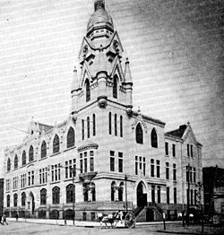
French Canadian Nationalism
Biculturalism
Canada was originally a Bicultural country, but the biculturalism is disappearing.
Ex: In 1871, New Brunswick decided to not support Roman Catholic schools and they ignored French Acadian people’s objections.
In 1891, Manitoba voted to replace its dual school system, they would only support English schools.

Slide 3
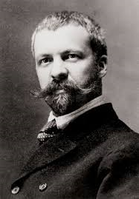
French Canadian Nationalism
Henri Bourassa
He was the journalist for the Liberal Party, then became a Member of Parliament.
He wanted biculturalism, and make the French and English culture equal.
He was against the immigration policy of the Liberal, which was bias for the English.
He was also against the railway because it brought too many English people.

Slide 4
French Canadian Nationalism
Manitoba School Question
controversy
The first controversy involving biculturalism was Manitoba School Questions.
In 1870, there were French-speaking people in Manitoba. Schools were Roman Catholic Schools with a subsidy from the HBC.
As English immigrants got more in Manitoba, the government voted to not support Roman catholic schools anymore.
English people’s idea was that one system would save money because they could pay less taxes. There were more English people in Canada, if these people went to French schools, they wouldn’t fit there.
French people’s opinion was that the BNA act stated that no provincial government can change denominational schools. The idea of having only one school system was against the law of Manitoba. It’s also important for French Roman Catholic children to attend school with same kind of people.

