Slide 1
Digital Literacy
By Seojin choi
This Photo by Unknown author is licensed under CC BY-SA-NC.

Slide 2
Define, in your own words, the term Digital Literacy
This Photo by Unknown author is licensed under CC BY-NC-ND.
This Photo by Unknown author is licensed under CC BY-SA.

Slide 3
Define, in your own words, the meaning of digital skills
This Photo by Unknown Author is licensed under CC BY-SA-NC

Slide 4
Explain how digital literacy differs from digital skills
This Photo by Unknown Author is licensed under CC BY-SA
This Photo by Unknown Author is licensed under CC BY-ND

Slide 5
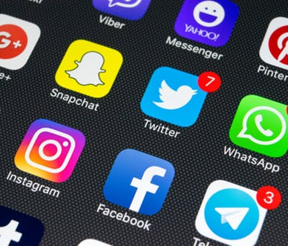
3 skills I feel like I’ve developed over the course of the year
This Photo by Unknown Author is licensed under CC BY-SA-NC

Slide 6
Why are both digital skills and digital literacy important in today’s educational environment
This Photo by Unknown Author is licensed under CC BY-SA

Slide 7
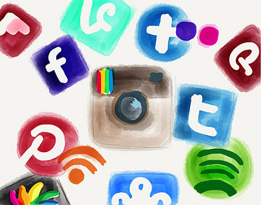
3 ways I will look to enhance my digital footprint next year
This Photo by Unknown Author is licensed under CC BY-SA-NC

