Slide 1
The Single Step Eye
By Sophia & Melia

Slide 2
Our Product
Our product was designed as a way to make getting ready in the morning slightly easier. It is similar to your average eyelash curler, except we replaced the rubber strip used to press against your lashes with a strip of a cosmetic sponge that has been soaked in a mascara formula. The Single Step Eyes eyelash curler will allow you to curl your lashes and apply mascara at the same time.

Slide 3
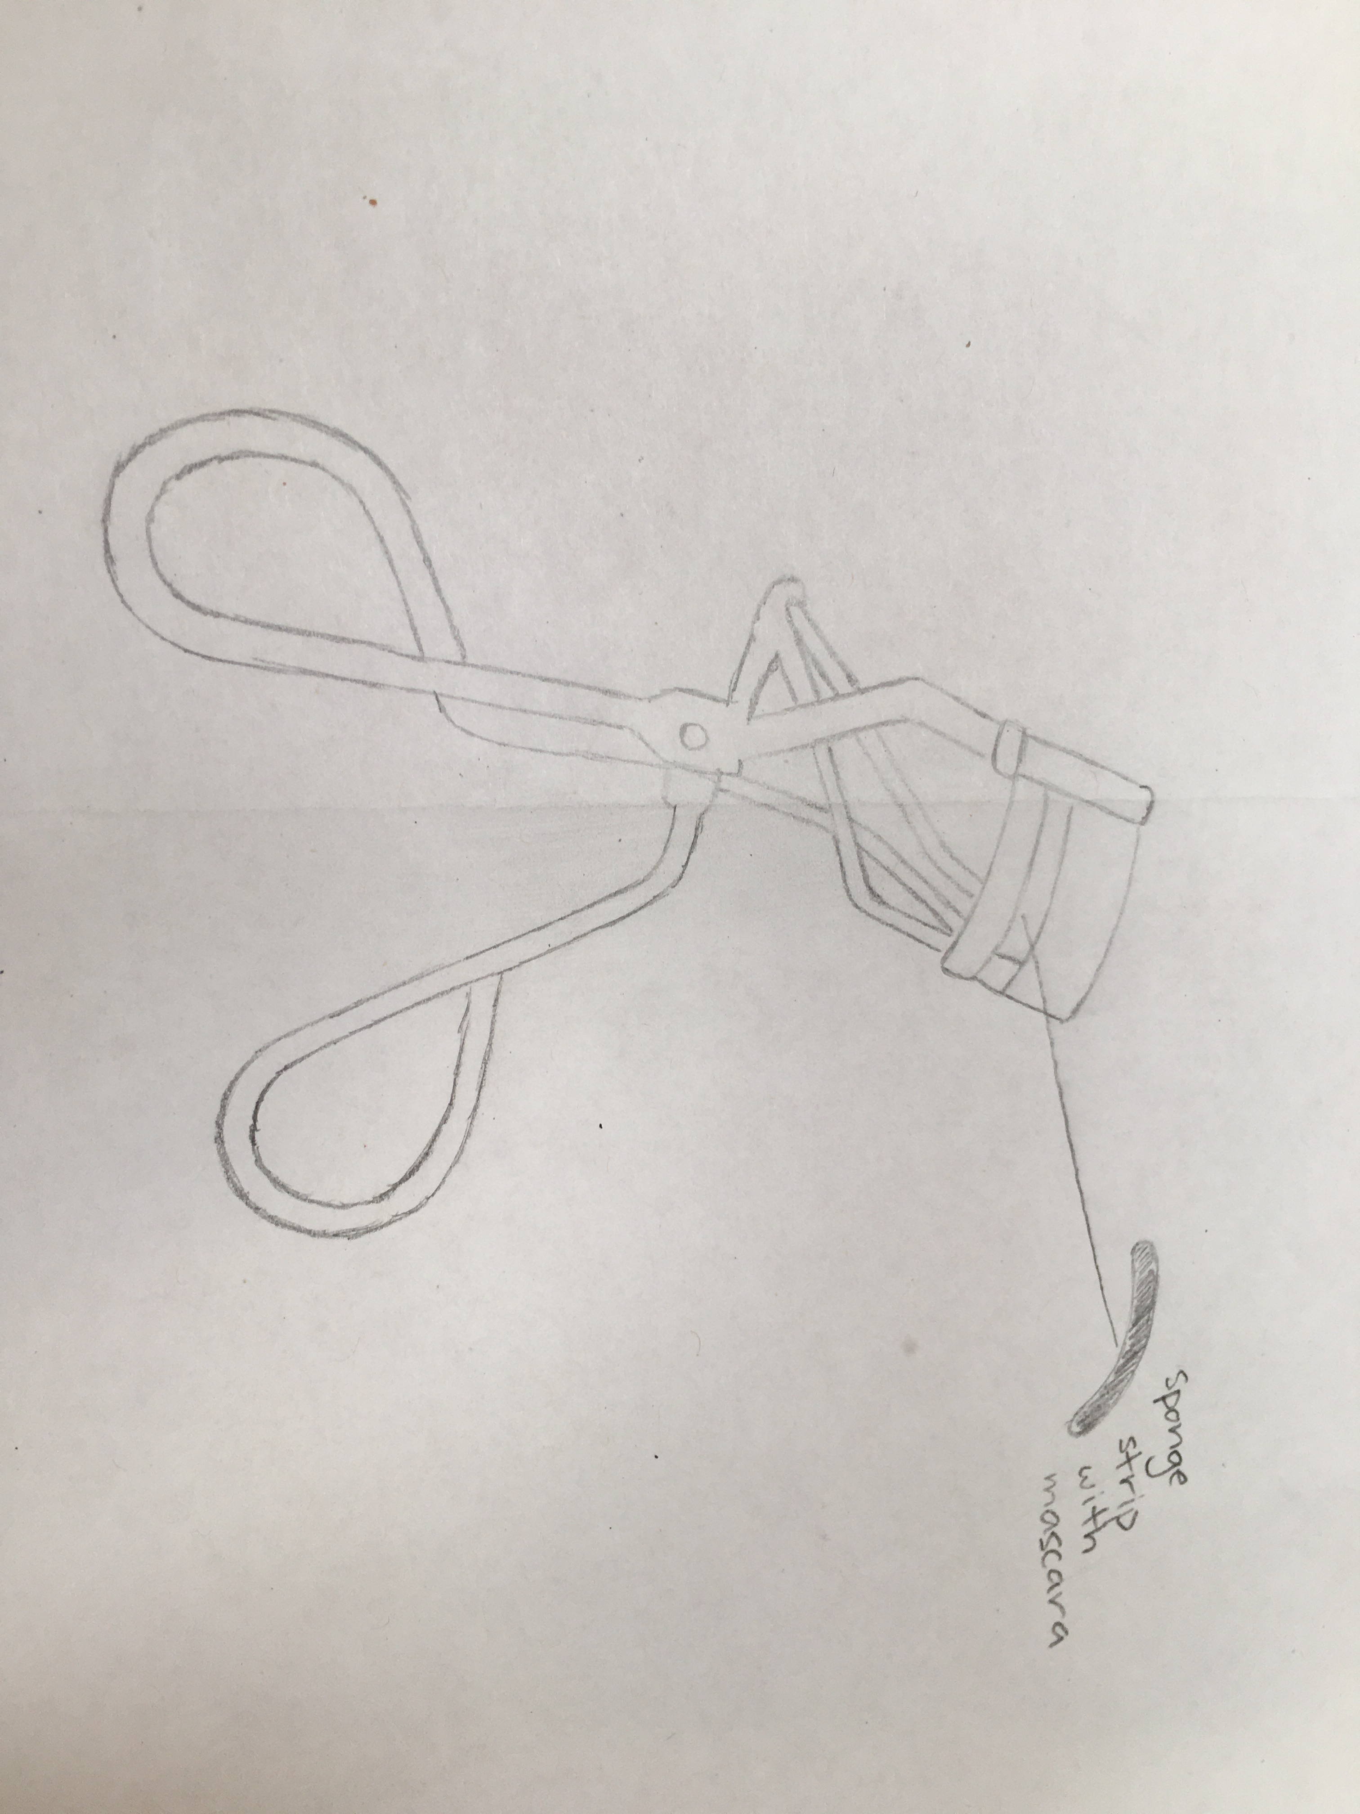

Slide 4
Materials
Eyelash curler
Mascara
Cosmetic sponge
Contact solution

Slide 5
Cost to Make $ price
Eyelash curler ~$5.00
Mascara - ~$10.00
Cosmetic sponge - ~$3.00 /3pc
Contact solution - ~$10.00 /2 bottles
Total - ~$5.00 /each
We are charging $10.00 /each

Slide 6
Size & Time
Height - 9.5cm
Width - 7cm
Approximately 15-20 minutes

Slide 7
Triple Bottom Line
People – The audience we are targeting are females or anyone who enjoys using makeup (mascara).
Planet – Our product doesn’t majorly effect the environment. It doesn’t exactly negatively impact it, as in there won’t really be any change. It is still however, not helping the environment.
Profit – We intend to charge our customers $10.00 for one Single Step Eye. It will cost approximately $5.00 to make one, meaning that our profit will be $5.00 for each curler we sell.

