Slide 1
Digital Literacy: Scavenger Hunt
By Vania Alijani

Slide 2
Section A: Guess Who?
Teachers:
Mr. R
Mr. B
Ms. K

Slide 3
Section B: Solve The Riddle
Oh what Am I?
And where can I be found?
Here’s a little Office hint and 365 countdown,
I am part of your district student accounts
And have many apps and tools abound!!!!
The answer to this riddle is Office365. It has a lot of apps and resources to use and it is part of our district accounts.

Slide 4
Section C: Food Recipe Theatre
This is my favorite French fry's recipe. The twist in the recipe is all the spices the cook puts on at the end. The recipe name is "How to Make Crispy French Fries Recipe | Homemade Perfect French Fries Recipe" and the cook is Varun Inamdar. You can find this recipe using the link (In my work cited slide) or on their channel, "Rajshri Food".

Slide 5
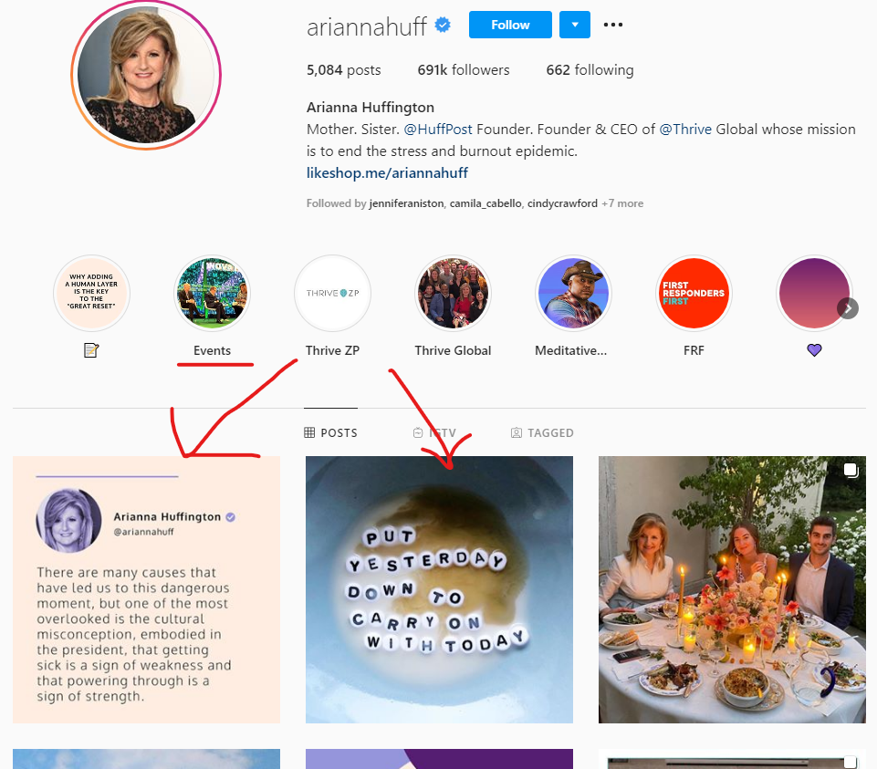
Section D: Hit the Post!
The blogger I chose was Arianna Huffington. I posted her instagram page, because as you can see (The red arrows) she has a lot of inspirational quotes posted and saved. She has a blog called the Huffpost (https://www.huffpost.com/) which is very inpirational and contains a lot of knowledge about real world events. I like her a lot because she and her blog were the things I looked to when wanting to hear news and events, especially during the pandemic.

Slide 6
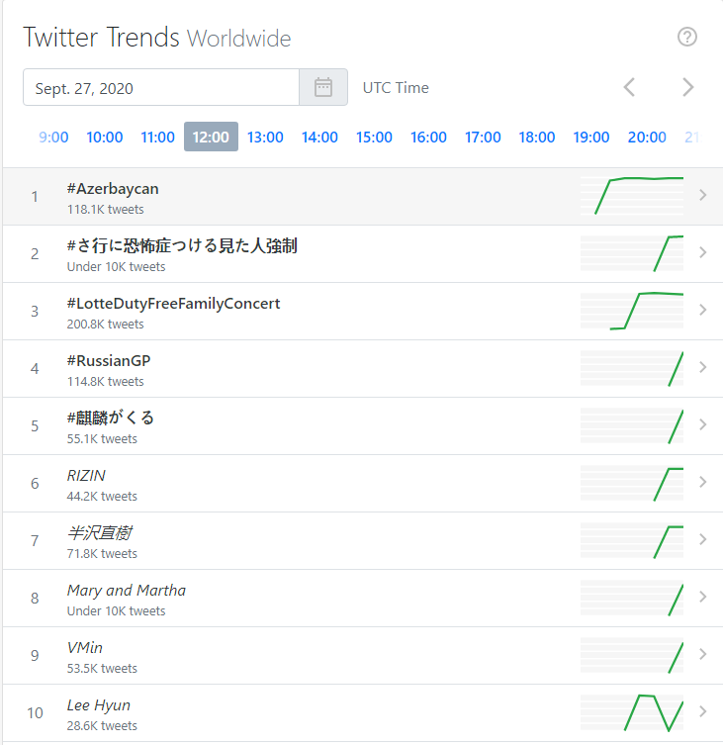
Section E: Hash -Tag -Your It
These are the trending hashtags on twitter this week.
1.twitter.com/search?q=%23azerbaycan&src=typed_query
2. twitter.com/search?q=%23%E3%81%95%E8%A1%8C%E3%81%AB%E6%81%90%E6%80%96%E7%97%87%E3%81%A4%E3%81%91%E3%82%8B%E8%A6%8B%E3%81%9F%E4%BA%BA%E5%BC%B7%E5%88%B6&src=typed_query
3. twitter.com/search?q=%20%20%23LotteDutyFreeFamilyConcert&src=typed_query
4. twitter.com/search?q=%23RussianGP&src=typed_query
5. twitter.com/search?q=%23%E9%BA%92%E9%BA%9F%E3%81%8C%E3%81%8F%E3%82%8B&src=typed_query
6. twitter.com/search?q=RIZIN&src=typed_query
7. twitter.com/search?q=%E5%8D%8A%E6%B2%A2%E7%9B%B4%E6%A8%B9%20&src=typed_query
8. twitter.com/search?q=Mary%20and%20Martha&src=typed_query
9. twitter.com/search?q=VMin&src=typed_query
10. twitter.com/search?q=Lee%20Hyun&src=typed_query

Slide 7
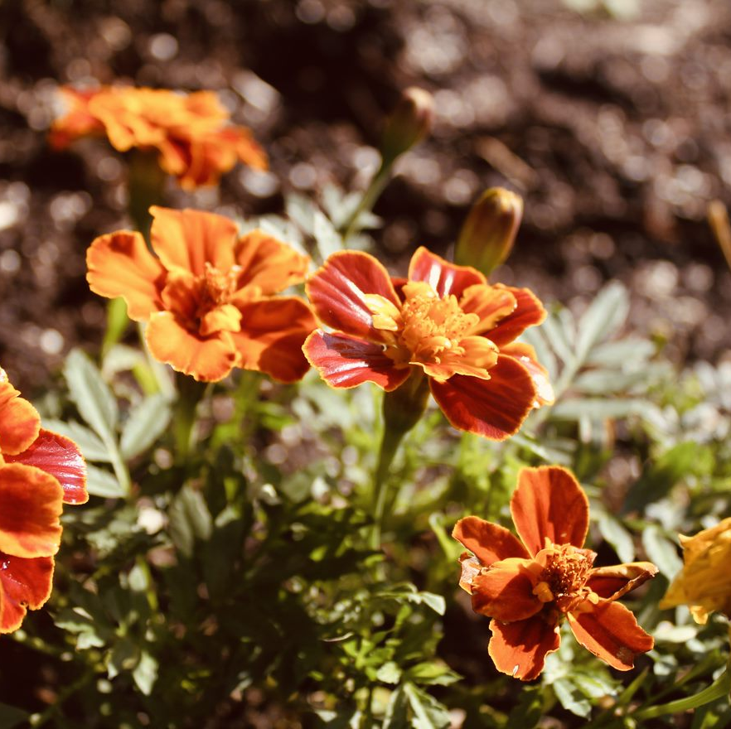
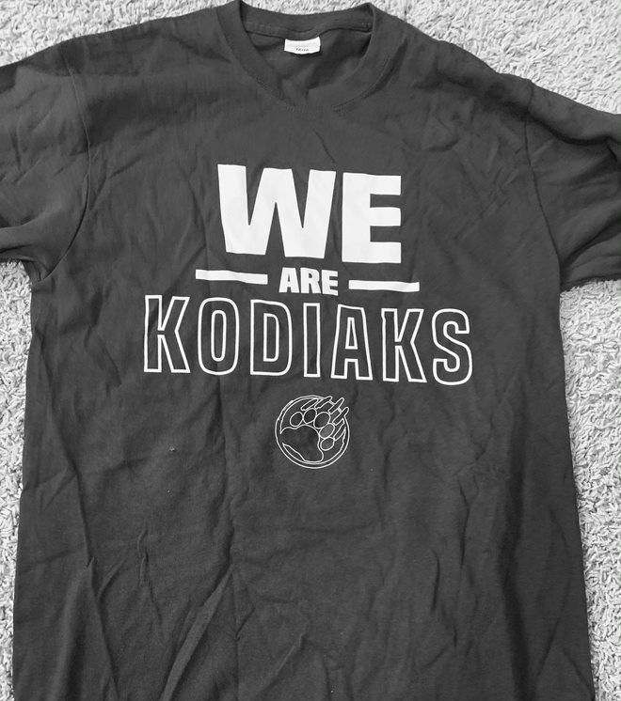
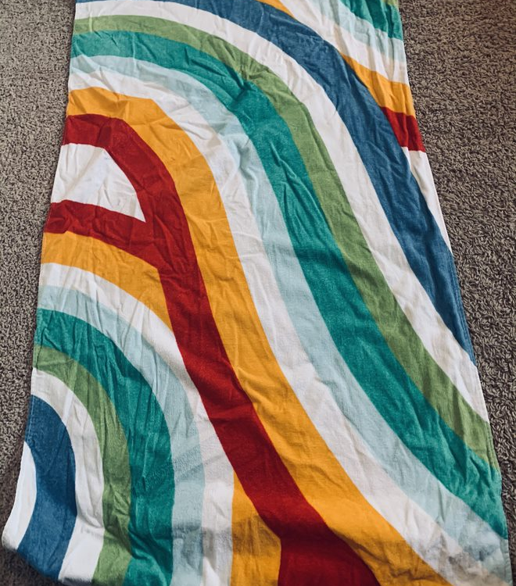
Section F: Its Photo Time!
I used my phone to take and edit these photos. The photo of nature was taken outside in the forest. The black and white photo is the Kodiak shirt and paws. The abstract photo is my beach towel which has a lot of colours.

Slide 8
Section G: What’s the Word
I picked this wordle because I like the black and white or monochrome colours it has. It Has a lot of big and small words and it has a nice overall aesthtic.

Slide 9
Section H: It’s app time!
Snapchat
Instagram
Youtube
Tik Tok
WhatsApp
These are the apps most people, including me, have on their phone.

Slide 10
Section I: Coding is Cool!
Five common languages used in coding are Python, Javascript, Java, C# and C.

Slide 11
Section J: The Do’s and Don’ts of Digital Citizenship
Being a Digital Citizen
Don't share personal information online.
Use safe and strong passwords and make sure that a parent or teacher(If it is a school account) knows.
Don't plagerize and cite your sources
Don't agree to meet people online
Not everyone is who they say they are on the internet

Slide 12
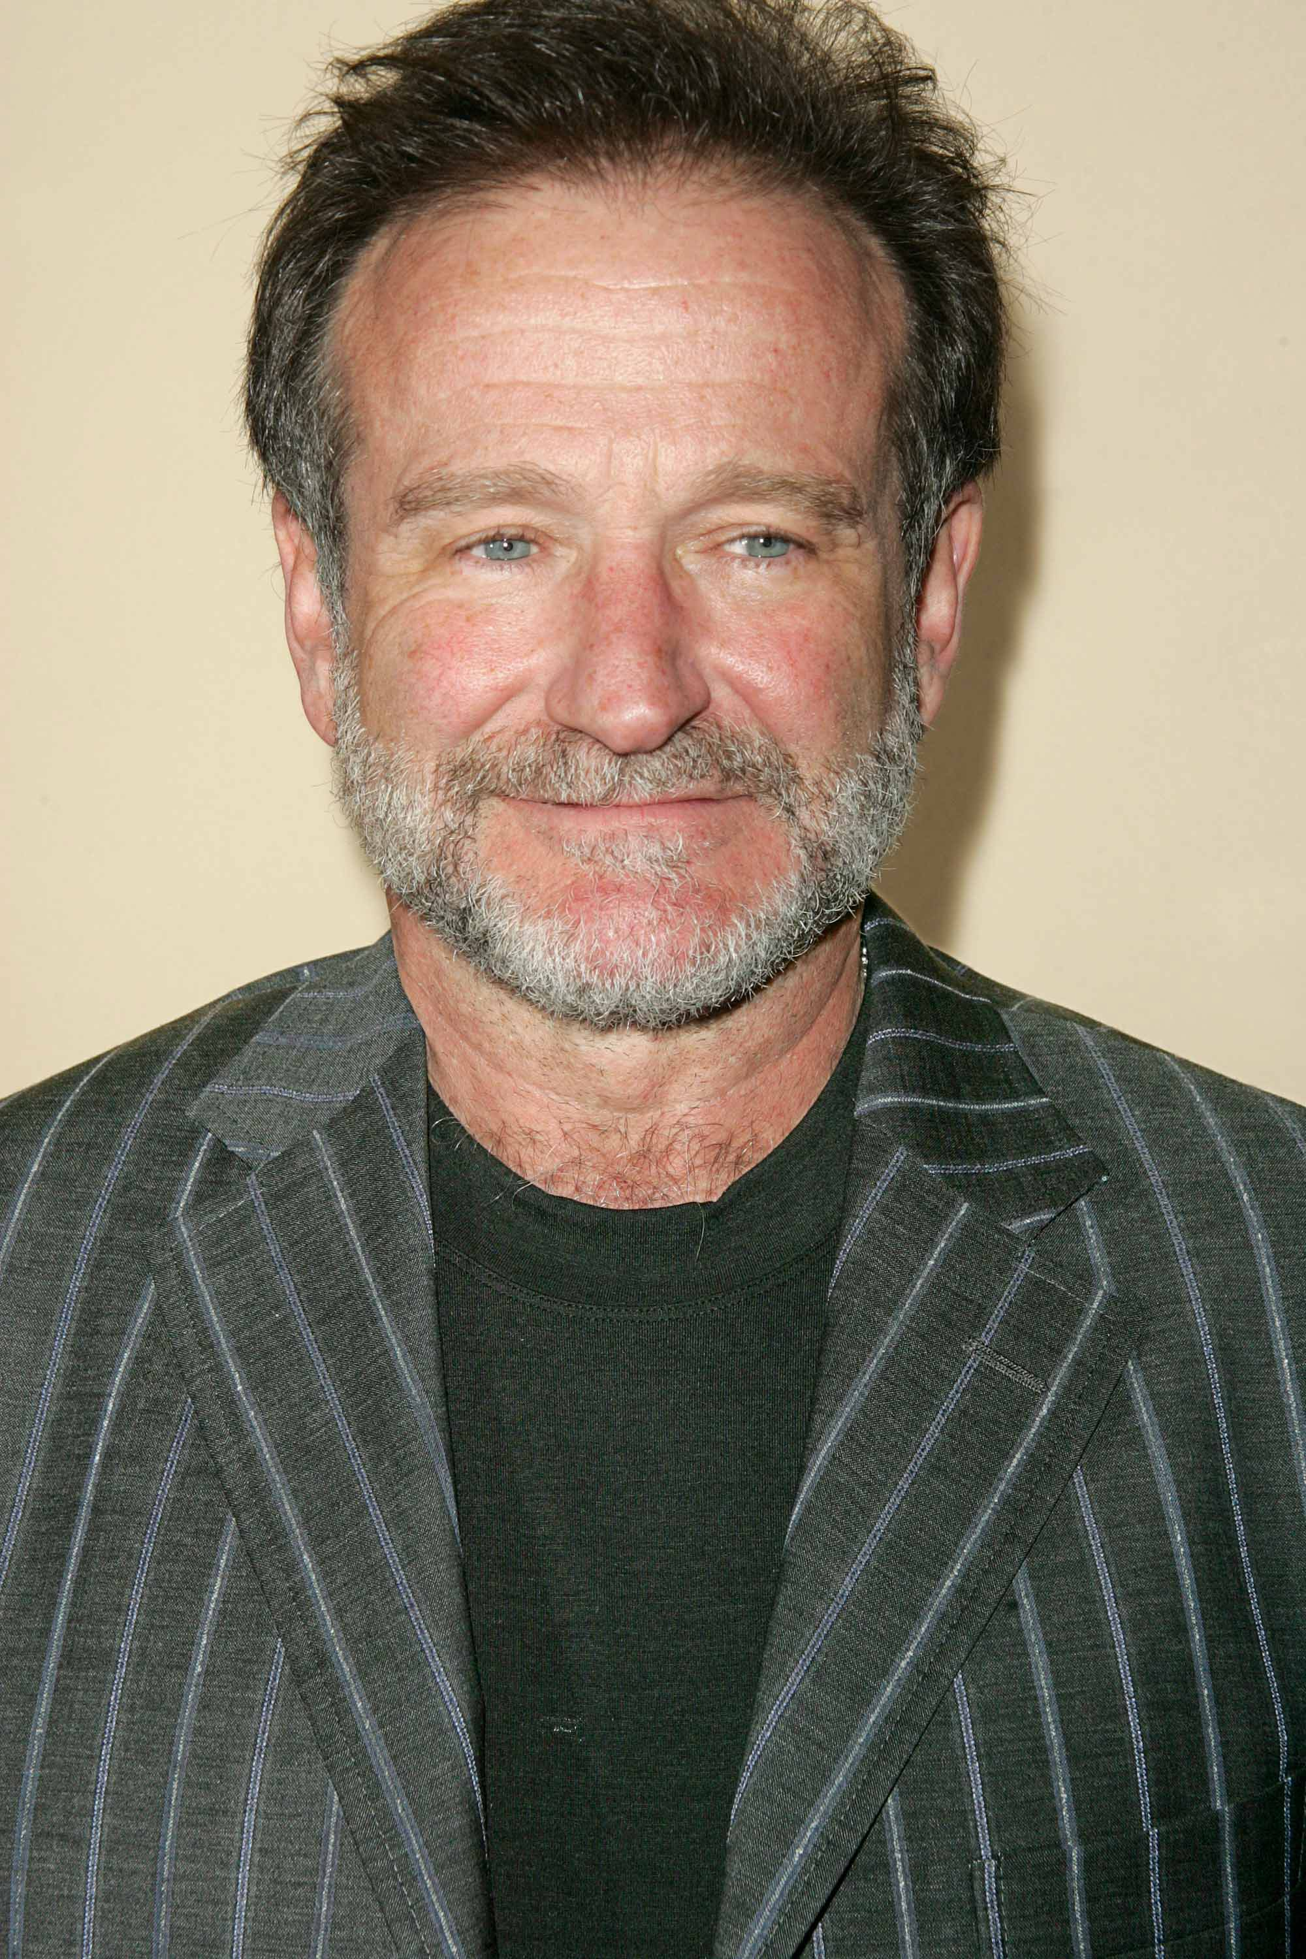
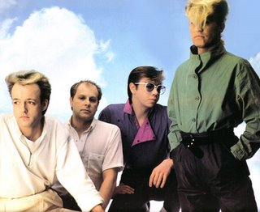
Section K: Digital Research For each of the following
The song is I Ran by A Flock Of Seagulls.
The image is of the worlds ugliest shark, the Goblin shark.
The poet that wrote this quote was Robin Williams.

Slide 13
Works cited:
Section A: Guess Who?, Cites/Apps used: emoji-maker.com/designer
Section C: Food Recipe Theatre, Cites/Apps used: youtu.be/8Lp8qXu5mvo
Section D: Hit the Post!, Cites/Apps used: huffpost.com/
instagram.com/ariannahuff/
Section E: Hash -Tag -Your It, Cites/Apps used: getdaytrends.com/2020-09-27/12/
twitter.com/
Section F: Its Photo Time!, Cites/Apps used: My photo album (In my phone)
Apple edit
Section G: What’s the Word, Cites/Apps used: clalliance.org/wp-content/uploads/files/doug-belshaw-edd-thesis-final.pdf
clalliance.org/
Section H: It’s app time!, Cites/Apps used: startuptalky.com/most-apps-downloaded/
Section I: Coding is Cool!, Cites/Apps used: youtu.be/j-3eArinB7E
youtu.be/Z1Yd7upQsXY
northeastern.edu/graduate/blog/most-popular-programming-languages/
Section J: The Do’s and Don’ts of Digital Citizenship, Cites/Apps used: naesp.org/principal-novemberdecember-2013-safe-positive-school-culture/safe-digital-citizenship
Section K: Digital Research For each of the following, Cites/Apps used: Shazam
Google.com/searchq=Carpe+diem!+Seize+the+day%2C+boys.+Make+your+lives+extraordinary.&oq=Carpe+diem!+Seize+the+day%2C+boys.+Make+your+lives+extraordinary.&aqs=chrome..69i57j0l6.1623j0j1&sourceid=chrome&ie=UTF-8
independent.co.uk/arts-entertainment/films/news/robin-williams-best-dead-poets-society-quotes-carpe-hear-it-carpe-carpe-diem-seize-day-boys-9663800.html
google.ca/imghp?hl=en&tab=ri&ogbl

