Slide 1
Digital Literacy 10 Scavenger Hunt
By Grace Jia

Slide 2
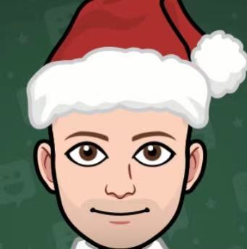
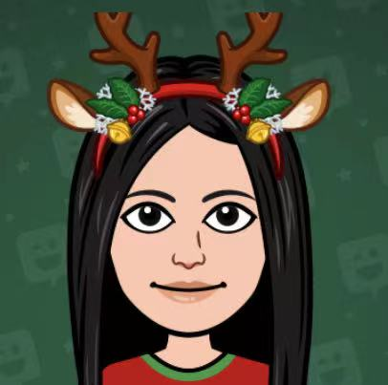
Section A: Guess Who?
Mr. Blake
Ms. Kim
Mr. Raghoobarsingh
https://www.bitmoji.com
I used this software to creat this three emojis

Slide 3
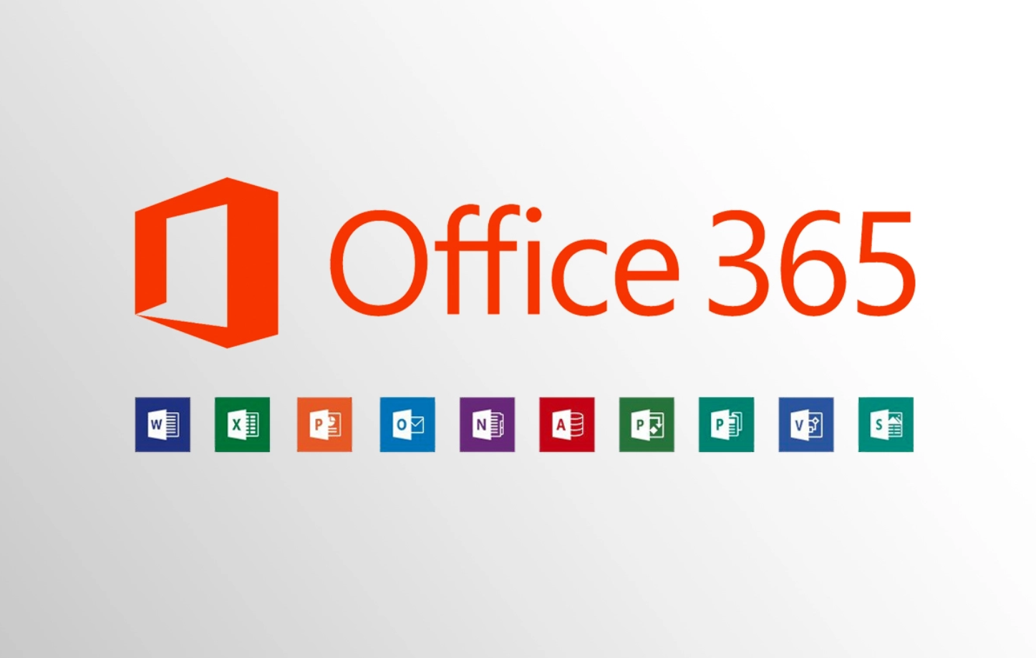
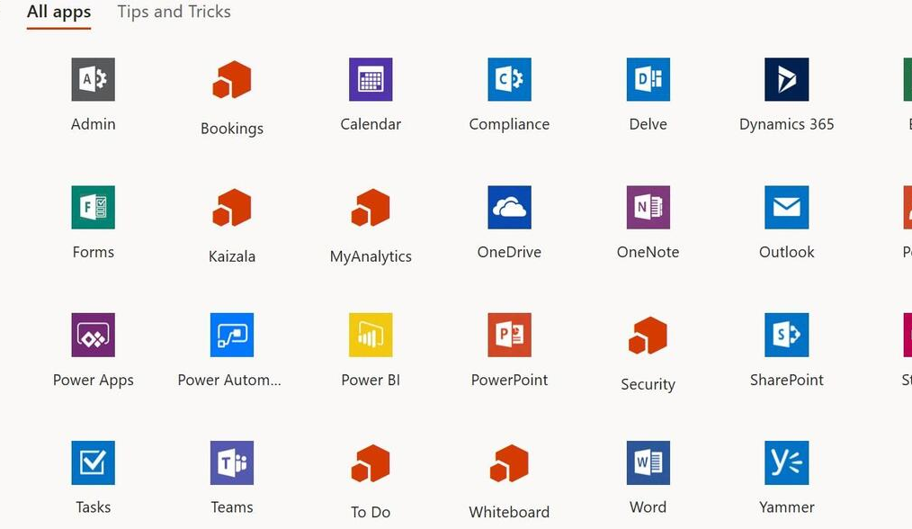
Section B: Solve the Riddle
Oh what Am I? And where can I be found? Here’s a little Office hint and 365 countdown, I am part of your district student accounts And have many apps and tools abound!!!!
Answer: I am Office 365 and I can be find in many website such us google.
Solution:
I started to have a little thought when I saw ''Here’s a little Office hint and 365 countdown’’, because the presence of Office and 365 definitely mean something.
After I saw ''I am part of your district student accounts And have many apps and tools abound'' and thought about the appearance of ‘’Office’’ and ‘’365’’, I fully understood.

Slide 4
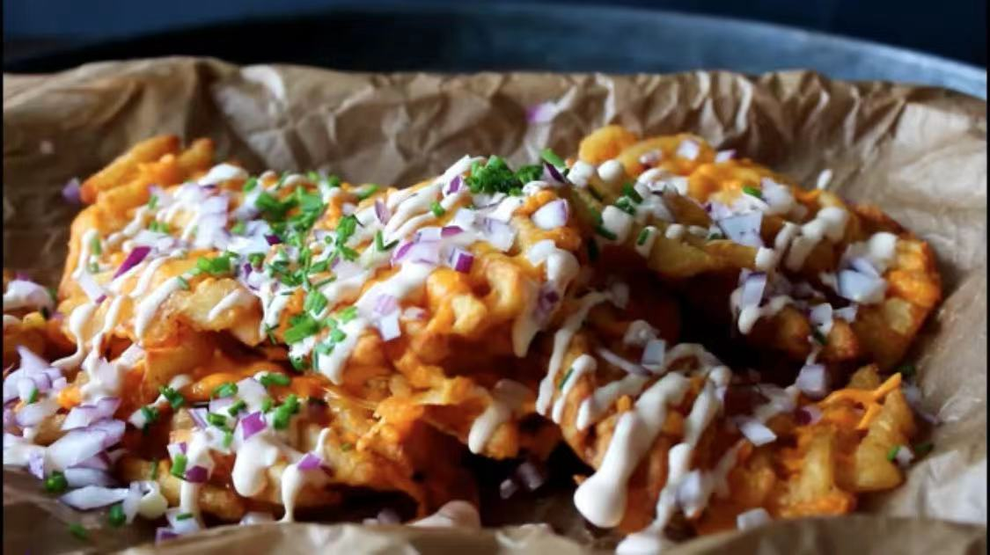
Section C: Food Recipe Theatre
Cheesy Waffle Fries
https://www.youtube.com/watch?v=KB61_WKg_uM Video Clip and the chef put the recipe below the video (top of the comment)
Cooking Site: One Kitchen – A Thousand ideas
Chef: Julia

Slide 5
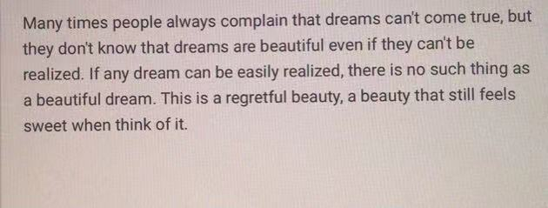
Section D: Hit the Post!
This post made me understand that there are always regrets in life. Just as not every river can flow into the sea, not every day is sunny. But it is also because of regret so that our lives are full of colour and romance. Feel every beauty in life don’t feel sad about regrets. ￼￼￼￼
Post: https://www.kuaishou.com

Slide 6
Section E: Hash-Tag-Your It
The most popular hashtags
1. #tiktok
2. #foryoupage
3. #fyp
4. #foryou
5. #viral
6. #love
7. #funny
8. #memes
9. #followme
10. #cute
Source: https://influencermarketinghub.com/top-tiktok-hashtags/

Slide 7
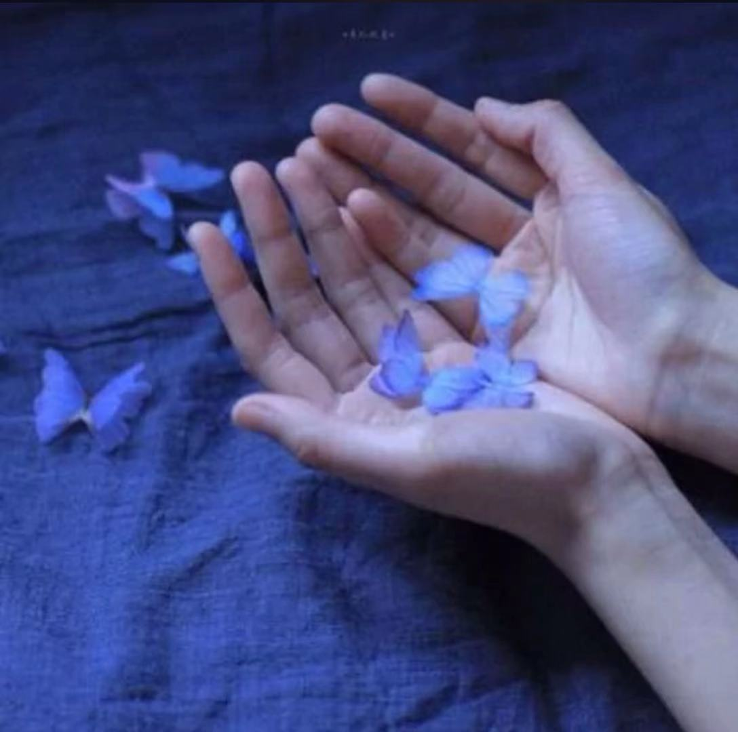
SECTION F: ITS PHOTO TIME!
Something wonderful and beautiful in nature
Something symbolic of the Kodiaks
Something Abstract

Slide 8
Section G: What’s the Word
Source:
https://esolmontanastudents.weebly.com/digital-literacy.html
This pattern is like putting knowledge together.

Slide 9
Section H: It’s app time!
1. TikTok 2. Zoom 3. WhatsApp 4. Facebook 5. Messenger

Slide 10
Section I: Coding is Cool!
Video: What is coding?
https://www.youtube.com/watch?v=j-3eArinB7E
#1: JavaScript
#2: Python
#3: Java
#4: PHP
#5: C#
Source: https://www.businessinsider.com/most-popular-programming-languages-github-2019-11#5-c-6
Coding game: https://www.codemonkey.com/?utm_campaign=cm_gs_a_br_ca&utm_source=google&utm_medium=cpc&utm_content=344740150035&utm_adgroup=codemonkey_em&utm_placement=&gclid=EAIaIQobChMIlrqEtp_A7QIVyxmtBh0RigRMEAAYASAAEgLln_D_BwE

Slide 11
Section J: The Do’s and Don’ts of Digital Citizenship

Slide 12
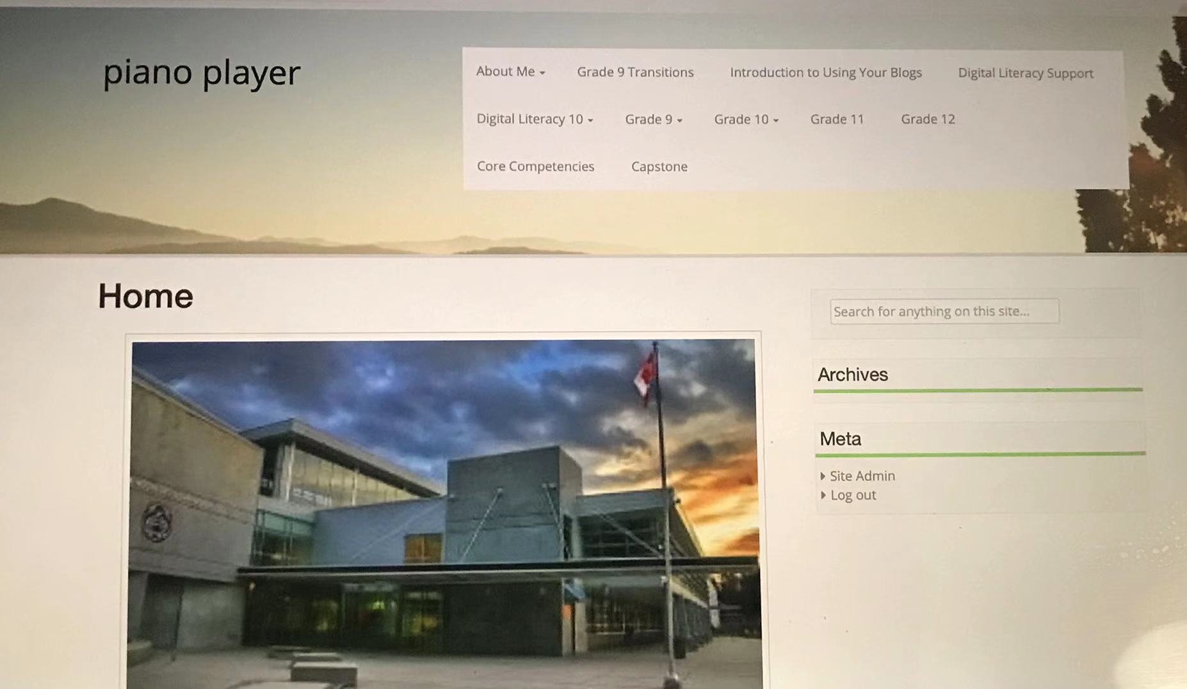
Section K: My Very Own EduBlog!

