Slide 1
Digital Literacy 10 Scavenger Hunt
By: Angel(YiQi) Zeng

Slide 2
Section A: Guess who?
Ms. Kim Mr. Blake Mr. Raghoobarsingh

Slide 3
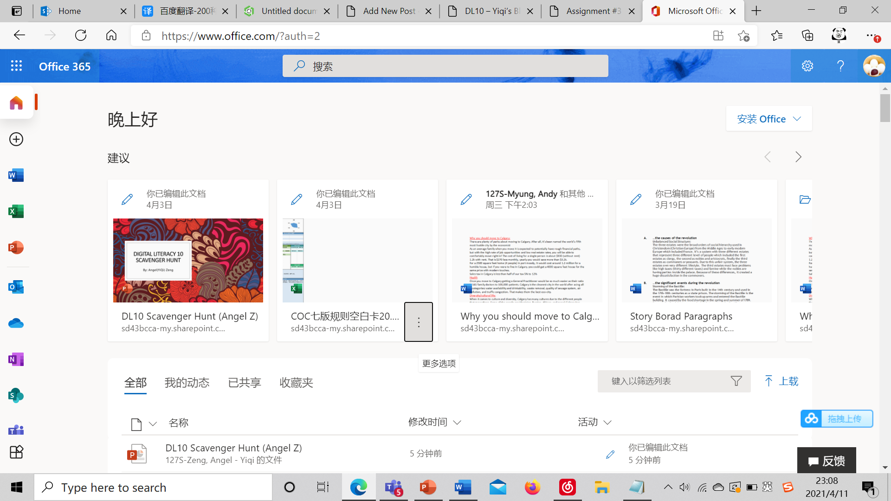
Section B: Solve the Riddle!
Oh, what am I?
And where can I be found?
Here’s a little Office hint and 365 count down.
I am part of your district student account
And have many apps and tools abound!!!!
Answer: Office 365

Slide 4
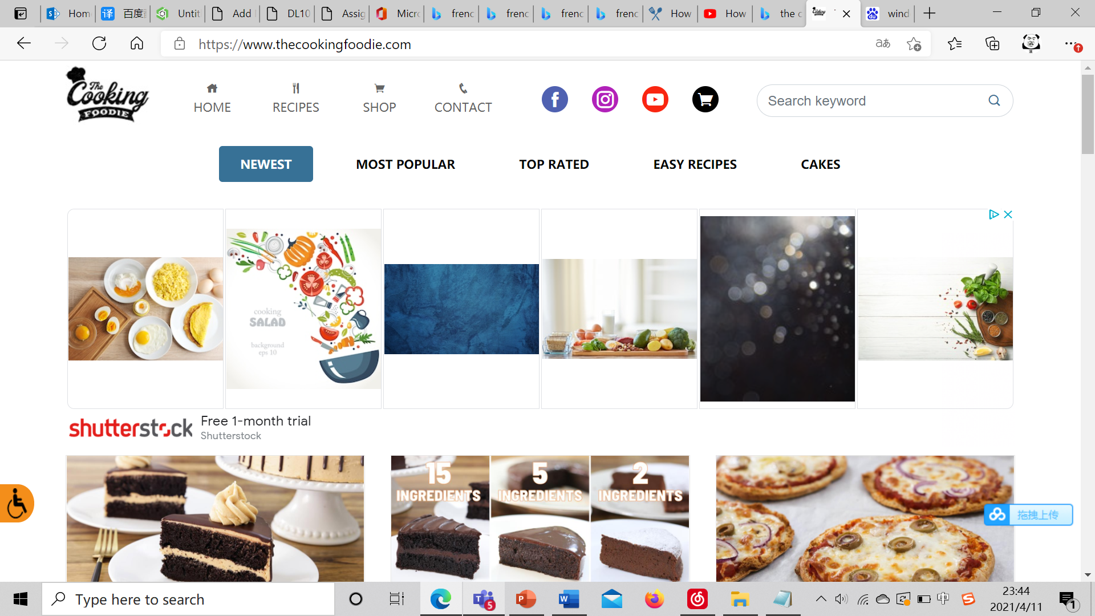
Section C: Food Recipe Theater
Recipe Name:
How to Make French Fries
Chief：
Unknown
Citation:
How to Make French Fries. (2020, May 24). Retrieved from https://www.thecookingfoodie.com/recipe/How-to-Make-French-fries--Best-French-Fries-Recipe

Slide 5
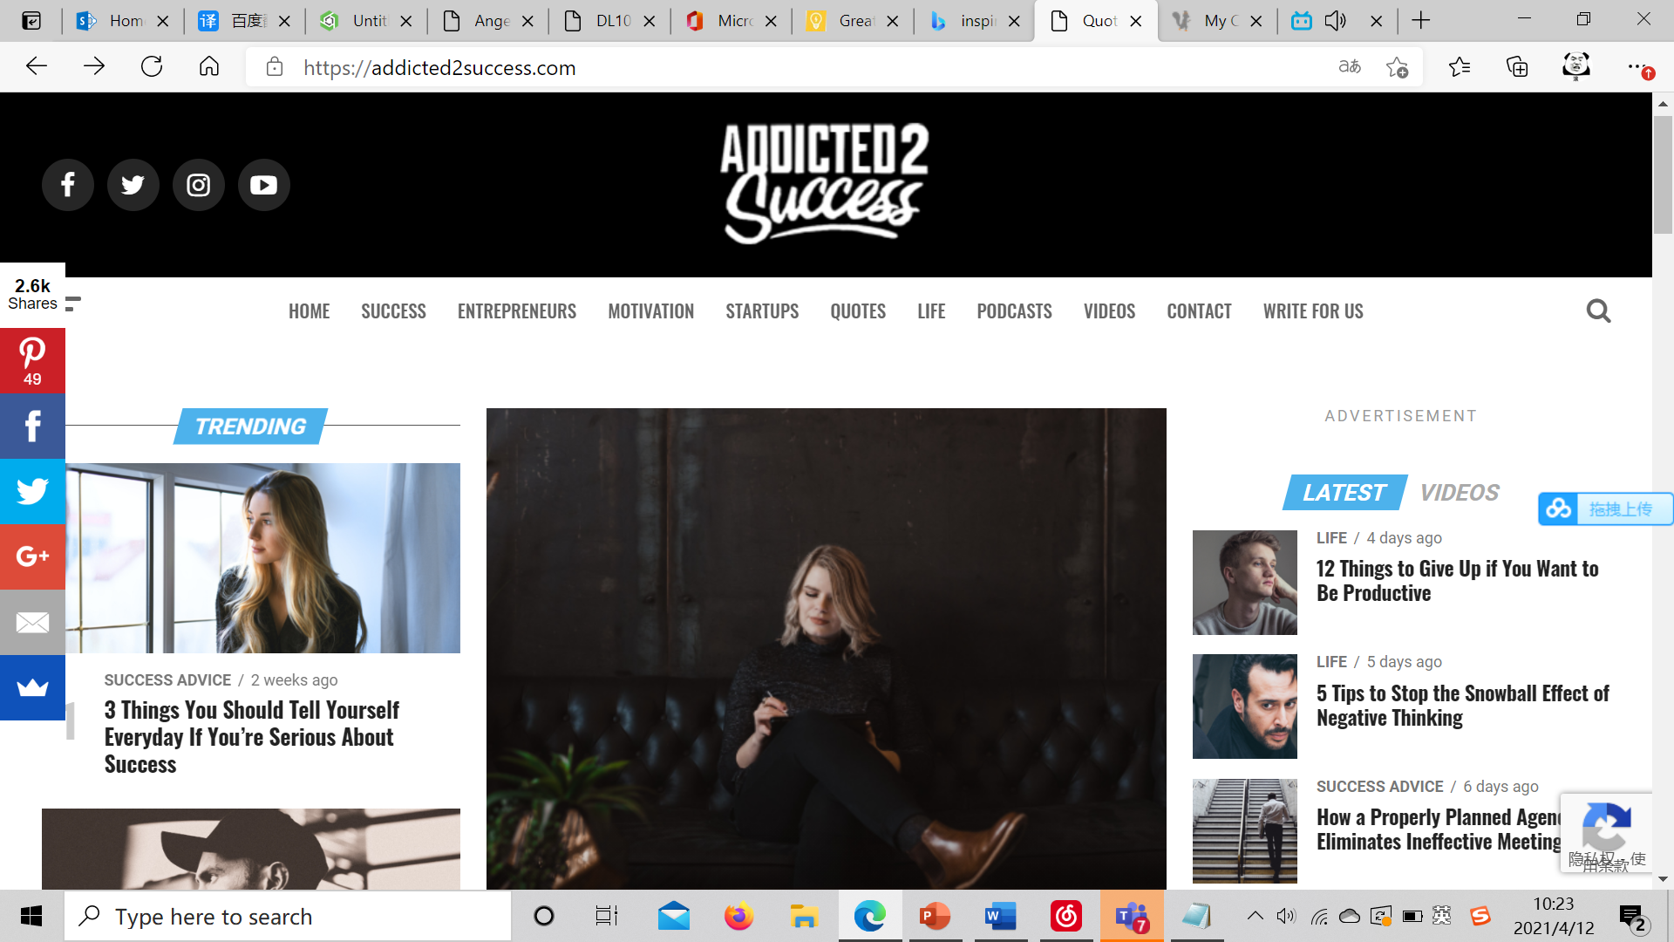
Section D: Hit the Post
Blog Name:
Addicted 2 Success
Blogger:
Joel Brown
Why Choose it:
I love how this blog is trying to express the importance of positive mindset to their readers.
Citation:
Brown, J. (2019). Addicted 2 Success. Retrieved from https://addicted2success.com/

Slide 6
Section E: Hash-Tag-It!
#Food
#Fashion
#Fitness
#Retail
#Travel
#Music
#Sports
#Entertainments
#Beauty and Makeup
#Lifestyle
Citation:
Aguiar, R. (2021, April 8). 140 Trending Instagram Hashtags In 2021. Retrieved from https://blog.kicksta.co/trending-instagram-hashtags/

Slide 7
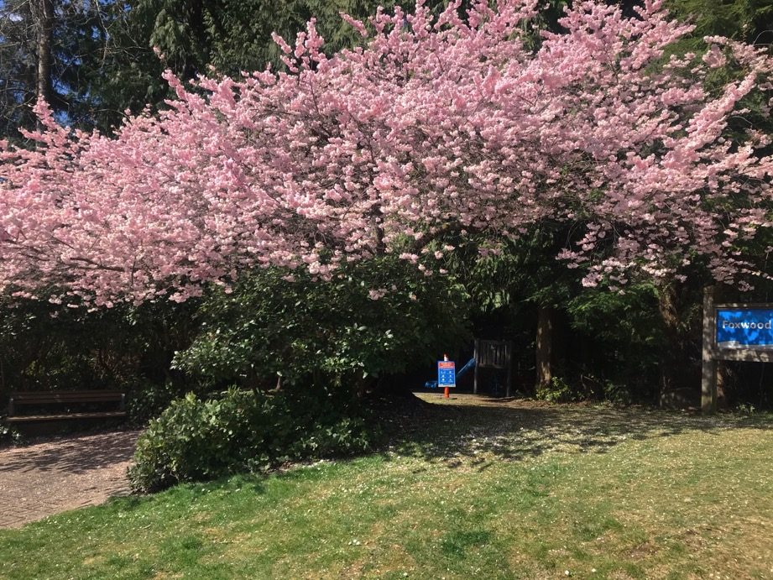
Section F: It’s Photo Time!! (1)

Slide 8
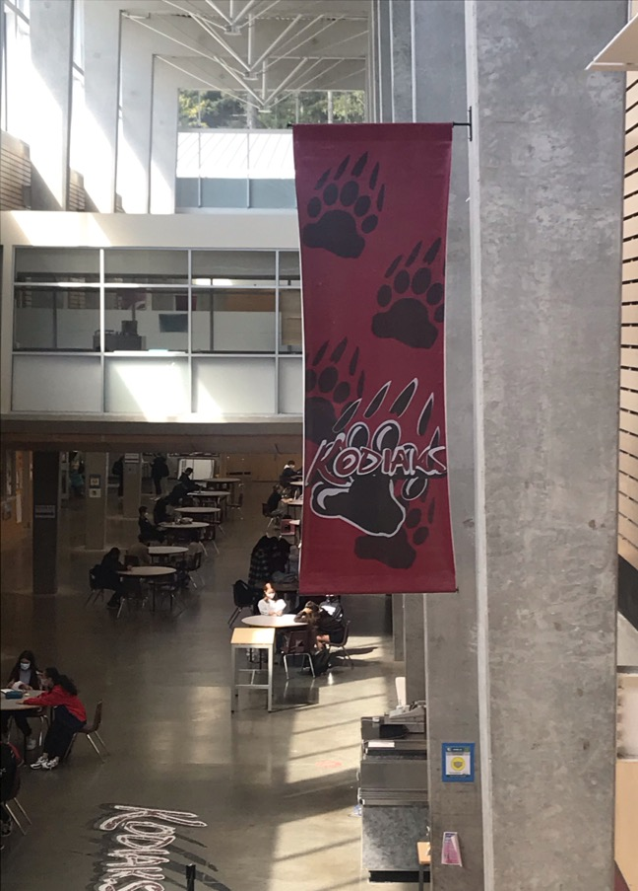
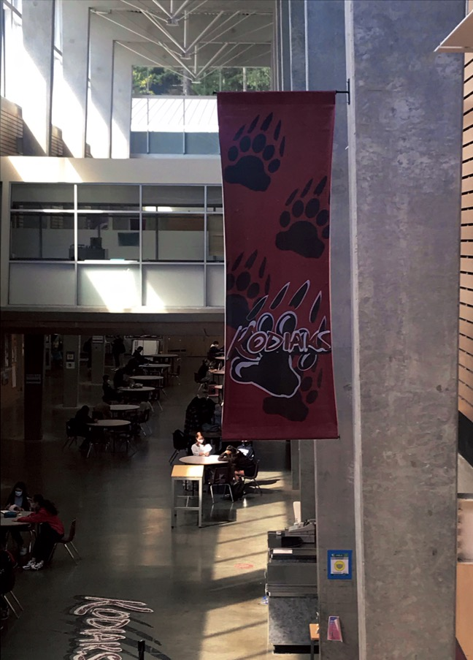
Section F: It’s Photo Time!! (2)

Slide 9
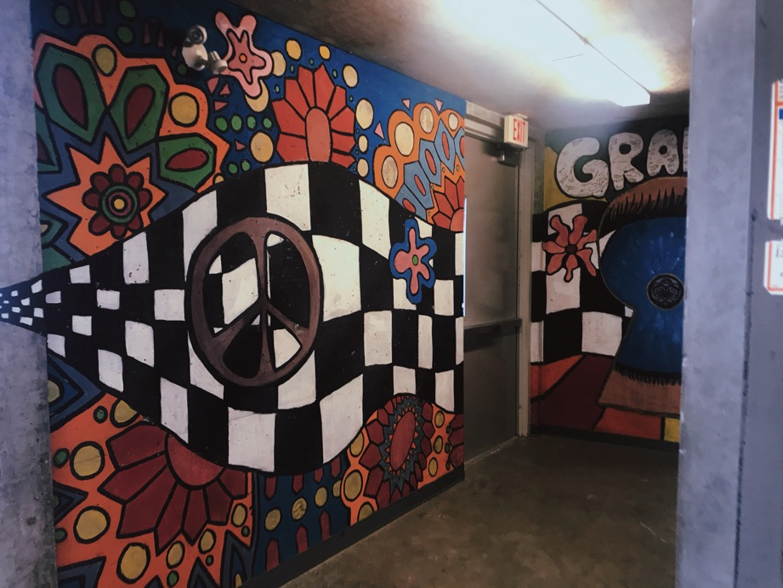
Section F: It’s Photo Time!! (3)

Slide 10
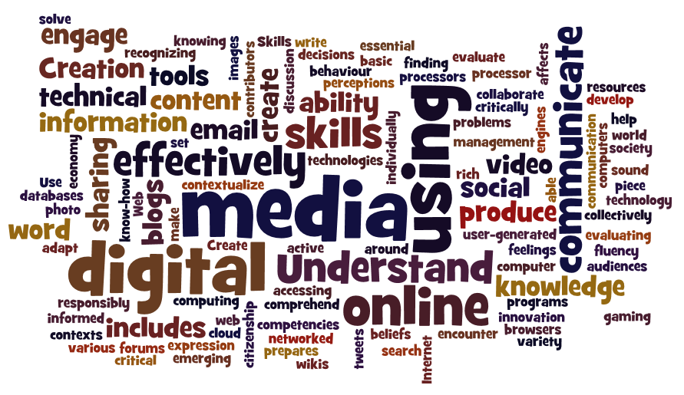
Section G: What’s the Word?
Citation:
Popular Culture in Education [Digital image]. (n.d.). Retrieved from https://www.emergingedtech.com/wp/wp-content/uploads/2016/07/digital-literacy-wordle-2.png

Slide 11
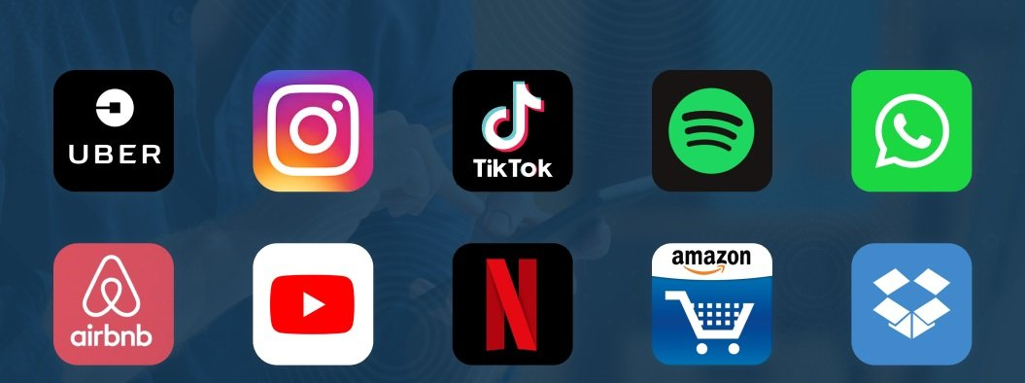
Section H: It’s App Time!
Citation:
Singh, A. (2020, December 1). Top 10 Most Popular Applications in 2021. Retrieved from https://www.netsolutions.com/insights/top-10-most-popular-apps-2018/
Uber
Instagram
TikTok
Netflix
Amazon

Slide 12
Section I: Coding is Cool
Free Online Coding Game site:
Coding Games | Education.com
Citation:
Education. (n.d.). Retrieved 2021, from https://www.education.com/games/coding/

Slide 13
Section J: The Do’s and Don’ts of Digital Citizenship
Citation:
Morris, K. (2019, March 12). 10 Internet Safety Tips For Students. Retrieved from http://www.kathleenamorris.com/2019/03/12/internet-safety/

Slide 14
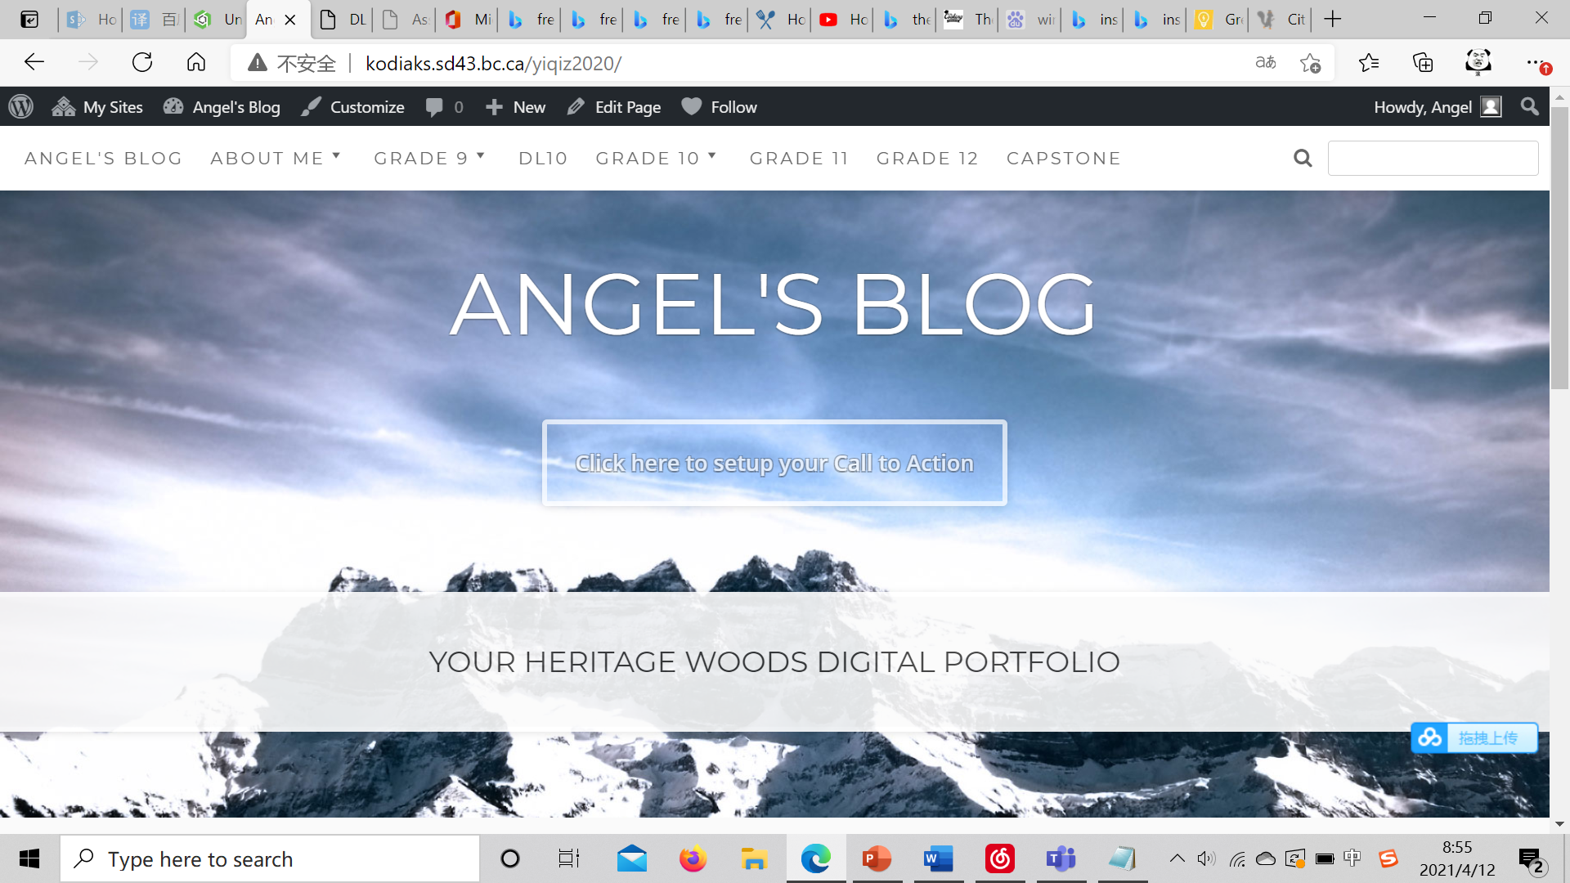
Section K: My Very Own Edublog

